Slide 1
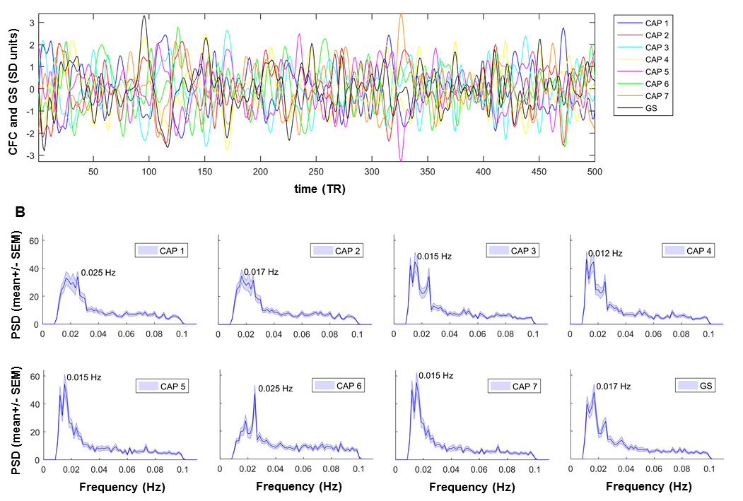
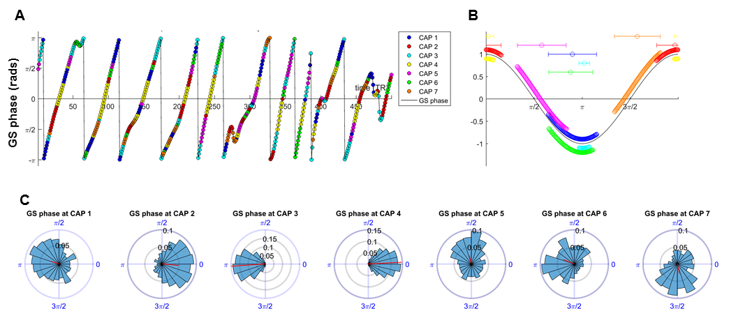
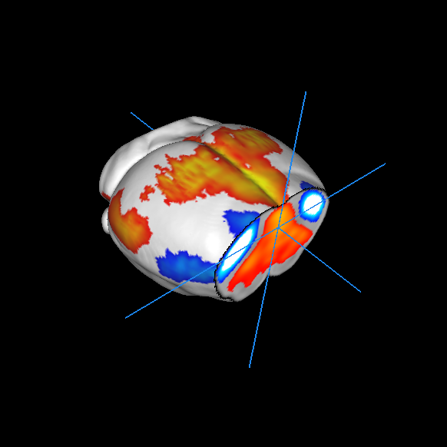
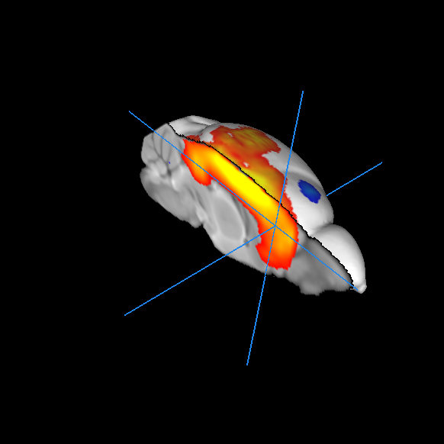
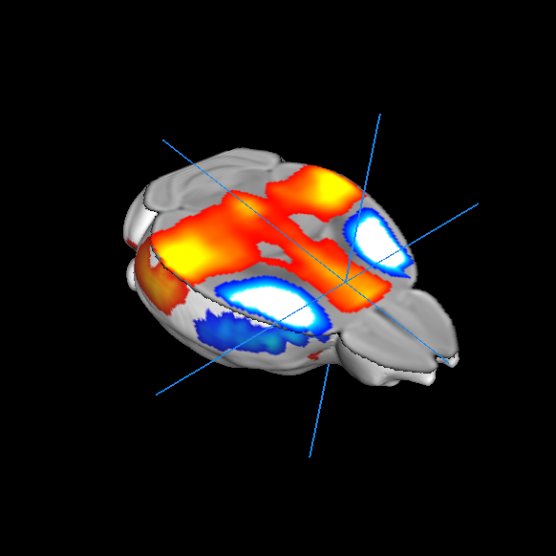
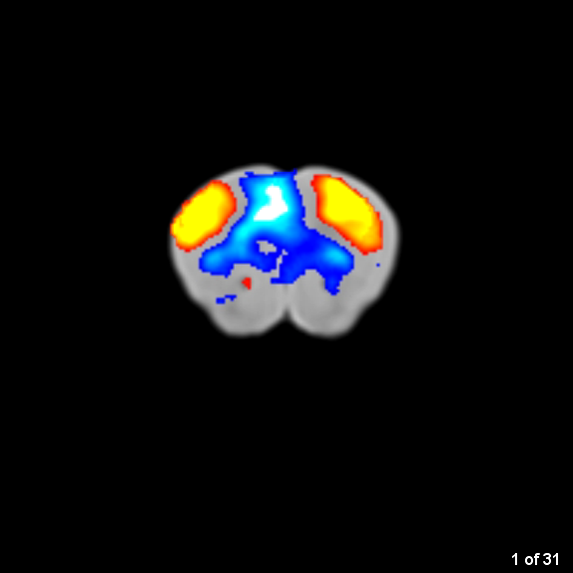
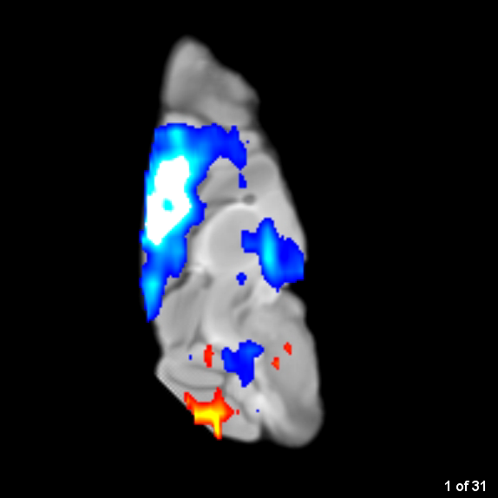
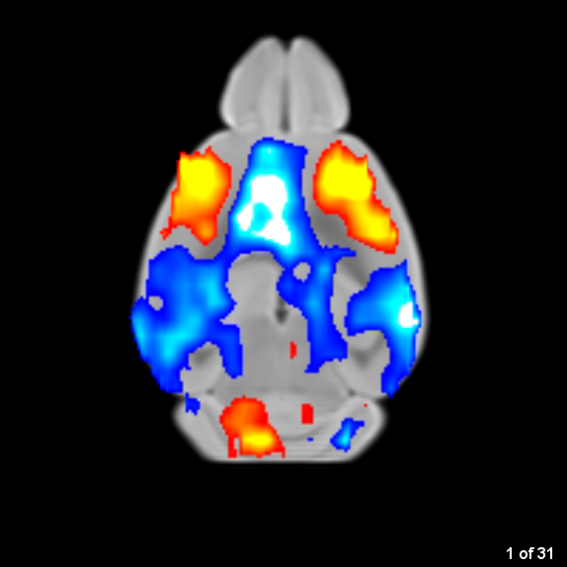
Brain-wide mapping of spontaneous network dynamics in the mouse brain
Daniel Gutierrez-Barragan^{1,2}, Stefano Panzeri¹, Alessandro Gozzi¹
Istituto Italiano di Tecnologia, Center for Neuroscience and Cognitive Systems @ UniTn, Rovereto, Italy
CIMeC - Center for Mind/Brain Sciences, University of Trento, Rovereto, Italy.
Introduction
Identification of recurrent brain states
Brain states exhibit oscillatory behavior
Conclusions
Resting-state fMRI (rsfMRI) is widely used to map the brain’s functional organization at the macroscale.
Human studies have described dynamic reconfiguration of rsfMRI connectivity networks via temporally-windowed correlations.
Are these reconfigurations stochastic and temporally unstructured, or do they reflect (partly) regular or oscillatory interactions between brain systems?
What neural systems are affected by this phenoemon and what is their exact neuroanatomical distribution?
Here we used frame-wise clustering of spontaneous BOLD fMRI to map and describe the dynamics of spontaneous network activity in the mouse brain
We describe a reproducible set of recurrent brain states encompassing previously defined mouse rsfMRI connectivity networks, which happen at specific phases of global fMRI signal oscillations.
Single rsfMRI frames contain information about network dynamics and interaction
Evolution of brain states exhibit band-limited oscillatory behavior
We describe an approach for mapping recurrent brain states in the mouse brain with voxel-wise resolution at the group and subject level
The approach does not entail the need to use pre-imposed regional parcellations, or correlation windows
Our findings reveal that brain-wide functional states of the mouse brain encompass previously defined connectivity networks
The identified states are characterized by weakly-coupled oscillatory activity
These results provide a novel interpretative framework for the emergence and organization of brain-wide network dynamics
Brain states occur at different phases of global fMRI signal oscillations
To identify recurrent brain states, we classified fMRI frames into clusters according to their spatial similarity and then averaged
Methods summary
Recurring brain states of the mouse brain
Brain state evolution
Resting-state fMRI. 40 male C57BI6/J-mice were scanned under shallow halothane anesthesia (0.75%) and artificial ventilation on a 7T-MRI scanner (Sforazzini et al., 2014) for 30 min (1500 time-points). Data were pre-processed as previously described (Liska et al., 2017).
Data analysis. We employed a clustering analysis to identify BOLD fMRI frames exhibiting congruent patterns of spontaneous BOLD-activity (CAPs). Concatenated frames were clustered according to their spatial-similarity using k-means++.
CAP dynamics. For each CAP we computed its spatial correlation with each fMRI-frame to obtain CAP-to-frame correlations (CFC) time-series for each subject. We next computed the power-spectrum of these correlations. CAP occurrence within GS oscillations were assessed by computing the GS’s instantaneous phase and used circular statistics to measure the probability distribution of GS-phases at each CAP’s occurrence
References
Sforazzini et al. Neuroimage 87, 403–415 (2014).
Liska et al. Cereb. Cortex 1–13 (2017).
Gozzi and Schwarz. Neuroimage 127, 496–509 (2016).
Liu and Duyn. Proc. Natl. Acad. Sci. 110, 4392–4397 (2013).
Tagliazucchi et al. Front. Neurosci. 10, 1–13 (2016).
Liang et al., Neuroimage 104, 89–99 (2015).
Allen et ak. Cereb. Cortex 24, 663–676 (2014).
Eschenko et al Cereb. Cortex 22, 426–435 (2012).
Acknowlegements
A.G. acknowledges funding from the Simons Foundation (SFARI 314688 and 400101, A.G.) and Brain and Behavior Foundation (2017 NARSAD independent Investigator Grant).

Slide 2
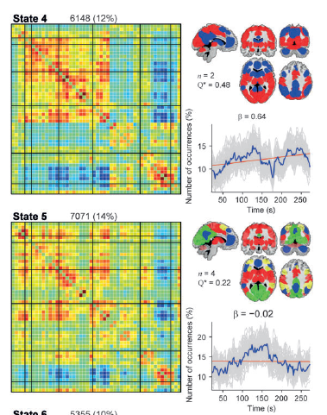
Brain-wide mapping of spontaneous network dynamics in the mouse brain
Daniel Gutierrez-Barragan^{1,2}, Stefano Panzeri¹, Alessandro Gozzi¹
Istituto Italiano di Tecnologia, Center for Neuroscience and Cognitive Systems @ UniTn, Rovereto, Italy
CIMeC - Center for Mind/Brain Sciences, University of Trento, Rovereto, Italy.
Human
Mouse
Allen et al., 2014
Gozzi and Schwarz, 2016 Neuroimage
rsfMRI signal is widely used to describe
network dynamics in humans
Homologous fMRI connectivity networks in mice and humans

Slide 3
Brain-wide mapping of spontaneous network dynamics in the mouse brain
Daniel Gutierrez-Barragan^{1,2}, Stefano Panzeri¹, Alessandro Gozzi¹
Istituto Italiano di Tecnologia, Center for Neuroscience and Cognitive Systems @ UniTn, Rovereto, Italy
CIMeC - Center for Mind/Brain Sciences, University of Trento, Rovereto, Italy.
Spontaneous network dynamics appears to be dominated by brief instances of activity at critical timepoints
(Liu et al., 2013, Tagliazucchi et al., 2016, Liang et al., 2015)
→ identification of brain states (“co-activation patterns” - CAPs)

Slide 4
Brain-wide mapping of spontaneous network dynamics in the mouse brain
Daniel Gutierrez-Barragan^{1,2}, Stefano Panzeri¹, Alessandro Gozzi¹
Istituto Italiano di Tecnologia, Center for Neuroscience and Cognitive Systems @ UniTn, Rovereto, Italy
CIMeC - Center for Mind/Brain Sciences, University of Trento, Rovereto, Italy.
Notes:
Information about network interaction single frames evolution

Slide 5
Brain-wide mapping of spontaneous network dynamics in the mouse brain
Daniel Gutierrez-Barragan^{1,2}, Stefano Panzeri¹, Alessandro Gozzi¹
Istituto Italiano di Tecnologia, Center for Neuroscience and Cognitive Systems @ UniTn, Rovereto, Italy
CIMeC - Center for Mind/Brain Sciences, University of Trento, Rovereto, Italy.
Recurring brain states (CAPs) can be identified by clustering fMRI frames from all subjects according to their spatial similarity, using the k-means algorithm and then averaged.
Results replicated on two independent (N=40 and N=41)
mouse datasets

Slide 6
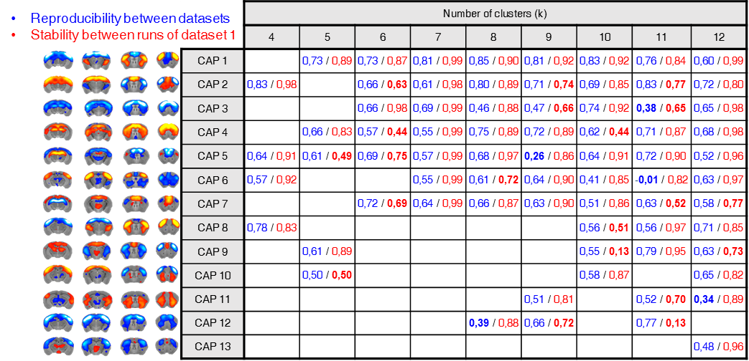
Brain-wide mapping of spontaneous network dynamics in the mouse brain
Daniel Gutierrez-Barragan^{1,2}, Stefano Panzeri¹, Alessandro Gozzi¹
Istituto Italiano di Tecnologia, Center for Neuroscience and Cognitive Systems @ UniTn, Rovereto, Italy
CIMeC - Center for Mind/Brain Sciences, University of Trento, Rovereto, Italy.
Dataset 1
40 mice, 500 vols.
Dataset 2
41 mice, 300 vols.
Preprocessing
Network mapping: static FC
K-means (k = 4:12)
Run 2: 500 iterations, 15 initializations
Run 1 : 500 iterations, 15 initializations
Run 1 : 500 iterations, 15 initializations
reproducibility
stability
k = 7
CAP Detection
CAP Dynamics
Dataset 1 (subset)
20 mice, 1500 vols.
Preprocessing
CAP matching
Single-subject reproducibility
K-means (k = 7)
Notes:
Saptial correlation

Slide 7
Brain-wide mapping of spontaneous network dynamics in the mouse brain
Daniel Gutierrez-Barragan^{1,2}, Stefano Panzeri¹, Alessandro Gozzi¹
Istituto Italiano di Tecnologia, Center for Neuroscience and Cognitive Systems @ UniTn, Rovereto, Italy
CIMeC - Center for Mind/Brain Sciences, University of Trento, Rovereto, Italy.
→ Seven recurrent brain states identified
→ 6 out of 7 states can be classified into “state” and “anti-state” pairs
Notes:
. We incrementally assessed each solution, based on reproducibility of the identified clusters in an independent dataset (41 subjects, 500)⁸. We chose k=7 as the most reproducible and stable solution across datasets

Slide 8
Brain-wide mapping of spontaneous network dynamics in the mouse brain
Daniel Gutierrez-Barragan^{1,2}, Stefano Panzeri¹, Alessandro Gozzi¹
Istituto Italiano di Tecnologia, Center for Neuroscience and Cognitive Systems @ UniTn, Rovereto, Italy
CIMeC - Center for Mind/Brain Sciences, University of Trento, Rovereto, Italy.
All states can be identified at the subject level
(30 min rsfMRI acquisition)
Voxel-wise incidence of CAP detection across subjects
CAPs from a single subject
Notes:
CAPs can reliably be found at the subject level.
Using a subset of 20 subjects with 1500 time-points.
Maps show at each voxel, the proportion of subjects which had a significant (p < 0,05 FDR corrected) co-activation (hot-colored) or co-deactivation (cold-colored).
For each subject, each CAP was compared to its corresponding group map, and spatial correlation was computed.
A subject was considered as having a CAP if its similarity with the group template was above and

Slide 9
Brain-wide mapping of spontaneous network dynamics in the mouse brain
Daniel Gutierrez-Barragan^{1,2}, Stefano Panzeri¹, Alessandro Gozzi¹
Istituto Italiano di Tecnologia, Center for Neuroscience and Cognitive Systems @ UniTn, Rovereto, Italy
CIMeC - Center for Mind/Brain Sciences, University of Trento, Rovereto, Italy.
The identified states exhibit band limited oscillatory activity
Notes:
0.4 hz
The observation of states and anti-states suggests the presence of macroscale oscillatory dynamics, which was confirmed by spectral analysis (Fig. 3).

Slide 10
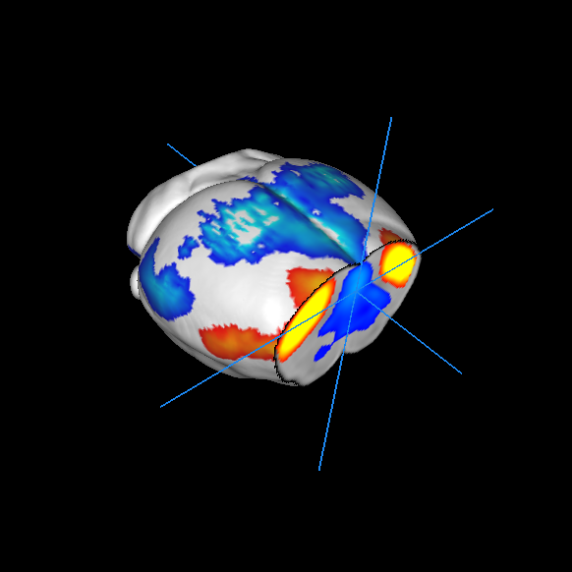
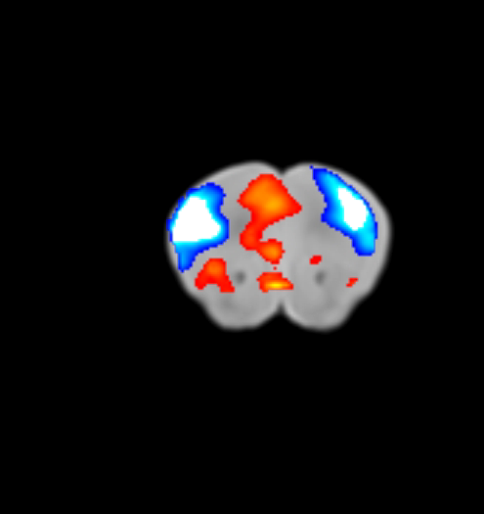
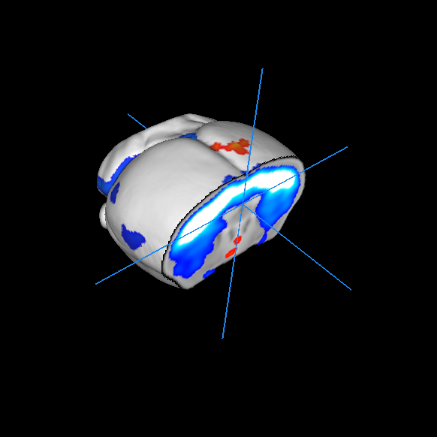
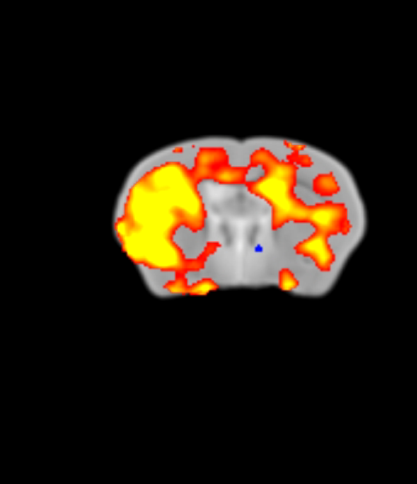
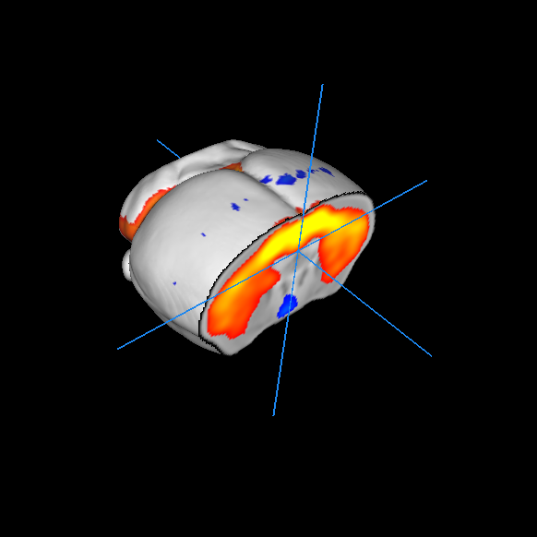
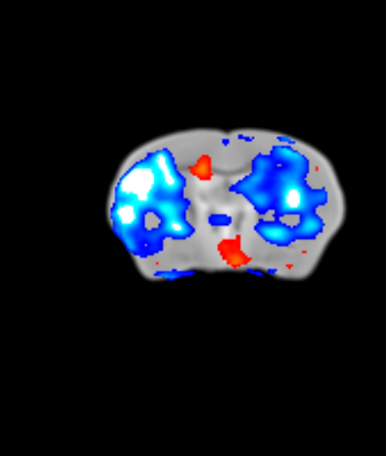
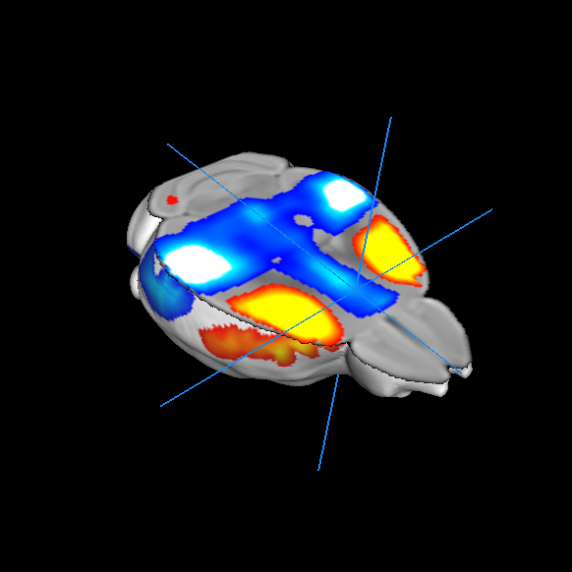
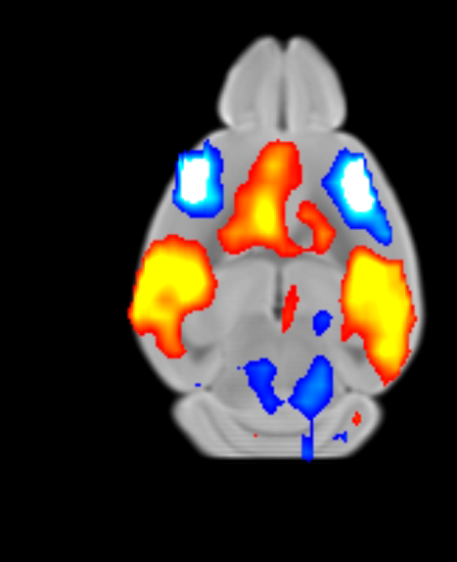
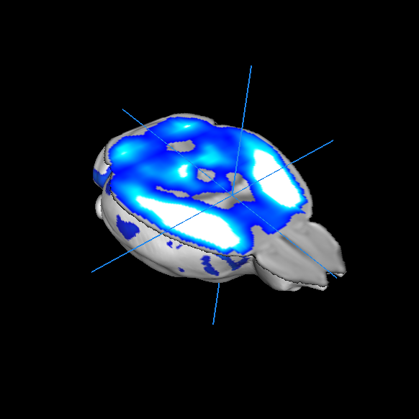
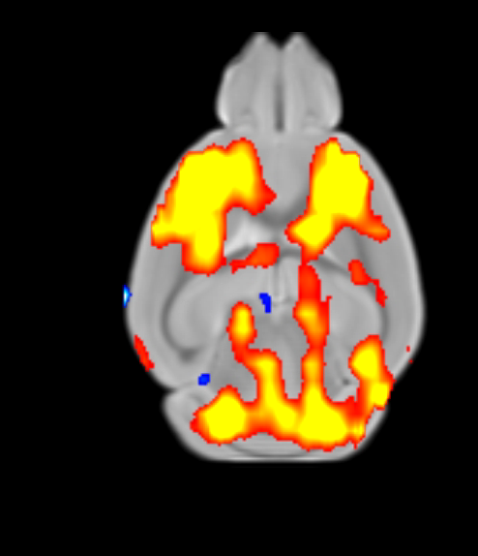
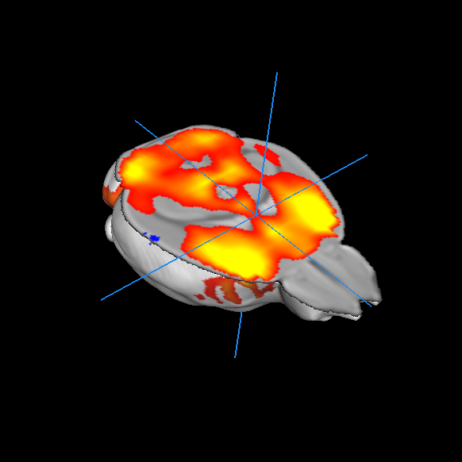
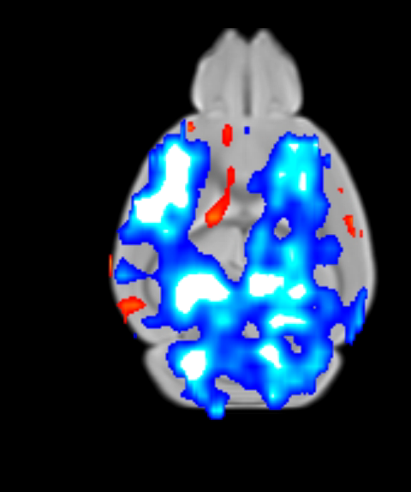
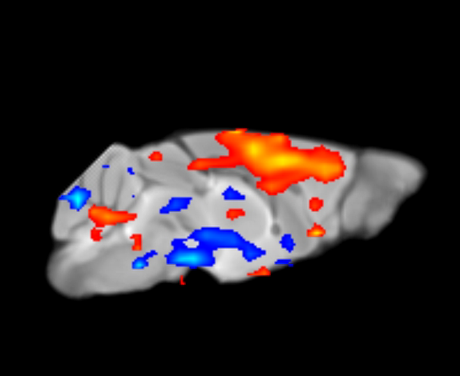
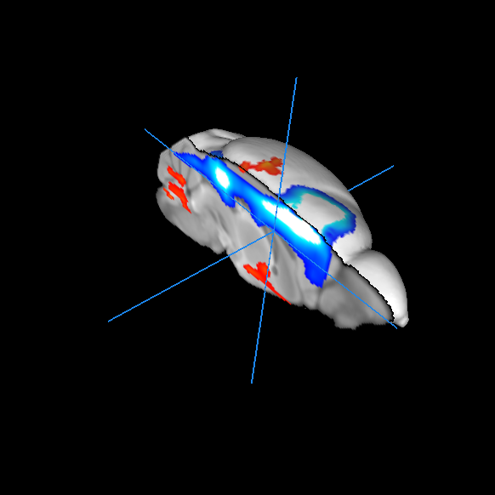
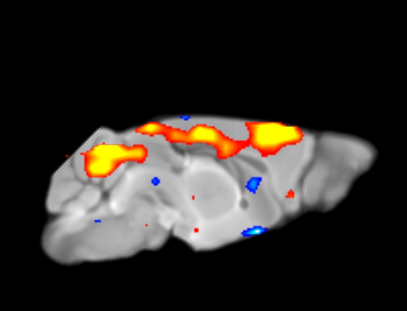
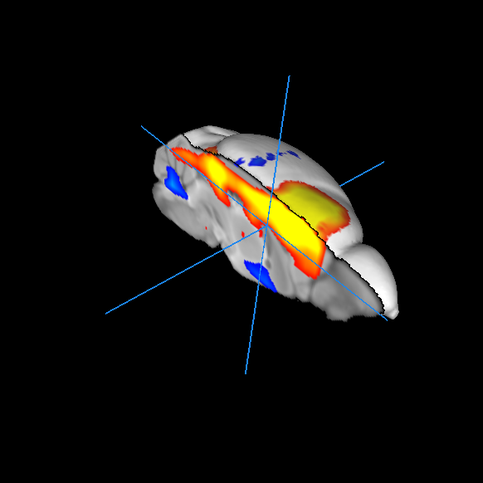
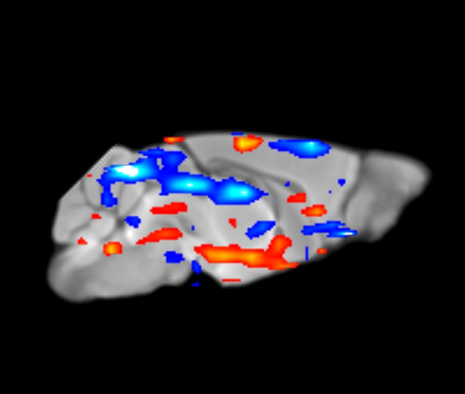
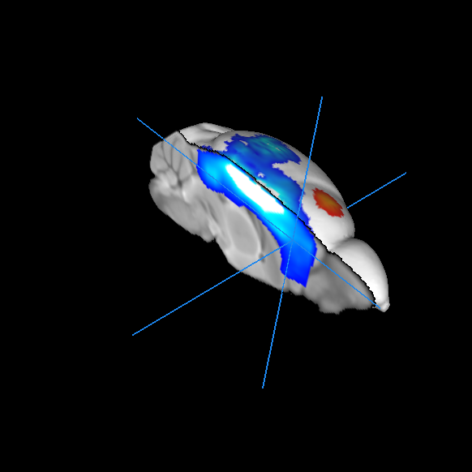
Brain-wide mapping of spontaneous network dynamics in the mouse brain
Daniel Gutierrez-Barragan^{1,2}, Stefano Panzeri¹, Alessandro Gozzi¹
Istituto Italiano di Tecnologia, Center for Neuroscience and Cognitive Systems @ UniTn, Rovereto, Italy
CIMeC - Center for Mind/Brain Sciences, University of Trento, Rovereto, Italy.
CAP 1
CAP 2
CAP 3
CAP 4
Notes:
0.4 hz
The observation of states and anti-states suggests the presence of macroscale oscillatory dynamics, which was confirmed by spectral analysis (Fig. 3).

Slide 11
Brain-wide mapping of spontaneous network dynamics in the mouse brain
Daniel Gutierrez-Barragan^{1,2}, Stefano Panzeri¹, Alessandro Gozzi¹
Istituto Italiano di Tecnologia, Center for Neuroscience and Cognitive Systems @ UniTn, Rovereto, Italy
CIMeC - Center for Mind/Brain Sciences, University of Trento, Rovereto, Italy.
Instantaneous phase of the fMRI GS
fMRI GS phase distribution at each state
The identified states exhibit significant phase-locking to fMRI GS oscillations
Global Signal as a “reference clock” for brain state evolution?
Notes:
We narrow band filtered the global signal and sampled occurences with
CFC higher than 1 SD to make sure frame is well clustere d
We next expressed CAP activity with respect to the fMRI global signal (GS), which we selected as putative reference “clock” for macroscale oscillatory dynamics. This analysis revealed clear and significant phase-locking of these states to GS oscillations (Fig. 4).

Slide 12
Brain-wide mapping of spontaneous network dynamics in the mouse brain
Daniel Gutierrez-Barragan^{1,2}, Stefano Panzeri¹, Alessandro Gozzi¹
Istituto Italiano di Tecnologia, Center for Neuroscience and Cognitive Systems @ UniTn, Rovereto, Italy
CIMeC - Center for Mind/Brain Sciences, University of Trento, Rovereto, Italy.
Datasets.
Male C57BI6/J-mice were scanned under shallow halothane anesthesia (0.75%) and artificial ventilation. All experiments were performed in accordance with Italian regulations governing animal welfare and protection.
  Dataset 1: 40 subjects, 500 volumes.
  Dataset 1 subset: 20 subjects, 1500 volumes.
  Dataset 2: 41 subjects, 300 volumes.
Scanning parameters.
7T-MRI Bruker PharmaScan. Mice were scanned using a single-shot EPI sequence (TR/TE-1200/15ms, flip-angle 30°, FOV 2×2 cm2, matrix 100×100, 24 coronal slices, slice thickness 0.50mm).
Preprocessing Pipeline.
  Raw BOLD time-series were despiked (AFNI/ 3dDespike); volumes were motion-corrected (AFNI/3dvolreg); then spatially normalized to an in-house C57Bl/6J mouse brain template (Sforazzini et al., 2014) (FSL/FLIRT, 12 DOF).
  Normalized data had a spatial resolution of 0.1 x 0.1 x 0,5 mm³ (192 x 192 x 24 voxels). Head motion traces and ventricular signals (averaged voxels over a manually drawn ventricular-mask) were regressed out of each voxel’s time-series (AFNI/3DDeconvolve).
  Signals were bandpass filtered from 0.01-0.1 Hz (AFNI/3dBandpass), and volumes were spatially smoothed (AFNI/3dmerge, Gaussian kernel of full-width-at-half-maximum of 0.5 mm).
  Signals were normalized to z-scores, and the global-signal was computed from the average of all in-brain voxels within the template mask from each time-point.
  Before clustering, frames from all subjects were masked to admit only the top 10% highest and 5% lowest signal values, as in Liu et al. (2013).

Slide 13
Brain-wide mapping of spontaneous network dynamics in the mouse brain
Daniel Gutierrez-Barragan^{1,2}, Stefano Panzeri¹, Alessandro Gozzi¹
Istituto Italiano di Tecnologia, Center for Neuroscience and Cognitive Systems @ UniTn, Rovereto, Italy
CIMeC - Center for Mind/Brain Sciences, University of Trento, Rovereto, Italy.
Marginal motion in sedated mice
No CAP predominantly associated to “high motion frames”
fMRI frame censoring (0.05 and 0.01 mm) does not affect CAP detection

Slide 14
Brain-wide mapping of spontaneous network dynamics in the mouse brain
Daniel Gutierrez-Barragan^{1,2}, Stefano Panzeri¹, Alessandro Gozzi¹
Istituto Italiano di Tecnologia, Center for Neuroscience and Cognitive Systems @ UniTn, Rovereto, Italy
CIMeC - Center for Mind/Brain Sciences, University of Trento, Rovereto, Italy.
CAP – anti-CAP oscillations are anti-correlated
Notes:
0.4 hz
The observation of states and anti-states suggests the presence of macroscale oscillatory dynamics, which was confirmed by spectral analysis (Fig. 3).

