Slide 1


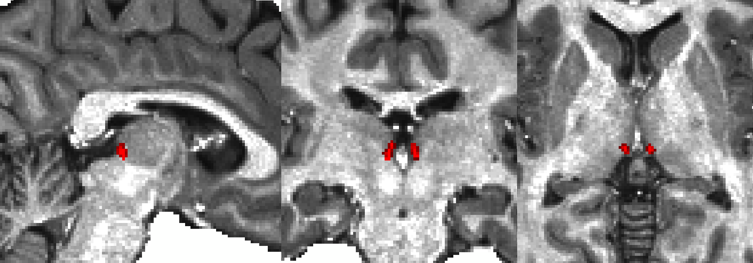
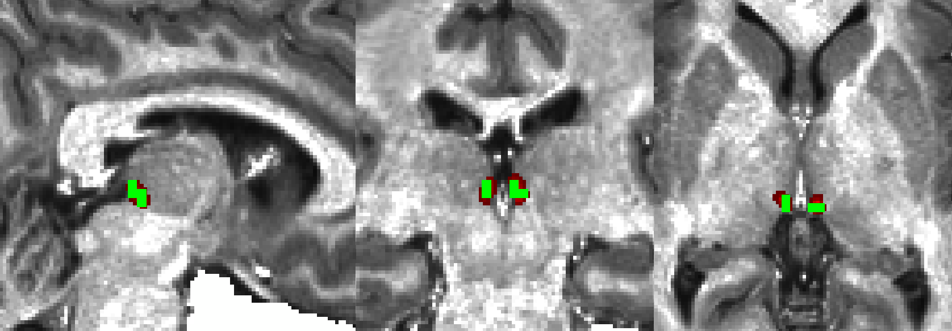
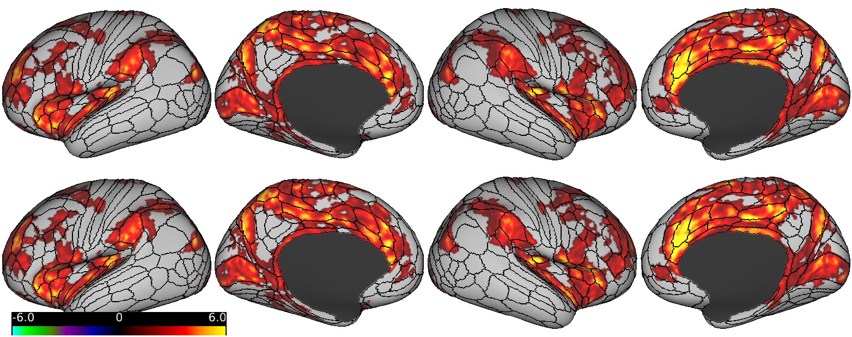
Presentation 320.11
Habenula Connectivity in Adolescent Mental Illness
Benjamin A. Ely,^{1,2}* Junqian Xu,¹⁻³ Vilma Gabbay^{1,2,4,5}
Icahn School of Medicine at Mount Sinai ¹Neuroscience, ²Graduate School, ³Radiology, ⁴Psychiatry
⁵Nathan S. Kline Institute for Psychiatric Research *Contact: benjamin.ely@mssm.edu
Mount Sinai
INTRODUCTION
RESULTS: WHOLE-BRAIN HABENULA CONNECTIVITY
METHODS II
  Mental illness often emerges in adolescence
  The habenula (Hb) inhibits midbrain monoamine signalling and may play a clinical roll in reward deficits¹
  The small size of the human Hb has limited in vivo research²
  Using an optimized high-resolution fMRI approach,³ we examined Hb connectivity in adolescents with a range of mood, anxiety, and behavior disorder symptoms
  ACC: Anterior Cingulate. dlPFC: Dorsolateral Prefrontal. NAc: Nulceus Accumbens. SN: Substantia Nigra. VTA: Ventral Tegmental Area.
Defining the Habenula:
  Semi-automated Hb segmentation⁴
  Optimized transformation to MNI³
  Functional Connectivity Analysis:
  ROI timeseries extraction via Conn
  Whole-brain Hb connectivity via Connectome Workbench
  Threshold-free cluster enhancement (TFCE) + FWE correction via PALM
Salience Network
Early Sensory/Motor Areas
Reward Areas
Combined Healthy + Clinical Adolescents (N=64, p_{TFCE-FWE} < 0.05)
Somatomotor
Strip
Hb
VTA
dlPFC
SN
0.9mm Segmented Hb (Native)
2.3mm Hb Seed (MNI)
VTA
Dorsal ACC
Anterior
Insula
Primary
Visual Cortex
X=0
Raphe
Nuclei
Z=-14
Auditory
Cortex
Healthy HCP Adults⁵ (N=68, p_{TFCE-FWE} < 0.05)
Somatomotor
Strip
Hb
VTA
dlPFC
VTA
SN
Dorsal ACC
METHODS I
Anterior
Insula
Primary
Visual Cortex
X=0
Raphe
Nuclei
Z=-14
Auditory
Cortex
Subjects:
  64 Adolescents (ages 12 - 20)
  15 Healthy controls
  49 Clinical subjects
  Depression (BDI), anxiety (MASC), and anhedonia (TEPS) scales
  Image Acquisition and Processing:
  3T Siemens Skyra with 16-ch coil
  T1w MPRAGE/T2w SPACE (0.8mm)
  10min rest EPI (2.3mm, 1s TR)
HCP preprocessing pipelines
Denoising via ICA-FIX, CompCor, 4mm smoothing*, 0.1-0.01Hz band-pass, and thalamic ROI regression⁴
  *After ROI timeseries extracted
-4 t-stat 7
RESULTS: CLINICAL > HEALTHY SUBJECTS
RESULTS: CORRELATION WITH ANXIETY
CONCLUSIONS
  Hb connectivity develops early in life
  Similar to healthy adults, includes reward, sensory, and salience areas
  May correlate with clinical symptoms
  Default network connectivity seen only in clinical subjects
REFERENCES
Fakhoury M. (2017), ‘The habenula in psychiatric disorders: More than three decades of translational investigation’, Neurosci Biobehav Rev, vol. 83.
Ely BA et al. (2016), ‘Resting-state functional connectivity of the human habenula in healthy individuals: associations with subclinical depression’, Hum Brain Mapp, vol. 37.
Ely BA et al. (in prep), ‘Human Habenula Functional Connectivity with Monoamine, Sensory, and Salience Systems’.
Kim JW et al. (2016), ‘Human habenula segmentation using myelin content’, NeuroImage, vol. 130.
-3 t-stat 3
-0.3 Pearson r 0.3

Slide 2
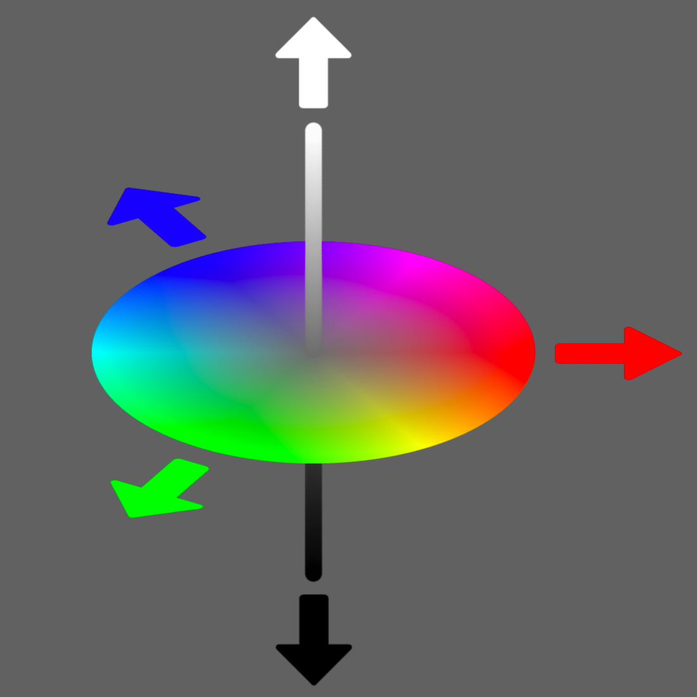
Presentation 320.11
Habenula Connectivity in Adolescent Mental Illness
Benjamin A. Ely,^{1,2}* Junqian Xu,¹⁻³ Vilma Gabbay^{1,2,4,5}
Icahn School of Medicine at Mount Sinai ¹Neuroscience, ²Graduate School, ³Radiology, ⁴Psychiatry
⁵Nathan S. Kline Institute for Psychiatric Research *Contact: benjamin.ely@mssm.edu
Mount Sinai
INTRODUCTION
HCP Multimodal Cortical Parcellation (Glasser MF et al. Nature 2016)
METHODS II
  Mental illness often emerges in adolescence
  The habenula (Hb) inhibits midbrain monoamine signalling and may play a clinical roll in reward deficits¹
  The small size of the human Hb has limited in vivo research²
  Using an optimized high-resolution fMRI approach,³ we examined Hb connectivity in adolescents with a range of mood, anxiety, and behavior disorder symptoms
Defining the Habenula:
  Semi-automated Hb segmentation⁴
  Optimized transformation to MNI³
  Functional Connectivity Analysis:
  ROI timeseries extraction via Conn
  Whole-brain Hb connectivity via Connectome Workbench
  Threshold-free cluster enhancement (TFCE) + FWE correction via PALM
0.9mm Segmented Hb (Native)
2.3mm Hb Seed (MNI)
METHODS I
Subjects:
  64 Adolescents (ages 12 - 20)
  15 Healthy controls
  49 Clinical subjects
  Depression (BDI), anxiety (MASC), and anhedonia (TEPS) scales
  Image Acquisition and Processing:
  3T Siemens Skyra with 16-ch coil
  T1w MPRAGE/T2w SPACE (0.8mm)
  10min rest EPI (2.3mm, 1s TR)
HCP preprocessing pipelines
Denoising via ICA-FIX, CompCor, 4mm smoothing*, 0.1-0.01Hz band-pass, and thalamic ROI regression⁴
  *After ROI timeseries extracted
CONCLUSIONS
  Hb connectivity develops early in life
  Similar to healthy adults, includes reward, sensory, and salience areas
  May correlate with clinical symptoms
  Default network connectivity seen only in clinical subjects
Task Positive
Visual
REFERENCES
Auditory
Fakhoury M. (2017), ‘The habenula in psychiatric disorders: More than three decades of translational investigation’, Neurosci Biobehav Rev, vol. 83.
Ely BA et al. (2016), ‘Resting-state functional connectivity of the human habenula in healthy individuals: associations with subclinical depression’, Hum Brain Mapp, vol. 37.
Ely BA et al. (in prep), ‘Human Habenula Functional Connectivity with Monoamine, Sensory, and Salience Systems’.
Kim JW et al. (2016), ‘Human habenula segmentation using myelin content’, NeuroImage, vol. 130.
Sensory
Motor
Task
Negative

Slide 3
Presentation 320.11
Habenula Connectivity in Adolescent Mental Illness
Benjamin A. Ely,^{1,2}* Junqian Xu,¹⁻³ Vilma Gabbay^{1,2,4,5}
Icahn School of Medicine at Mount Sinai ¹Neuroscience, ²Graduate School, ³Radiology, ⁴Psychiatry
⁵Nathan S. Kline Institute for Psychiatric Research *Contact: benjamin.ely@mssm.edu
Mount Sinai
INTRODUCTION
Unthresholded Hb Connectivity, HCP Adults (N=68)
METHODS II
  Mental illness often emerges in adolescence
  The habenula (Hb) inhibits midbrain monoamine signalling and may play a clinical roll in reward deficits¹
  The small size of the human Hb has limited in vivo research²
  Using an optimized high-resolution fMRI approach,³ we examined Hb connectivity in adolescents with a range of mood, anxiety, and behavior disorder symptoms
Defining the Habenula:
  Semi-automated Hb segmentation⁴
  Optimized transformation to MNI³
  Functional Connectivity Analysis:
  ROI timeseries extraction via Conn
  Whole-brain Hb connectivity via Connectome Workbench
  Threshold-free cluster enhancement (TFCE) + FWE correction via PALM
0.9mm Segmented Hb (Native)
2.3mm Hb Seed (MNI)
-4 t-stat 7
METHODS I
Subjects:
  64 Adolescents (ages 12 - 20)
  15 Healthy controls
  49 Clinical subjects
  Depression (BDI), anxiety (MASC), and anhedonia (TEPS) scales
  Image Acquisition and Processing:
  3T Siemens Skyra with 16-ch coil
  T1w MPRAGE/T2w SPACE (0.8mm)
  10min rest EPI (2.3mm, 1s TR)
HCP preprocessing pipelines
Denoising via ICA-FIX, CompCor, 4mm smoothing*, 0.1-0.01Hz band-pass, and thalamic ROI regression⁴
  *After ROI timeseries extracted
CONCLUSIONS
  Hb connectivity develops early in life
  Similar to healthy adults, includes reward, sensory, and salience areas
  May correlate with clinical symptoms
  Default network connectivity seen only in clinical subjects
REFERENCES
Fakhoury M. (2017), ‘The habenula in psychiatric disorders: More than three decades of translational investigation’, Neurosci Biobehav Rev, vol. 83.
Ely BA et al. (2016), ‘Resting-state functional connectivity of the human habenula in healthy individuals: associations with subclinical depression’, Hum Brain Mapp, vol. 37.
Ely BA et al. (in prep), ‘Human Habenula Functional Connectivity with Monoamine, Sensory, and Salience Systems’.
Kim JW et al. (2016), ‘Human habenula segmentation using myelin content’, NeuroImage, vol. 130.

Slide 4
Presentation 320.11
Habenula Connectivity in Adolescent Mental Illness
Benjamin A. Ely,^{1,2}* Junqian Xu,¹⁻³ Vilma Gabbay^{1,2,4,5}
Icahn School of Medicine at Mount Sinai ¹Neuroscience, ²Graduate School, ³Radiology, ⁴Psychiatry
⁵Nathan S. Kline Institute for Psychiatric Research *Contact: benjamin.ely@mssm.edu
Mount Sinai
INTRODUCTION
Unthresholded Hb Connectivity, All Adolescents (N=64)
METHODS II
  Mental illness often emerges in adolescence
  The habenula (Hb) inhibits midbrain monoamine signalling and may play a clinical roll in reward deficits¹
  The small size of the human Hb has limited in vivo research²
  Using an optimized high-resolution fMRI approach,³ we examined Hb connectivity in adolescents with a range of mood, anxiety, and behavior disorder symptoms
Defining the Habenula:
  Semi-automated Hb segmentation⁴
  Optimized transformation to MNI³
  Functional Connectivity Analysis:
  ROI timeseries extraction via Conn
  Whole-brain Hb connectivity via Connectome Workbench
  Threshold-free cluster enhancement (TFCE) + FWE correction via PALM
0.9mm Segmented Hb (Native)
2.3mm Hb Seed (MNI)
-4 t-stat 7
METHODS I
Subjects:
  64 Adolescents (ages 12 - 20)
  15 Healthy controls
  49 Clinical subjects
  Depression (BDI), anxiety (MASC), and anhedonia (TEPS) scales
  Image Acquisition and Processing:
  3T Siemens Skyra with 16-ch coil
  T1w MPRAGE/T2w SPACE (0.8mm)
  10min rest EPI (2.3mm, 1s TR)
HCP preprocessing pipelines
Denoising via ICA-FIX, CompCor, 4mm smoothing*, 0.1-0.01Hz band-pass, and thalamic ROI regression⁴
  *After ROI timeseries extracted
CONCLUSIONS
  Hb connectivity develops early in life
  Similar to healthy adults, includes reward, sensory, and salience areas
  May correlate with clinical symptoms
  Default network connectivity seen only in clinical subjects
REFERENCES
Fakhoury M. (2017), ‘The habenula in psychiatric disorders: More than three decades of translational investigation’, Neurosci Biobehav Rev, vol. 83.
Ely BA et al. (2016), ‘Resting-state functional connectivity of the human habenula in healthy individuals: associations with subclinical depression’, Hum Brain Mapp, vol. 37.
Ely BA et al. (in prep), ‘Human Habenula Functional Connectivity with Monoamine, Sensory, and Salience Systems’.
Kim JW et al. (2016), ‘Human habenula segmentation using myelin content’, NeuroImage, vol. 130.

Slide 5
Presentation 320.11
Habenula Connectivity in Adolescent Mental Illness
Benjamin A. Ely,^{1,2}* Junqian Xu,¹⁻³ Vilma Gabbay^{1,2,4,5}
Icahn School of Medicine at Mount Sinai ¹Neuroscience, ²Graduate School, ³Radiology, ⁴Psychiatry
⁵Nathan S. Kline Institute for Psychiatric Research *Contact: benjamin.ely@mssm.edu
Mount Sinai
INTRODUCTION
Unthresholded Hb Connectivity, Healthy Control Adolescents (N=15)
METHODS II
  Mental illness often emerges in adolescence
  The habenula (Hb) inhibits midbrain monoamine signalling and may play a clinical roll in reward deficits¹
  The small size of the human Hb has limited in vivo research²
  Using an optimized high-resolution fMRI approach,³ we examined Hb connectivity in adolescents with a range of mood, anxiety, and behavior disorder symptoms
Defining the Habenula:
  Semi-automated Hb segmentation⁴
  Optimized transformation to MNI³
  Functional Connectivity Analysis:
  ROI timeseries extraction via Conn
  Whole-brain Hb connectivity via Connectome Workbench
  Threshold-free cluster enhancement (TFCE) + FWE correction via PALM
0.9mm Segmented Hb (Native)
2.3mm Hb Seed (MNI)
-3 t-stat 5
METHODS I
Subjects:
  64 Adolescents (ages 12 - 20)
  15 Healthy controls
  49 Clinical subjects
  Depression (BDI), anxiety (MASC), and anhedonia (TEPS) scales
  Image Acquisition and Processing:
  3T Siemens Skyra with 16-ch coil
  T1w MPRAGE/T2w SPACE (0.8mm)
  10min rest EPI (2.3mm, 1s TR)
HCP preprocessing pipelines
Denoising via ICA-FIX, CompCor, 4mm smoothing*, 0.1-0.01Hz band-pass, and thalamic ROI regression⁴
  *After ROI timeseries extracted
CONCLUSIONS
  Hb connectivity develops early in life
  Similar to healthy adults, includes reward, sensory, and salience areas
  May correlate with clinical symptoms
  Default network connectivity seen only in clinical subjects
REFERENCES
Fakhoury M. (2017), ‘The habenula in psychiatric disorders: More than three decades of translational investigation’, Neurosci Biobehav Rev, vol. 83.
Ely BA et al. (2016), ‘Resting-state functional connectivity of the human habenula in healthy individuals: associations with subclinical depression’, Hum Brain Mapp, vol. 37.
Ely BA et al. (in prep), ‘Human Habenula Functional Connectivity with Monoamine, Sensory, and Salience Systems’.
Kim JW et al. (2016), ‘Human habenula segmentation using myelin content’, NeuroImage, vol. 130.

Slide 6
Presentation 320.11
Habenula Connectivity in Adolescent Mental Illness
Benjamin A. Ely,^{1,2}* Junqian Xu,¹⁻³ Vilma Gabbay^{1,2,4,5}
Icahn School of Medicine at Mount Sinai ¹Neuroscience, ²Graduate School, ³Radiology, ⁴Psychiatry
⁵Nathan S. Kline Institute for Psychiatric Research *Contact: benjamin.ely@mssm.edu
Mount Sinai
INTRODUCTION
Unthresholded Hb Connectivity, Mood Disorder Adolescents (N=30)
METHODS II
  Mental illness often emerges in adolescence
  The habenula (Hb) inhibits midbrain monoamine signalling and may play a clinical roll in reward deficits¹
  The small size of the human Hb has limited in vivo research²
  Using an optimized high-resolution fMRI approach,³ we examined Hb connectivity in adolescents with a range of mood, anxiety, and behavior disorder symptoms
Defining the Habenula:
  Semi-automated Hb segmentation⁴
  Optimized transformation to MNI³
  Functional Connectivity Analysis:
  ROI timeseries extraction via Conn
  Whole-brain Hb connectivity via Connectome Workbench
  Threshold-free cluster enhancement (TFCE) + FWE correction via PALM
0.9mm Segmented Hb (Native)
2.3mm Hb Seed (MNI)
-3 t-stat 5
METHODS I
Subjects:
  64 Adolescents (ages 12 - 20)
  15 Healthy controls
  49 Clinical subjects
  Depression (BDI), anxiety (MASC), and anhedonia (TEPS) scales
  Image Acquisition and Processing:
  3T Siemens Skyra with 16-ch coil
  T1w MPRAGE/T2w SPACE (0.8mm)
  10min rest EPI (2.3mm, 1s TR)
HCP preprocessing pipelines
Denoising via ICA-FIX, CompCor, 4mm smoothing*, 0.1-0.01Hz band-pass, and thalamic ROI regression⁴
  *After ROI timeseries extracted
CONCLUSIONS
  Hb connectivity develops early in life
  Similar to healthy adults, includes reward, sensory, and salience areas
  May correlate with clinical symptoms
  Default network connectivity seen only in clinical subjects
REFERENCES
Fakhoury M. (2017), ‘The habenula in psychiatric disorders: More than three decades of translational investigation’, Neurosci Biobehav Rev, vol. 83.
Ely BA et al. (2016), ‘Resting-state functional connectivity of the human habenula in healthy individuals: associations with subclinical depression’, Hum Brain Mapp, vol. 37.
Ely BA et al. (in prep), ‘Human Habenula Functional Connectivity with Monoamine, Sensory, and Salience Systems’.
Kim JW et al. (2016), ‘Human habenula segmentation using myelin content’, NeuroImage, vol. 130.

Slide 7
Presentation 320.11
Habenula Connectivity in Adolescent Mental Illness
Benjamin A. Ely,^{1,2}* Junqian Xu,¹⁻³ Vilma Gabbay^{1,2,4,5}
Icahn School of Medicine at Mount Sinai ¹Neuroscience, ²Graduate School, ³Radiology, ⁴Psychiatry
⁵Nathan S. Kline Institute for Psychiatric Research *Contact: benjamin.ely@mssm.edu
Mount Sinai
INTRODUCTION
Unthresholded Hb Connectivity, Anxiety Disorder Adolescents (N=27)
METHODS II
  Mental illness often emerges in adolescence
  The habenula (Hb) inhibits midbrain monoamine signalling and may play a clinical roll in reward deficits¹
  The small size of the human Hb has limited in vivo research²
  Using an optimized high-resolution fMRI approach,³ we examined Hb connectivity in adolescents with a range of mood, anxiety, and behavior disorder symptoms
Defining the Habenula:
  Semi-automated Hb segmentation⁴
  Optimized transformation to MNI³
  Functional Connectivity Analysis:
  ROI timeseries extraction via Conn
  Whole-brain Hb connectivity via Connectome Workbench
  Threshold-free cluster enhancement (TFCE) + FWE correction via PALM
0.9mm Segmented Hb (Native)
2.3mm Hb Seed (MNI)
-3 t-stat 5
METHODS I
Subjects:
  64 Adolescents (ages 12 - 20)
  15 Healthy controls
  49 Clinical subjects
  Depression (BDI), anxiety (MASC), and anhedonia (TEPS) scales
  Image Acquisition and Processing:
  3T Siemens Skyra with 16-ch coil
  T1w MPRAGE/T2w SPACE (0.8mm)
  10min rest EPI (2.3mm, 1s TR)
HCP preprocessing pipelines
Denoising via ICA-FIX, CompCor, 4mm smoothing*, 0.1-0.01Hz band-pass, and thalamic ROI regression⁴
  *After ROI timeseries extracted
CONCLUSIONS
  Hb connectivity develops early in life
  Similar to healthy adults, includes reward, sensory, and salience areas
  May correlate with clinical symptoms
  Default network connectivity seen only in clinical subjects
REFERENCES
Fakhoury M. (2017), ‘The habenula in psychiatric disorders: More than three decades of translational investigation’, Neurosci Biobehav Rev, vol. 83.
Ely BA et al. (2016), ‘Resting-state functional connectivity of the human habenula in healthy individuals: associations with subclinical depression’, Hum Brain Mapp, vol. 37.
Ely BA et al. (in prep), ‘Human Habenula Functional Connectivity with Monoamine, Sensory, and Salience Systems’.
Kim JW et al. (2016), ‘Human habenula segmentation using myelin content’, NeuroImage, vol. 130.

Slide 8
Presentation 320.11
Habenula Connectivity in Adolescent Mental Illness
Benjamin A. Ely,^{1,2}* Junqian Xu,¹⁻³ Vilma Gabbay^{1,2,4,5}
Icahn School of Medicine at Mount Sinai ¹Neuroscience, ²Graduate School, ³Radiology, ⁴Psychiatry
⁵Nathan S. Kline Institute for Psychiatric Research *Contact: benjamin.ely@mssm.edu
Mount Sinai
INTRODUCTION
Unthresholded Hb Connectivity, Behavioral Disorder Adolescents (N=26)
METHODS II
  Mental illness often emerges in adolescence
  The habenula (Hb) inhibits midbrain monoamine signalling and may play a clinical roll in reward deficits¹
  The small size of the human Hb has limited in vivo research²
  Using an optimized high-resolution fMRI approach,³ we examined Hb connectivity in adolescents with a range of mood, anxiety, and behavior disorder symptoms
Defining the Habenula:
  Semi-automated Hb segmentation⁴
  Optimized transformation to MNI³
  Functional Connectivity Analysis:
  ROI timeseries extraction via Conn
  Whole-brain Hb connectivity via Connectome Workbench
  Threshold-free cluster enhancement (TFCE) + FWE correction via PALM
0.9mm Segmented Hb (Native)
2.3mm Hb Seed (MNI)
-3 t-stat 5
METHODS I
Subjects:
  64 Adolescents (ages 12 - 20)
  15 Healthy controls
  49 Clinical subjects
  Depression (BDI), anxiety (MASC), and anhedonia (TEPS) scales
  Image Acquisition and Processing:
  3T Siemens Skyra with 16-ch coil
  T1w MPRAGE/T2w SPACE (0.8mm)
  10min rest EPI (2.3mm, 1s TR)
HCP preprocessing pipelines
Denoising via ICA-FIX, CompCor, 4mm smoothing*, 0.1-0.01Hz band-pass, and thalamic ROI regression⁴
  *After ROI timeseries extracted
CONCLUSIONS
  Hb connectivity develops early in life
  Similar to healthy adults, includes reward, sensory, and salience areas
  May correlate with clinical symptoms
  Default network connectivity seen only in clinical subjects
REFERENCES
Fakhoury M. (2017), ‘The habenula in psychiatric disorders: More than three decades of translational investigation’, Neurosci Biobehav Rev, vol. 83.
Ely BA et al. (2016), ‘Resting-state functional connectivity of the human habenula in healthy individuals: associations with subclinical depression’, Hum Brain Mapp, vol. 37.
Ely BA et al. (in prep), ‘Human Habenula Functional Connectivity with Monoamine, Sensory, and Salience Systems’.
Kim JW et al. (2016), ‘Human habenula segmentation using myelin content’, NeuroImage, vol. 130.

Slide 9
Presentation 320.11
Habenula Connectivity in Adolescent Mental Illness
Benjamin A. Ely,^{1,2}* Junqian Xu,¹⁻³ Vilma Gabbay^{1,2,4,5}
Icahn School of Medicine at Mount Sinai ¹Neuroscience, ²Graduate School, ³Radiology, ⁴Psychiatry
⁵Nathan S. Kline Institute for Psychiatric Research *Contact: benjamin.ely@mssm.edu
Mount Sinai
INTRODUCTION
Raphe Nuclei PET vs. Adolescent Hb Connectivity
METHODS II
  Mental illness often emerges in adolescence
  The habenula (Hb) inhibits midbrain monoamine signalling and may play a clinical roll in reward deficits¹
  The small size of the human Hb has limited in vivo research²
  Using an optimized high-resolution fMRI approach,³ we examined Hb connectivity in adolescents with a range of mood, anxiety, and behavior disorder symptoms
Defining the Habenula:
  Semi-automated Hb segmentation⁴
  Optimized transformation to MNI³
  Functional Connectivity Analysis:
  ROI timeseries extraction via Conn
  Whole-brain Hb connectivity via Connectome Workbench
  Threshold-free cluster enhancement (TFCE) + FWE correction via PALM
PET image showing midsagittal view of human raphe nuclei. Removed from template due to copyright concerns; see Figure 2b in Son YD et al.
NeuroImage, 2012.
0.9mm Segmented Hb (Native)
2.3mm Hb Seed (MNI)
X=0
METHODS I
X=0
Subjects:
  64 Adolescents (ages 12 - 20)
  15 Healthy controls
  49 Clinical subjects
  Depression (BDI), anxiety (MASC), and anhedonia (TEPS) scales
  Image Acquisition and Processing:
  3T Siemens Skyra with 16-ch coil
  T1w MPRAGE/T2w SPACE (0.8mm)
  10min rest EPI (2.3mm, 1s TR)
HCP preprocessing pipelines
Denoising via ICA-FIX, CompCor, 4mm smoothing*, 0.1-0.01Hz band-pass, and thalamic ROI regression⁴
  *After ROI timeseries extracted
CONCLUSIONS
  Hb connectivity develops early in life
  Similar to healthy adults, includes reward, sensory, and salience areas
  May correlate with clinical symptoms
  Default network connectivity seen only in clinical subjects
REFERENCES
Fakhoury M. (2017), ‘The habenula in psychiatric disorders: More than three decades of translational investigation’, Neurosci Biobehav Rev, vol. 83.
Ely BA et al. (2016), ‘Resting-state functional connectivity of the human habenula in healthy individuals: associations with subclinical depression’, Hum Brain Mapp, vol. 37.
Ely BA et al. (in prep), ‘Human Habenula Functional Connectivity with Monoamine, Sensory, and Salience Systems’.
Kim JW et al. (2016), ‘Human habenula segmentation using myelin content’, NeuroImage, vol. 130.
X=-2
X=-4
3.5 t-stat 7

Slide 10
Presentation 320.11
Habenula Connectivity in Adolescent Mental Illness
Benjamin A. Ely,^{1,2}* Junqian Xu,¹⁻³ Vilma Gabbay^{1,2,4,5}
Icahn School of Medicine at Mount Sinai ¹Neuroscience, ²Graduate School, ³Radiology, ⁴Psychiatry
⁵Nathan S. Kline Institute for Psychiatric Research *Contact: benjamin.ely@mssm.edu
Mount Sinai
INTRODUCTION
METHODS II
  Mental illness often emerges in adolescence
  The habenula (Hb) inhibits midbrain monoamine signalling and may play a clinical roll in reward deficits¹
  The small size of the human Hb has limited in vivo research²
  Using an optimized high-resolution fMRI approach,³ we examined Hb connectivity in adolescents with a range of mood, anxiety, and behavior disorder symptoms
Defining the Habenula:
  Semi-automated Hb segmentation⁴
  Optimized transformation to MNI³
  Functional Connectivity Analysis:
  ROI timeseries extraction via Conn
  Whole-brain Hb connectivity via Connectome Workbench
  Threshold-free cluster enhancement (TFCE) + FWE correction via PALM
0.9mm Segmented Hb (Native)
2.3mm Hb Seed (MNI)
CLINICAL MEASURES AND ROI CONNECTIVITY
Cohort | N | Age | Clinical Measures |  |  | Hb Connectivity
 |  |  | BDI | MASC | TEPS | stat | VTA | SN | NAc
HCP Adults | 68 | 29.6 ± 3.1 | N/A | N/A | N/A | r | 0.058 | 0.041 | 0.022
 |  |  |  |  |  | p | < 10⁻¹⁵ | < 10⁻⁸ | < 10⁻⁴
All Adolescents | 64 | 15.5 ± 2.3 | 9.3 ± 10.4 | 38.1 ± 19.2 | 80.9 ± 15.6 | r | 0.15 | 0.15 | 0.075
 |  |  |  |  |  | p | < 10⁻¹¹ | < 10⁻¹² | < 10⁻⁵
Healthy Adolescents | 15 | 15.1 ± 2.7 | 1.2 ± 1.8 | 22.4 ± 10.3 | 86.0 ± 14.2 | r | 0.16 | 0.21 | 0.065
 |  |  |  |  |  | p | < 10⁻³ | < 10⁻⁴ | 0.043
Mood Dx Adolescents | 30 | 15.7 ± 2.4 | 15.0 ± 11.4 | 43.0 ± 18.8 | 75.3 ± 17.3 | r | 0.16 | 0.13 | 0.095
 |  |  |  |  |  | p | < 10⁻⁵ | < 10⁻⁵ | < 10⁻³
Anxiety Dx Adolescents | 27 | 15.3 ± 2.2 | 13.3 ± 12.6 | 48.7 ± 19.7 | 75.5 ± 17.7 | r | 0.17 | 0.15 | 0.10
 |  |  |  |  |  | p | < 10⁻⁵ | < 10⁻⁵ | < 10⁻³
Behavior Dx Adolescents | 26 | 16.0 ± 2.4 | 8.7 ± 8.2 | 39.1 ± 17.3 | 85.4 ± 10.3 | r | 0.17 | 0.14 | 0.067
 |  |  |  |  |  | p | < 10⁻⁶ | < 10⁻⁴ | 0.012
BDI = Beck Depression Inventory. MASC = Multidimensional Anxiety Scale for Children. Dx = Diagnosis. TEPS = Temporal Experience of Pleasure Scale.
METHODS I
Subjects:
  64 Adolescents (ages 12 - 20)
  15 Healthy controls
  49 Clinical subjects
  Depression (BDI), anxiety (MASC), and anhedonia (TEPS) scales
  Image Acquisition and Processing:
  3T Siemens Skyra with 16-ch coil
  T1w MPRAGE/T2w SPACE (0.8mm)
  10min rest EPI (2.3mm, 1s TR)
HCP preprocessing pipelines
Denoising via ICA-FIX, CompCor, 4mm smoothing*, 0.1-0.01Hz band-pass, and thalamic ROI regression⁴
  *After ROI timeseries extracted
CONCLUSIONS
  Hb connectivity develops early in life
  Similar to healthy adults, includes reward, sensory, and salience areas
  May correlate with clinical symptoms
  Default network connectivity seen only in clinical subjects
REFERENCES
Fakhoury M. (2017), ‘The habenula in psychiatric disorders: More than three decades of translational investigation’, Neurosci Biobehav Rev, vol. 83.
Ely BA et al. (2016), ‘Resting-state functional connectivity of the human habenula in healthy individuals: associations with subclinical depression’, Hum Brain Mapp, vol. 37.
Ely BA et al. (in prep), ‘Human Habenula Functional Connectivity with Monoamine, Sensory, and Salience Systems’.
Kim JW et al. (2016), ‘Human habenula segmentation using myelin content’, NeuroImage, vol. 130.

Slide 11
Presentation 320.11
Habenula Connectivity in Adolescent Mental Illness
Benjamin A. Ely,^{1,2}* Junqian Xu,¹⁻³ Vilma Gabbay^{1,2,4,5}
Icahn School of Medicine at Mount Sinai ¹Neuroscience, ²Graduate School, ³Radiology, ⁴Psychiatry
⁵Nathan S. Kline Institute for Psychiatric Research *Contact: benjamin.ely@mssm.edu
Mount Sinai
INTRODUCTION
Adolescent Hb* Connectivity vs. Psychiatric Symptoms
METHODS II
  Mental illness often emerges in adolescence
  The habenula (Hb) inhibits midbrain monoamine signalling and may play a clinical roll in reward deficits¹
  The small size of the human Hb has limited in vivo research²
  Using an optimized high-resolution fMRI approach,³ we examined Hb connectivity in adolescents with a range of mood, anxiety, and behavior disorder symptoms
  *Based on a generic Hb template ROI derived from 68 HCP subjects³
Defining the Habenula:
  Semi-automated Hb segmentation⁴
  Optimized transformation to MNI³
  Functional Connectivity Analysis:
  ROI timeseries extraction via Conn
  Whole-brain Hb connectivity via Connectome Workbench
  Threshold-free cluster enhancement (TFCE) + FWE correction via PALM
Anhedonia in All Subjects (N=64)
Less
Anhedonic
x = control
o = clinical
0.9mm Segmented Hb (Native)
2.3mm Hb Seed (MNI)
TEPS
Score
X=0
r = -0.29
p_{unc} = 0.042
More
Anhedonic
METHODS I
Hb*-VTA Connectivity (Pearson r)
Subjects:
  64 Adolescents (ages 12 - 20)
  15 Healthy controls
  49 Clinical subjects
  Depression (BDI), anxiety (MASC), and anhedonia (TEPS) scales
  Image Acquisition and Processing:
  3T Siemens Skyra with 16-ch coil
  T1w MPRAGE/T2w SPACE (0.8mm)
  10min rest EPI (2.3mm, 1s TR)
HCP preprocessing pipelines
Denoising via ICA-FIX, CompCor, 4mm smoothing*, 0.1-0.01Hz band-pass, and thalamic ROI regression⁴
  *After ROI timeseries extracted
Anxiety in Clinical Subjects (N=49)
More
Anxious
CONCLUSIONS
r = -0.29
p_{unc} = 0.044
  Hb connectivity develops early in life
  Similar to healthy adults, includes reward, sensory, and salience areas
  May correlate with clinical symptoms
  Default network connectivity seen only in clinical subjects
MASC
Score
Less
Anxious
REFERENCES
Fakhoury M. (2017), ‘The habenula in psychiatric disorders: More than three decades of translational investigation’, Neurosci Biobehav Rev, vol. 83.
Ely BA et al. (2016), ‘Resting-state functional connectivity of the human habenula in healthy individuals: associations with subclinical depression’, Hum Brain Mapp, vol. 37.
Ely BA et al. (in prep), ‘Human Habenula Functional Connectivity with Monoamine, Sensory, and Salience Systems’.
Kim JW et al. (2016), ‘Human habenula segmentation using myelin content’, NeuroImage, vol. 130.
Hb*-NAc Connectivity (Pearson r)

Slide 12
Presentation 320.11
Habenula Connectivity in Adolescent Mental Illness
Benjamin A. Ely,^{1,2}* Junqian Xu,¹⁻³ Vilma Gabbay^{1,2,4,5}
Icahn School of Medicine at Mount Sinai ¹Neuroscience, ²Graduate School, ³Radiology, ⁴Psychiatry
⁵Nathan S. Kline Institute for Psychiatric Research *Contact: benjamin.ely@mssm.edu
Mount Sinai
INTRODUCTION
Hb Connectivity Correlation with Depression Severity (BDI)
METHODS II
  Mental illness often emerges in adolescence
  The habenula (Hb) inhibits midbrain monoamine signalling and may play a clinical roll in reward deficits¹
  The small size of the human Hb has limited in vivo research²
  Using an optimized high-resolution fMRI approach,³ we examined Hb connectivity in adolescents with a range of mood, anxiety, and behavior disorder symptoms
Defining the Habenula:
  Semi-automated Hb segmentation⁴
  Optimized transformation to MNI³
  Functional Connectivity Analysis:
  ROI timeseries extraction via Conn
  Whole-brain Hb connectivity via Connectome Workbench
  Threshold-free cluster enhancement (TFCE) + FWE correction via PALM
0.9mm Segmented Hb (Native)
2.3mm Hb Seed (MNI)
-0.3 Pearson r 0.3
METHODS I
Subjects:
  64 Adolescents (ages 12 - 20)
  15 Healthy controls
  49 Clinical subjects
  Depression (BDI), anxiety (MASC), and anhedonia (TEPS) scales
  Image Acquisition and Processing:
  3T Siemens Skyra with 16-ch coil
  T1w MPRAGE/T2w SPACE (0.8mm)
  10min rest EPI (2.3mm, 1s TR)
HCP preprocessing pipelines
Denoising via ICA-FIX, CompCor, 4mm smoothing*, 0.1-0.01Hz band-pass, and thalamic ROI regression⁴
  *After ROI timeseries extracted
CONCLUSIONS
  Hb connectivity develops early in life
  Similar to healthy adults, includes reward, sensory, and salience areas
  May correlate with clinical symptoms
  Default network connectivity seen only in clinical subjects
REFERENCES
Fakhoury M. (2017), ‘The habenula in psychiatric disorders: More than three decades of translational investigation’, Neurosci Biobehav Rev, vol. 83.
Ely BA et al. (2016), ‘Resting-state functional connectivity of the human habenula in healthy individuals: associations with subclinical depression’, Hum Brain Mapp, vol. 37.
Ely BA et al. (in prep), ‘Human Habenula Functional Connectivity with Monoamine, Sensory, and Salience Systems’.
Kim JW et al. (2016), ‘Human habenula segmentation using myelin content’, NeuroImage, vol. 130.

Slide 13
Presentation 320.11
Habenula Connectivity in Adolescent Mental Illness
Benjamin A. Ely,^{1,2}* Junqian Xu,¹⁻³ Vilma Gabbay^{1,2,4,5}
Icahn School of Medicine at Mount Sinai ¹Neuroscience, ²Graduate School, ³Radiology, ⁴Psychiatry
⁵Nathan S. Kline Institute for Psychiatric Research *Contact: benjamin.ely@mssm.edu
Mount Sinai
INTRODUCTION
Hb Connectivity Correlation with Anxiety Severity (MASC)
METHODS II
  Mental illness often emerges in adolescence
  The habenula (Hb) inhibits midbrain monoamine signalling and may play a clinical roll in reward deficits¹
  The small size of the human Hb has limited in vivo research²
  Using an optimized high-resolution fMRI approach,³ we examined Hb connectivity in adolescents with a range of mood, anxiety, and behavior disorder symptoms
Defining the Habenula:
  Semi-automated Hb segmentation⁴
  Optimized transformation to MNI³
  Functional Connectivity Analysis:
  ROI timeseries extraction via Conn
  Whole-brain Hb connectivity via Connectome Workbench
  Threshold-free cluster enhancement (TFCE) + FWE correction via PALM
0.9mm Segmented Hb (Native)
2.3mm Hb Seed (MNI)
-0.3 Pearson r 0.3
METHODS I
Subjects:
  64 Adolescents (ages 12 - 20)
  15 Healthy controls
  49 Clinical subjects
  Depression (BDI), anxiety (MASC), and anhedonia (TEPS) scales
  Image Acquisition and Processing:
  3T Siemens Skyra with 16-ch coil
  T1w MPRAGE/T2w SPACE (0.8mm)
  10min rest EPI (2.3mm, 1s TR)
HCP preprocessing pipelines
Denoising via ICA-FIX, CompCor, 4mm smoothing*, 0.1-0.01Hz band-pass, and thalamic ROI regression⁴
  *After ROI timeseries extracted
CONCLUSIONS
  Hb connectivity develops early in life
  Similar to healthy adults, includes reward, sensory, and salience areas
  May correlate with clinical symptoms
  Default network connectivity seen only in clinical subjects
REFERENCES
Fakhoury M. (2017), ‘The habenula in psychiatric disorders: More than three decades of translational investigation’, Neurosci Biobehav Rev, vol. 83.
Ely BA et al. (2016), ‘Resting-state functional connectivity of the human habenula in healthy individuals: associations with subclinical depression’, Hum Brain Mapp, vol. 37.
Ely BA et al. (in prep), ‘Human Habenula Functional Connectivity with Monoamine, Sensory, and Salience Systems’.
Kim JW et al. (2016), ‘Human habenula segmentation using myelin content’, NeuroImage, vol. 130.

Slide 14
Presentation 320.11
Habenula Connectivity in Adolescent Mental Illness
Benjamin A. Ely,^{1,2}* Junqian Xu,¹⁻³ Vilma Gabbay^{1,2,4,5}
Icahn School of Medicine at Mount Sinai ¹Neuroscience, ²Graduate School, ³Radiology, ⁴Psychiatry
⁵Nathan S. Kline Institute for Psychiatric Research *Contact: benjamin.ely@mssm.edu
Mount Sinai
INTRODUCTION
Hb Connectivity Correlation with Anhedonia Severity (TEPS)
METHODS II
  Mental illness often emerges in adolescence
  The habenula (Hb) inhibits midbrain monoamine signalling and may play a clinical roll in reward deficits¹
  The small size of the human Hb has limited in vivo research²
  Using an optimized high-resolution fMRI approach,³ we examined Hb connectivity in adolescents with a range of mood, anxiety, and behavior disorder symptoms
Defining the Habenula:
  Semi-automated Hb segmentation⁴
  Optimized transformation to MNI³
  Functional Connectivity Analysis:
  ROI timeseries extraction via Conn
  Whole-brain Hb connectivity via Connectome Workbench
  Threshold-free cluster enhancement (TFCE) + FWE correction via PALM
0.9mm Segmented Hb (Native)
2.3mm Hb Seed (MNI)
-0.3 Pearson r 0.3
METHODS I
Subjects:
  64 Adolescents (ages 12 - 20)
  15 Healthy controls
  49 Clinical subjects
  Depression (BDI), anxiety (MASC), and anhedonia (TEPS) scales
  Image Acquisition and Processing:
  3T Siemens Skyra with 16-ch coil
  T1w MPRAGE/T2w SPACE (0.8mm)
  10min rest EPI (2.3mm, 1s TR)
HCP preprocessing pipelines
Denoising via ICA-FIX, CompCor, 4mm smoothing*, 0.1-0.01Hz band-pass, and thalamic ROI regression⁴
  *After ROI timeseries extracted
CONCLUSIONS
  Hb connectivity develops early in life
  Similar to healthy adults, includes reward, sensory, and salience areas
  May correlate with clinical symptoms
  Default network connectivity seen only in clinical subjects
REFERENCES
Fakhoury M. (2017), ‘The habenula in psychiatric disorders: More than three decades of translational investigation’, Neurosci Biobehav Rev, vol. 83.
Ely BA et al. (2016), ‘Resting-state functional connectivity of the human habenula in healthy individuals: associations with subclinical depression’, Hum Brain Mapp, vol. 37.
Ely BA et al. (in prep), ‘Human Habenula Functional Connectivity with Monoamine, Sensory, and Salience Systems’.
Kim JW et al. (2016), ‘Human habenula segmentation using myelin content’, NeuroImage, vol. 130.

Slide 15
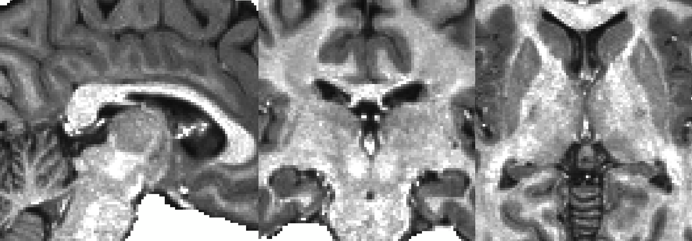
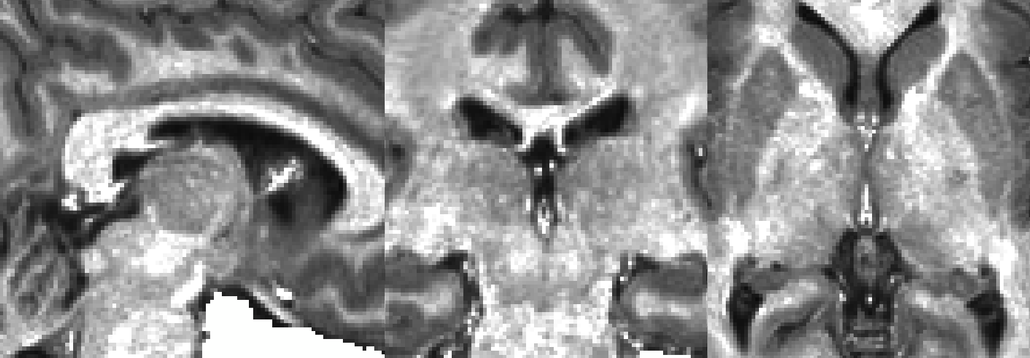
Presentation 320.11
Habenula Connectivity in Adolescent Mental Illness
Benjamin A. Ely,^{1,2}* Junqian Xu,¹⁻³ Vilma Gabbay^{1,2,4,5}
Icahn School of Medicine at Mount Sinai ¹Neuroscience, ²Graduate School, ³Radiology, ⁴Psychiatry
⁵Nathan S. Kline Institute for Psychiatric Research *Contact: benjamin.ely@mssm.edu
Mount Sinai
INTRODUCTION
T1w/T2w MRI – Native Subject Space, Anatomical Resolution
METHODS II
  Mental illness often emerges in adolescence
  The habenula (Hb) inhibits midbrain monoamine signalling and may play a clinical roll in reward deficits¹
  The small size of the human Hb has limited in vivo research²
  Using an optimized high-resolution fMRI approach,³ we examined Hb connectivity in adolescents with a range of mood, anxiety, and behavior disorder symptoms
Defining the Habenula:
  Semi-automated Hb segmentation⁴
  Optimized transformation to MNI³
  Functional Connectivity Analysis:
  ROI timeseries extraction via Conn
  Whole-brain Hb connectivity via Connectome Workbench
  Threshold-free cluster enhancement (TFCE) + FWE correction via PALM
0.9mm Segmented Hb (Native)
2.3mm Hb Seed (MNI)
METHODS I
Subjects:
  64 Adolescents (ages 12 - 20)
  15 Healthy controls
  49 Clinical subjects
  Depression (BDI), anxiety (MASC), and anhedonia (TEPS) scales
  Image Acquisition and Processing:
  3T Siemens Skyra with 16-ch coil
  T1w MPRAGE/T2w SPACE (0.8mm)
  10min rest EPI (2.3mm, 1s TR)
HCP preprocessing pipelines
Denoising via ICA-FIX, CompCor, 4mm smoothing*, 0.1-0.01Hz band-pass, and thalamic ROI regression⁴
  *After ROI timeseries extracted
T1w/T2w MRI – MNI Space, Anatomical Resolution
CONCLUSIONS
  Hb connectivity develops early in life
  Similar to healthy adults, includes reward, sensory, and salience areas
  May correlate with clinical symptoms
  Default network connectivity seen only in clinical subjects
REFERENCES
Fakhoury M. (2017), ‘The habenula in psychiatric disorders: More than three decades of translational investigation’, Neurosci Biobehav Rev, vol. 83.
Ely BA et al. (2016), ‘Resting-state functional connectivity of the human habenula in healthy individuals: associations with subclinical depression’, Hum Brain Mapp, vol. 37.
Ely BA et al. (in prep), ‘Human Habenula Functional Connectivity with Monoamine, Sensory, and Salience Systems’.
Kim JW et al. (2016), ‘Human habenula segmentation using myelin content’, NeuroImage, vol. 130.

Slide 16
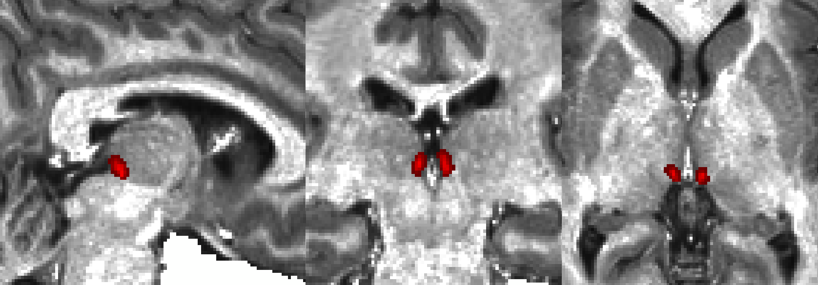
Presentation 320.11
Habenula Connectivity in Adolescent Mental Illness
Benjamin A. Ely,^{1,2}* Junqian Xu,¹⁻³ Vilma Gabbay^{1,2,4,5}
Icahn School of Medicine at Mount Sinai ¹Neuroscience, ²Graduate School, ³Radiology, ⁴Psychiatry
⁵Nathan S. Kline Institute for Psychiatric Research *Contact: benjamin.ely@mssm.edu
Mount Sinai
INTRODUCTION
Hb Segmentation – Native Subject Space, Anatomical Resolution
METHODS II
  Mental illness often emerges in adolescence
  The habenula (Hb) inhibits midbrain monoamine signalling and may play a clinical roll in reward deficits¹
  The small size of the human Hb has limited in vivo research²
  Using an optimized high-resolution fMRI approach,³ we examined Hb connectivity in adolescents with a range of mood, anxiety, and behavior disorder symptoms
Defining the Habenula:
  Semi-automated Hb segmentation⁴
  Optimized transformation to MNI³
  Functional Connectivity Analysis:
  ROI timeseries extraction via Conn
  Whole-brain Hb connectivity via Connectome Workbench
  Threshold-free cluster enhancement (TFCE) + FWE correction via PALM
0.9mm Segmented Hb (Native)
2.3mm Hb Seed (MNI)
METHODS I
Subjects:
  64 Adolescents (ages 12 - 20)
  15 Healthy controls
  49 Clinical subjects
  Depression (BDI), anxiety (MASC), and anhedonia (TEPS) scales
  Image Acquisition and Processing:
  3T Siemens Skyra with 16-ch coil
  T1w MPRAGE/T2w SPACE (0.8mm)
  10min rest EPI (2.3mm, 1s TR)
HCP preprocessing pipelines
Denoising via ICA-FIX, CompCor, 4mm smoothing*, 0.1-0.01Hz band-pass, and thalamic ROI regression⁴
  *After ROI timeseries extracted
Hb Segmentation – MNI Space, Anatomical Resolution (Demonstration Only)
CONCLUSIONS
  Hb connectivity develops early in life
  Similar to healthy adults, includes reward, sensory, and salience areas
  May correlate with clinical symptoms
  Default network connectivity seen only in clinical subjects
REFERENCES
Fakhoury M. (2017), ‘The habenula in psychiatric disorders: More than three decades of translational investigation’, Neurosci Biobehav Rev, vol. 83.
Ely BA et al. (2016), ‘Resting-state functional connectivity of the human habenula in healthy individuals: associations with subclinical depression’, Hum Brain Mapp, vol. 37.
Ely BA et al. (in prep), ‘Human Habenula Functional Connectivity with Monoamine, Sensory, and Salience Systems’.
Kim JW et al. (2016), ‘Human habenula segmentation using myelin content’, NeuroImage, vol. 130.

Slide 17
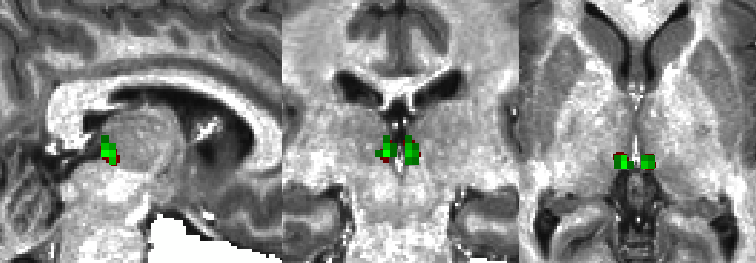
Presentation 320.11
Habenula Connectivity in Adolescent Mental Illness
Benjamin A. Ely,^{1,2}* Junqian Xu,¹⁻³ Vilma Gabbay^{1,2,4,5}
Icahn School of Medicine at Mount Sinai ¹Neuroscience, ²Graduate School, ³Radiology, ⁴Psychiatry
⁵Nathan S. Kline Institute for Psychiatric Research *Contact: benjamin.ely@mssm.edu
Mount Sinai
INTRODUCTION
Hb Segmentation – Native Subject Space, Anatomical Resolution
METHODS II
  Mental illness often emerges in adolescence
  The habenula (Hb) inhibits midbrain monoamine signalling and may play a clinical roll in reward deficits¹
  The small size of the human Hb has limited in vivo research²
  Using an optimized high-resolution fMRI approach,³ we examined Hb connectivity in adolescents with a range of mood, anxiety, and behavior disorder symptoms
Defining the Habenula:
  Semi-automated Hb segmentation⁴
  Optimized transformation to MNI³
  Functional Connectivity Analysis:
  ROI timeseries extraction via Conn
  Whole-brain Hb connectivity via Connectome Workbench
  Threshold-free cluster enhancement (TFCE) + FWE correction via PALM
0.9mm Segmented Hb (Native)
2.3mm Hb Seed (MNI)
METHODS I
Subjects:
  64 Adolescents (ages 12 - 20)
  15 Healthy controls
  49 Clinical subjects
  Depression (BDI), anxiety (MASC), and anhedonia (TEPS) scales
  Image Acquisition and Processing:
  3T Siemens Skyra with 16-ch coil
  T1w MPRAGE/T2w SPACE (0.8mm)
  10min rest EPI (2.3mm, 1s TR)
HCP preprocessing pipelines
Denoising via ICA-FIX, CompCor, 4mm smoothing*, 0.1-0.01Hz band-pass, and thalamic ROI regression⁴
  *After ROI timeseries extracted
Full Hb ROI – MNI Space, Functional Resolution
CONCLUSIONS
  Hb connectivity develops early in life
  Similar to healthy adults, includes reward, sensory, and salience areas
  May correlate with clinical symptoms
  Default network connectivity seen only in clinical subjects
REFERENCES
Fakhoury M. (2017), ‘The habenula in psychiatric disorders: More than three decades of translational investigation’, Neurosci Biobehav Rev, vol. 83.
Ely BA et al. (2016), ‘Resting-state functional connectivity of the human habenula in healthy individuals: associations with subclinical depression’, Hum Brain Mapp, vol. 37.
Ely BA et al. (in prep), ‘Human Habenula Functional Connectivity with Monoamine, Sensory, and Salience Systems’.
Kim JW et al. (2016), ‘Human habenula segmentation using myelin content’, NeuroImage, vol. 130.

Slide 18
Presentation 320.11
Habenula Connectivity in Adolescent Mental Illness
Benjamin A. Ely,^{1,2}* Junqian Xu,¹⁻³ Vilma Gabbay^{1,2,4,5}
Icahn School of Medicine at Mount Sinai ¹Neuroscience, ²Graduate School, ³Radiology, ⁴Psychiatry
⁵Nathan S. Kline Institute for Psychiatric Research *Contact: benjamin.ely@mssm.edu
Mount Sinai
INTRODUCTION
Hb Segmentation – Native Subject Space, Anatomical Resolution
METHODS II
  Mental illness often emerges in adolescence
  The habenula (Hb) inhibits midbrain monoamine signalling and may play a clinical roll in reward deficits¹
  The small size of the human Hb has limited in vivo research²
  Using an optimized high-resolution fMRI approach,³ we examined Hb connectivity in adolescents with a range of mood, anxiety, and behavior disorder symptoms
Defining the Habenula:
  Semi-automated Hb segmentation⁴
  Optimized transformation to MNI³
  Functional Connectivity Analysis:
  ROI timeseries extraction via Conn
  Whole-brain Hb connectivity via Connectome Workbench
  Threshold-free cluster enhancement (TFCE) + FWE correction via PALM
0.9mm Segmented Hb (Native)
2.3mm Hb Seed (MNI)
METHODS I
Subjects:
  64 Adolescents (ages 12 - 20)
  15 Healthy controls
  49 Clinical subjects
  Depression (BDI), anxiety (MASC), and anhedonia (TEPS) scales
  Image Acquisition and Processing:
  3T Siemens Skyra with 16-ch coil
  T1w MPRAGE/T2w SPACE (0.8mm)
  10min rest EPI (2.3mm, 1s TR)
HCP preprocessing pipelines
Denoising via ICA-FIX, CompCor, 4mm smoothing*, 0.1-0.01Hz band-pass, and thalamic ROI regression⁴
  *After ROI timeseries extracted
Thresholded Hb ROI – MNI Space, Functional Resolution
CONCLUSIONS
  Hb connectivity develops early in life
  Similar to healthy adults, includes reward, sensory, and salience areas
  May correlate with clinical symptoms
  Default network connectivity seen only in clinical subjects
REFERENCES
Fakhoury M. (2017), ‘The habenula in psychiatric disorders: More than three decades of translational investigation’, Neurosci Biobehav Rev, vol. 83.
Ely BA et al. (2016), ‘Resting-state functional connectivity of the human habenula in healthy individuals: associations with subclinical depression’, Hum Brain Mapp, vol. 37.
Ely BA et al. (in prep), ‘Human Habenula Functional Connectivity with Monoamine, Sensory, and Salience Systems’.
Kim JW et al. (2016), ‘Human habenula segmentation using myelin content’, NeuroImage, vol. 130.

