Slide 1


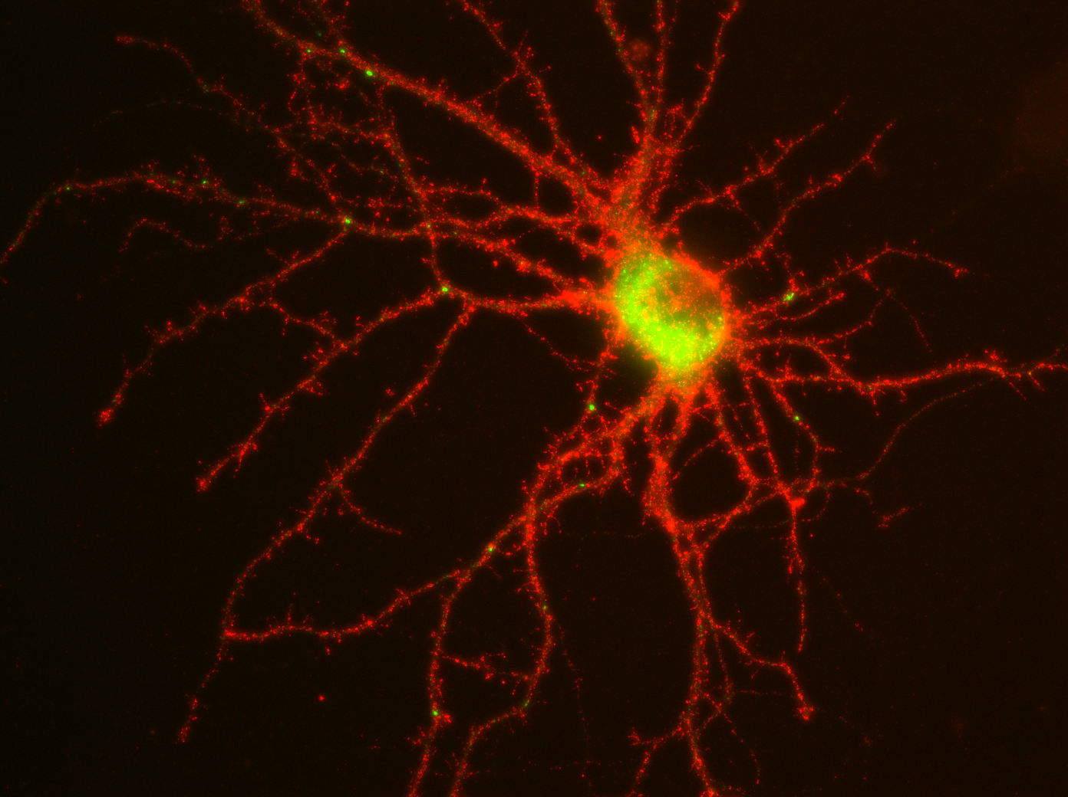

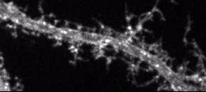





Role of synaptic plasticity in AMPA receptor intracellular trafficking
Hangen E., Cordelières F., Petersen J., Choquet D. & Coussen, F.
Interdisciplinary Institute for Neuroscience, CNRS-UMR5297, Université de Bordeaux, 33076 Bordeaux, France. Bordeaux Imaging Center, UMS-3420, Bordeaux France.
Presentation Number: 371.03
Poster Board Number: D31/DP02
GFP-GluA1
Hangen, E., Cordelières, F.P., Petersen, J., Choquet, D. and Coussen, F. (2018). Neuronal activity and intracellular calcium levels regulate intracellular transport of newly synthetized AMPAR.
Cell Reports, 24, 1001-1012.

Slide 2

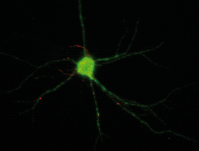
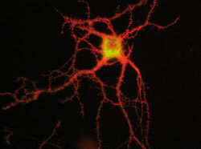
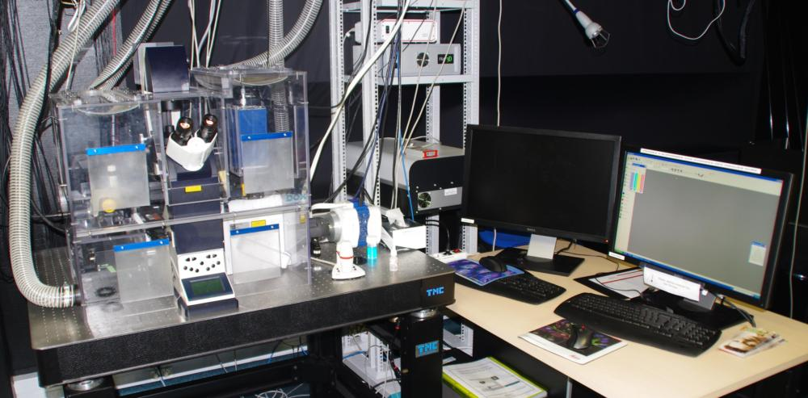
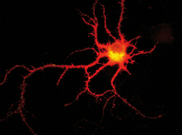
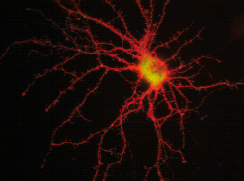
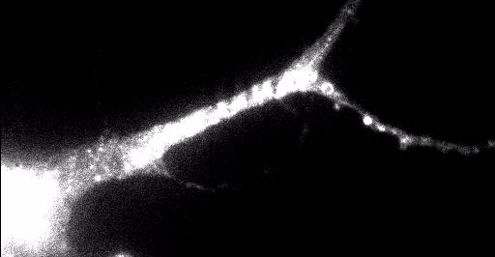



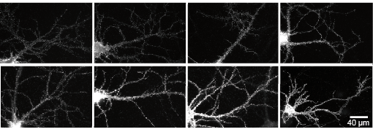


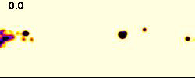

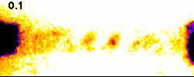
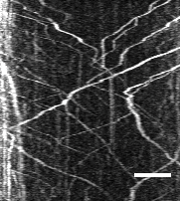
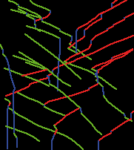
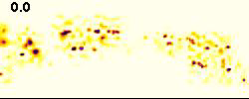
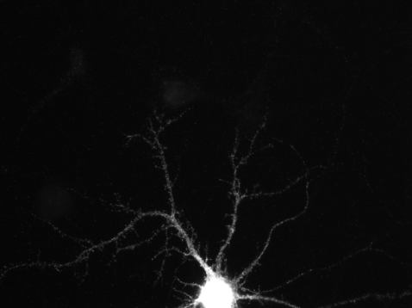
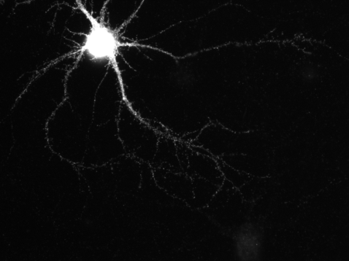
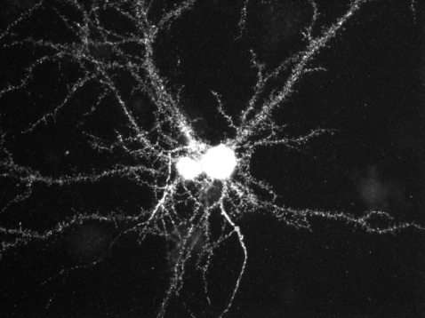
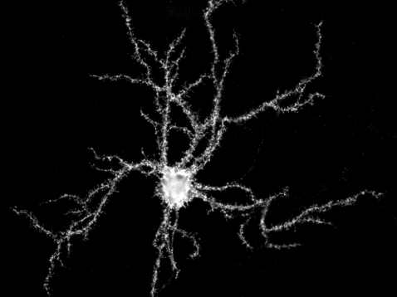
Role of synaptic plasticity in AMPA receptor intracellular trafficking
Hangen E., Cordelières F., Petersen J., Choquet D. & Coussen, F.
Interdisciplinary Institute for Neuroscience, UMR5297, Université de Bordeaux, 33076 Bordeaux, France
Introduction
Abundance of AMPA receptors (AMPARs) at the synapse is essential for the establishment and maintenance of synaptic function. Their synaptic localization is dependent on a highly dynamic exocytosis, endocytosis and plasma membrane mobility events. Our hypothesis is that synaptic localization of AMPARs is also regulated by their intracellular trafficking at basal state and during LTP. However, AMPARs post-ER trafficking toward the plasma membrane still remains poorly understood because of the lack of appropriate biological and imaging tools.
Using a new biochemical tool combined with photonic live imaging, we controlled and followed the dynamic secretion of tagged GluA1 containing receptors in cultured rat hippocampal neurons and characterize AMPAR intracellular transport. These analyzes are performed in basal condition, during induction of LTP and 20-50 min after LTP. Finally we have studied the impact of GluA1 phosphorylation on its transport by expressing phospho-mimetic mutants known to be phosphorylated during synaptic plasticity.
Tools
Principle
How does it work?
Kinetic of GluA1 externalization
Setup
Normal secretion
Controled secretion
N-Term
Plasma Mbr
EC
GluA1 surface expression
A1
A1
ARIAD-A1
Signal seq
IC
2.5
ER
+ Ligand
Endogenous protease: Furin
2
Conditional
aggreg. domain
1.5
30’
60’
Mean pixel intensity (a. u.)
Golgi
1
Golgi
Furin site
0.5
120
Tag of interest
30
60
90
PM
Transmemb. protein
GluA subunits
90’
120’
Time (min.)
Spinning Disk-LIFA (BIC)
Image acquisition with high frequency
ER
Externalization of GluA1 is maximal 60’ after ligand application, reaching a plateau. Videos between 30-50 min after ligand.
Camera EvolveTM EMCCD High sensitivity
C-Term
+ Ligand
ER
Results
Basal
High Ca²⁺
LTP
After LTP: GluA1-AA / GluA1-DD
Glu-Uncaging
Externalization of neosynthetized receptors: 5-20’ post induction
Control
MNI-Glutamate
Time after LTP-Ind.
5 min
10 min
15 min
20 min
GluA1-AA
Ca ²⁺
Live Labeling of GluA1
GluA1-DD
Ctl
4
**
**
***
3
Speed IN and OUT
Transport
Mean intensity (a.u.)
Vesicle density
2
20
2.5
*
ns
LTP
1
15
2
5
10
15
20
1.5
Ca²⁺
**
Time: min after LTP-Ind
10
µm / second
5
% Time in Pause
Mean Speed OUT
Ves / 20 µm² / min
1
4
40
****
2.5
ns
**
****
IC transport: 20-40’ post induction
5
0.5
3
30
2
AA
DD
AA
OUT
DD
AA
IN
DD
Mean ΔF/F
1.5
% Time
µm / sec
2
Uncaging
20
1
Control
cLTP
Ca²⁺
% Time IN / OUT / Pause
Time in pause
1
10
0.5
50
****
10
20
30
40
50
Before
During
Before
During
Before
During
Before
During
Basal
0.5
Ctl
40
*
****
10
****
Time: sec
Ctl
MNI-Glu
Ctl
MNI-Glu
0.4
LTP
30
7.5
% Time in video
Seconds
0.3
20
5
LTP-Induction: 0 Mg ²⁺, 100 µM Glycine, 30 µM BIC
Mean ΔF/F
2.5
0.2
10
Ca²⁺
Vesicle density
Mean Speed
0.1
OUT
IN
P
OUT
IN
P
AA
DD
2
10
20
30
40
AA
DD
Vesicle density
Time IN / OUT / Pause
1.5
20
*
2
***
****
LTP
Time: sec
EC GluA1 Distal / Proximal
20
50
****
Mean ΔF/F
15
1.5
40
1
Ves / 20 µm² / min
µm / sec
15
30
10
1
Frequency distribution of speeds
Ves / 20 µm² / min
% Time
0.5
5
10
20
0.5
Vesicle density
Time IN / OUT / Pause
Mean Speed
5
10
OUT
IN
Pause
10
20
30
40
50
Ctl
Ind-LTP
Ctl
LTP-Ind
Ctl
LTP-Ind
30
***
50
ns
3
**
***
30
GluA1, Basal
OUT
IN
Pause
Time: sec
OUT
IN
40
ns
ns
2
20
AA
AA
DD
DD
Frequency distribution of speeds
20
30
µm / sec
Relative frequency %
40’ induction
40’ induction
Mean Speed
Time IN / OUT / Pause
Frequency distribution of speeds
Ves / 20 µm² / min
% Time
****
2.5
ns
30
****
50
10
20
1
10
2
OUT
10
****
1.5
ns
ns
****
****
1.5
20
IN
80
40
****
Ctl
LTP
Ctl
LTP
Ctl
LTP
Ctl
LTP
Ctl
LTP
Ctl
LTP
1
2
3
4
5
Relative frequency %
60
Instantaneous speed; µm / sec
µm / sec
% Time
**
***
30
OUT
IN
Pause
OUT
IN
1
1
10
40
Relative frequency %
0.5
20
20
Distal / Proximal
OUT
IN
1
2
3
4
Ctl
LTP-Ind
Ctl
LTP-Ind
Ctl
LTP-Ind
10
**
**
***
0.5
Instantaneous speed; µm / sec
OUT
IN
Pause
1
2
3
4
Basal GluA1 transport means
Transport antero (OUT) and retrogradely (IN) in dendritic shaft.
Mean speed around 1.5 µm / sec, having one third of its time in pause and more in OUT direction than in IN.
Frequency distribution is the same for IN and OUT.
Instantaneous speed; µm / sec
LTP means
Externalization of neosynthetized GluA1 in proximal and distal dendrite.
More vesicles than basal.
Speed IN and OUT increased.
New population of vesicles with a speed around 3.5 µm / sec to the detriment of slow vesicles.
AA
20’
DD
AA
30’
DD
AA
40’
DD
AA
50’
DD
High Ca 2+ means
Less vesicles than basal.
Speeds IN and OUT decreased and pause increased.
Frequency distribution shifted to low speed.
Phosphorylation of GluA1 means
More vesicles for GluA1-DD than GluA1-AA.
Less pause for GluA1-DD.
Vesicles containing GluA1-DD are sent at the distal dendrite.
Conclusions

