Slide 1
The Role of Animals in Basic,
Medical, and Veterinary Health Research

Slide 2
Please Rate Your Comfort Level With the Prescribing of
Drugs Developed and Tested Using the Following Species
Fruit Fly
40
Mouse
Dog
Monkey
30
?
# of votes
20
10
0
somewhat
comfortable
somewhat
uncomfortable
comfortable
uncomfortable
Comfort Level

Slide 3
Please Rate Your Comfort Level With the Use of the
Following Species in Your Own Research.
40
Fruit Fly
n = 56
Mouse
30
Dog
Monkey
# of votes
20
10
0
somewhat
comfortable
somewhat
uncomfortable
comfortable
uncomfortable
Sample Poll from Harvard Medical School Animal Research Symposium 2017
Comfort Level
Notes:
Survey given to Harvard Medical School, Division of Medical Sciences graduate students enrolled in the Conduct of Science Course in October of 2013. Total of 56 respondents.

Slide 4
Please Rate Your Comfort Level With the Use of
Data From Experiments on the Following Species.
50
Fruit Fly
40
n = 56
Mouse
Dog
Monkey
30
# of votes
20
10
0
somewhat
comfortable
somewhat
uncomfortable
comfortable
uncomfortable
Sample Poll from Harvard Medical School Animal Research Symposium 2017
Notes:
Survey given to Harvard Medical School, Division of Medical Sciences graduate students enrolled in the Conduct of Science Course in October of 2013. Total of 56 respondents.

Slide 5
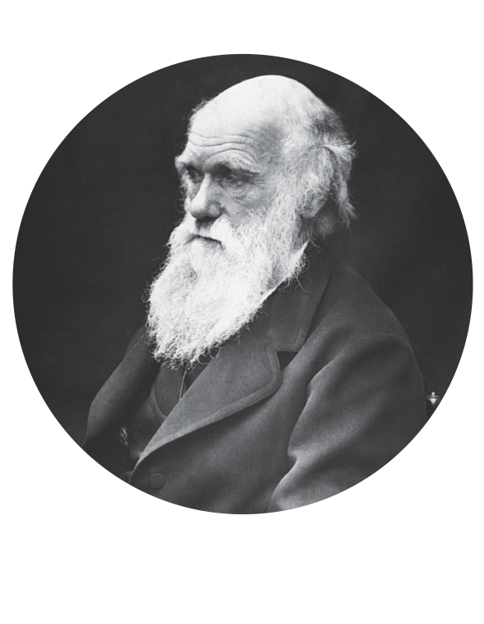

Animal research contributed to
70% of Nobel prizes in physiology or medicine
"I know that physiology cannot possibly progress except by means of experimenting on live animals, and I feel the deepest conviction that he who retards the progress of physiology commits a crime against mankind.”
Charles Darwin
The London Times, 1881
Notes:
Introduce importance of animal research for medical progress
Nobel prize percentage source: https://speakingofresearch.files.wordpress.com/2008/03/medical-advances-and-animal-research1.pdf
Quote source: Darwin CR. Mr. Darwin on vivisection. The Times of London 1881;10. as quoted in: Ringach DL. The use of nonhuman animals in biomedical research. Am J Med Sci. 2011 Oct;342(4):305-13. doi: 10.1097/MAJ.0b013e31822a6c35. PubMed PMID: 21817874.
For example, utilizing genetic likeness of animals for scientific progress.
Transgenic animals are useful models to:
Study disease development
Evaluate medicines and gene therapies
Produce and test the purity of human therapeutic proteins

Slide 6
The Beneficiaries of Animal Research
(Image: SVPAZ)
Our Families
Our Environment
Our Pets
Notes:
Without animal research, who would lose? Introduce listed beneficiaries: medical advances through animal research help humans, the health of our pets, and provide an understanding of our environment and the interconnectedness / biodiversity of life
Pets suffer from many of the same diseases as humans and, thus, benefit from many of the same treatments developed via animal research (e.g., similarities between feline immunodeficiency virus and HIV). Pets’ food, medicines, and vaccinations were developed using animal research. For example, many puppies died within months of contracting canine parvovirus until the vaccine was developed via animal research in the early 1980s.

Slide 7
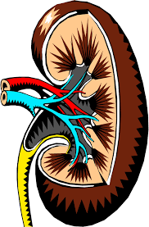
Human Health Advances
Examples of medical advances based on animal research:
kidney transplants
insulin injections
Parkinson’s disease implants
Insulin
dogs, rabbits, and mice
MMR vaccine
nonhuman primates
Blood transfusions
dogs, guinea pigs, and rabbits
Polio
mice and nonhuman primates
Kidney transplants
dogs and pigs
Parkinson’s Disease implants
nonhuman primates
Gene therapy retinitis pigmentosa
dogs
Penicillin and Streptomycin
mice and guinea pigs
“There could have been no oral polio vaccine without the use of innumerable animals.”
Albert Sabin, Polio researcher
Notes:
Virtually all medical advances utilized animal research models at some point in the R & D process
Model system used for discovery is listed alongside medical advance
Source: https://speakingofresearch.files.wordpress.com/2008/03/medical-advances-and-animal-research1.pdf
https://speakingofresearch.com/facts/medical-benefits/

Slide 8
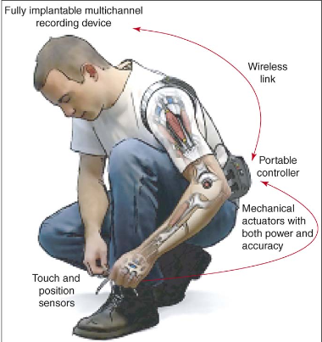
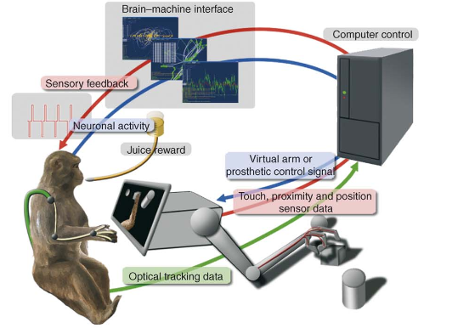
Limb Function Through Advances in
Brain Machine Interfaces (BMI)
BMI technology informed by nonhuman
primate neuronal recordings
BMI’s potential to restore
limb mobility
Source: Lebedev & Nicolelis. Trends in Neuroscience. July 2006.
Notes:
BMI involves a direct connection between the brain areas associated with movement and a wired device like a prosthetic. Neuronal activity is recorded and processed through a computer to power the robotic arm. Feedback from sensors on the arm is converted to micro stimulation of sensory brain areas. BMI aims to generate a prosthetic that feels and acts like a human limb. BMIs may be used as therapy for restoring motor control in disabled individuals. More information can be found at http://www.brainfacts.org/in-the-lab/animals-in-research/2016/animal-research-success-stories-brain-machine-interface-090616
Images from: http://www.afanporsaber.es/files/homepage/group/loveLAB/love/classes/design/readings/bmi2.pdf

Slide 9
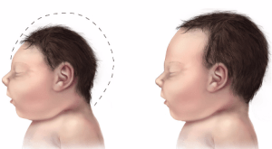
Why Researchers Select A Specific Animal Model
Biological similarity between animal model and human
For example, the common disease progression of the Zika virus:
Notes:
Researchers are working with macaque monkeys to understand the impact
of Zika, the latest virus to emerge as a global threat. Zika infection in
pregnant women can cause microcephaly, a condition where the child is
born with a small head due to abnormal brain development. It also appears
to cause stillbirth, miscarriages and fetal growth restriction. These prob-
lems all appear to be rooted in how the Zika virus affects the developing
fetus and the placenta, which nourishes the baby in its mother’s womb.
The Zika virus infects monkeys just as it does humans, and both experience
the disease in the same way. Researchers can study pregnant monkeys
much as an obstetrician follows a woman’s pregnancy – they can take
blood, monitor fetal development through ultrasounds and collect amniotic
fluid. They can then test vaccines and drugs with the hope of protecting
the fetus. No other animal model allows for this entire spectrum of study
and application of the findings to pregnant women.
Photo source: FBR (https://fbresearch.org/new-threats-zika-infection-complications-pregnancy/)

Slide 10
Laboratory Animals: ‘Partners’ in biomedical innovation
Laboratory Animals in U.S.
Source: Love Animals? Support Animals in Research. Foundation for Biomedical Research. September 2017.
Notes:
The majority of animals in biomedical research are rodents with a small percentage of researchers working with cats, dogs, and NHPs.
Source: Love Animals? Support Animals in Research. Foundation for Biomedical Research. September 2017.

Slide 11
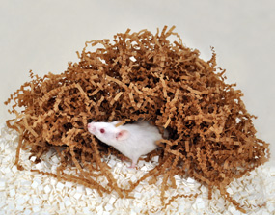
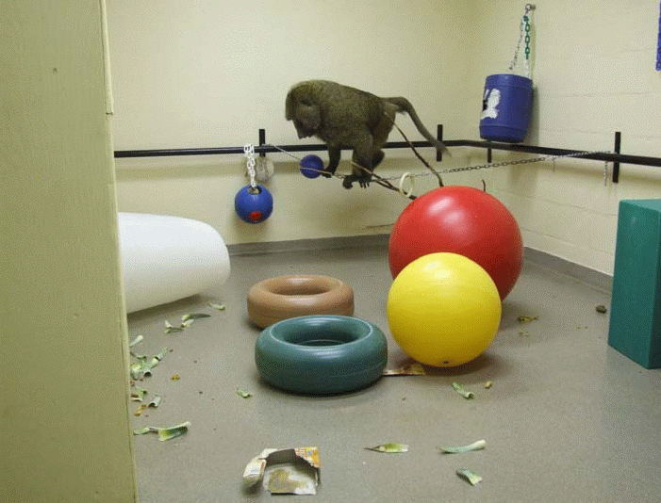
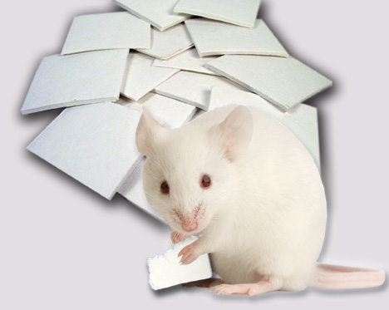
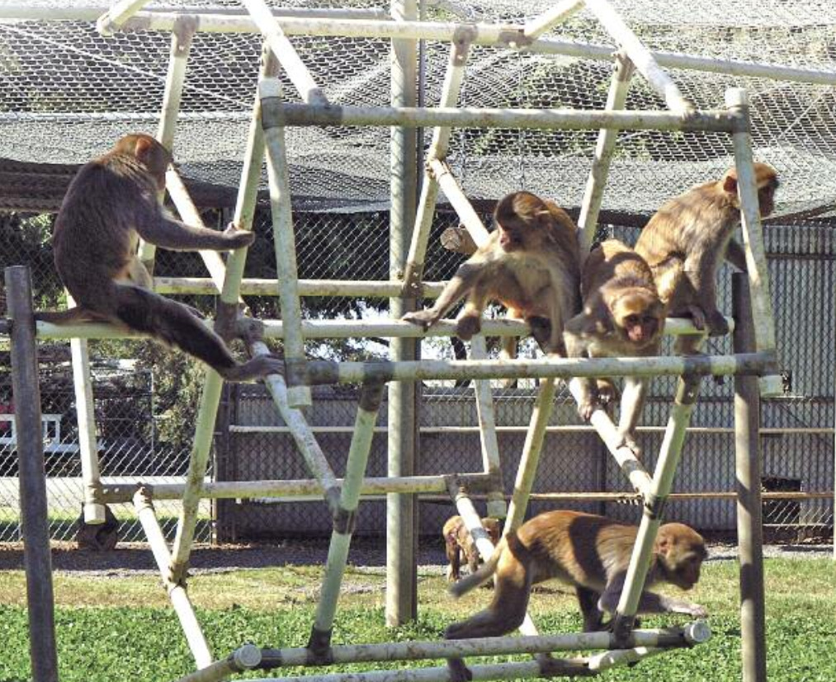
Researchers Manage the Health and Well Being of Laboratory Animals
Health Care
cared for daily by animal welfare
staff and regularly monitored by veterinarians
Nutrition
veterinarian approved diet
Environment
clean with minimal stressors
Psychological
species specific enrichment
Notes:
Laboratory animals are kept in clean, enriched environments with oversight from veterinarians and behavioral experts.
Photo source: https://nprcresearch.org/primate/NHP-White-Paper-Print-08-22-16.pdf

Slide 12
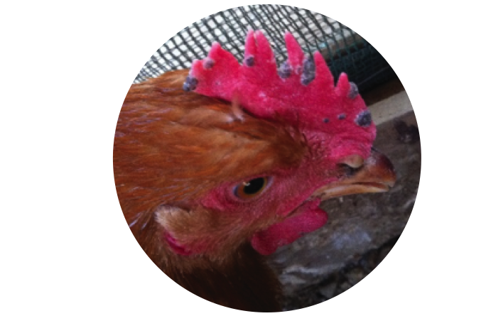
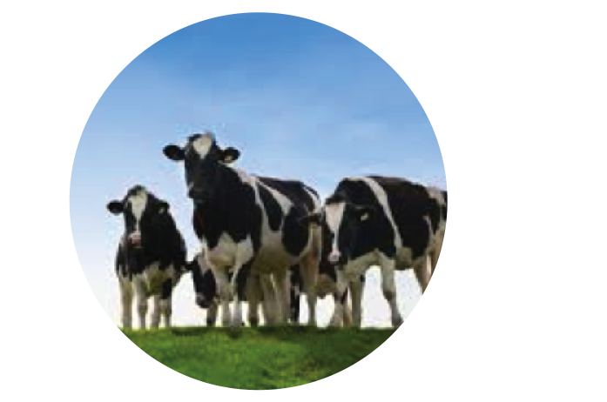
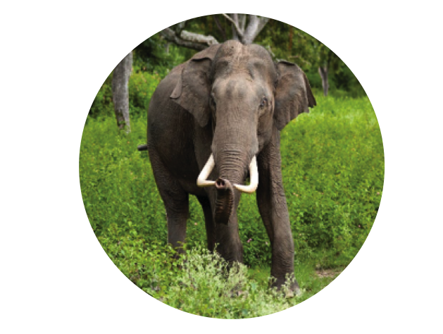
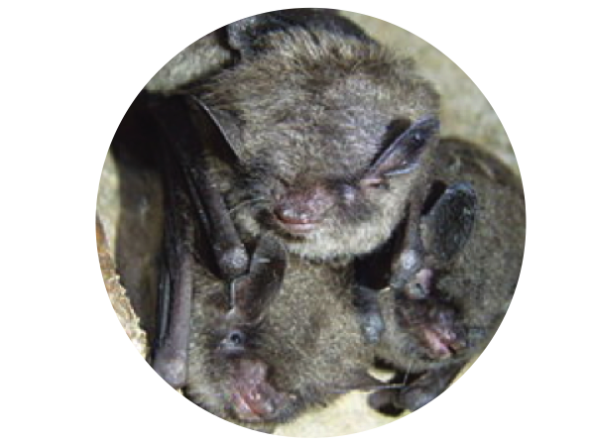
Veterinary Advances
Fowl pox vaccination
mice
Rumensin Antimicrobial
mice
Elephant endotheliotropic herpes virus
mice and rabbits
White Nose syndrome
brown bats
White Nose Syndrome — Brown Bats
Notes:
Through animal research, scientists better understand and have developed treatments for conditions affecting the animal kingdom including diseases affecting pets.
Sources: https://www.wsj.com/articles/love-your-dog-support-animal-research-1505672563; https://fbresearch.org/animal-research-helps-endangered-species/
Model system used for discovery is listed alongside veterinary advance
Fowl pox: virus produces lesions on bird’s skin, throat, and trachea; interferes with bird’s ability to eat, drink, and breathe normally
Rumensin: antimicrobial used to prevent and control coccidiosis parasite was originally developed through mouse research
EEHV: Asian elephants are highly susceptible to EEHV, a lethal strain of herpes; studying antibody responses to EEHV proteins in mice and rabbits aims to improve diagnostics and treatments for wild and captive elephants
White nose syndrome: bats’ wings are coated in white ‘fuzz’ during hibernation; fungus affects endangered Indiana and gray bat species; exposed common brown bats to white fungus to understand disease mechanisms
https://speakingofresearch.com/facts/veterinary-benefits/

Slide 13
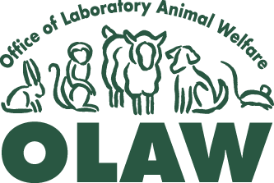


How Animal Research is Regulated
In the US today, the Animal Welfare Act (AWA) and the Public Health Service (PHS) Policy assure the humane treatment of animals in research, testing, and teaching practices.
Implements PHS Policy
Animal procedures in NIH and NSF grants
are evaluated by NIH Office of Laboratory Animal Welfare
Drug metabolism
and device biocompatibility require regulated animal research
USDA oversees AWA compliance
Notes:
Scientists work with laboratory animals in a regulated way as set forth by AWA and PHS.
FDA:
Requires animal research for device and drug approval.
Devices – animal testing is only necessary if new material is used; biocompatibility testing is required
Drugs and Biologics – animal testing is used to determine drug absorption (into blood), drug metabolism, product and metabolite toxicity, speed of metabolite excretion
https://www.fda.gov/AboutFDA/Transparency/Basics/ucm194932.htm
OLAW:
https://grants.nih.gov/grants/olaw/olaw.htm
USDA:
https://www.nal.usda.gov/awic/animal-welfare-act

Slide 14
Regulations Governing Animal Research
In IACUC proposals, scientists must…
1. Cite literature to explain:
• Why their model is the appropriate experimental
subject to address the research question
• Why alternative research subjects (e.g., cell
culture and computer simulation) would not yield
similar information
• Why their potential results would not
unnecessarily duplicate previous research
2. Perform sample size calculations to determine
number of animals necessary
Many institutions are implementing animal
research conduct by following the 3 R’s:
• Replace with an alternative
• Refine methods to minimize pain and invasiveness
• Reduce the number of animals
Animal Welfare Act (AWA) and the Public Health Service (PHS) Policy require each research institution to appoint an Institutional Animal Care and Use Committee (IACUC) including a veterinarian and a non-affiliated public representative to review all experimental protocols, inspect facilities, and suspend any research practice not in compliance
Notes:
Each research institution oversees individual laboratories’ practices through an IACUC. The IACUC requires researchers to justify their work with animals and their use of the 3 Rs.
Above source: https://www.darwinproject.ac.uk/commentary/life-sciences/darwin-and-vivisection
Below source: http://www.nabr.org/animal-welfare-2/animal-welfare-in-practice/functions-of-the-iacuc/
https://speakingofresearch.com/facts/research-regulation/

Slide 15
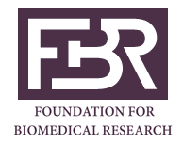

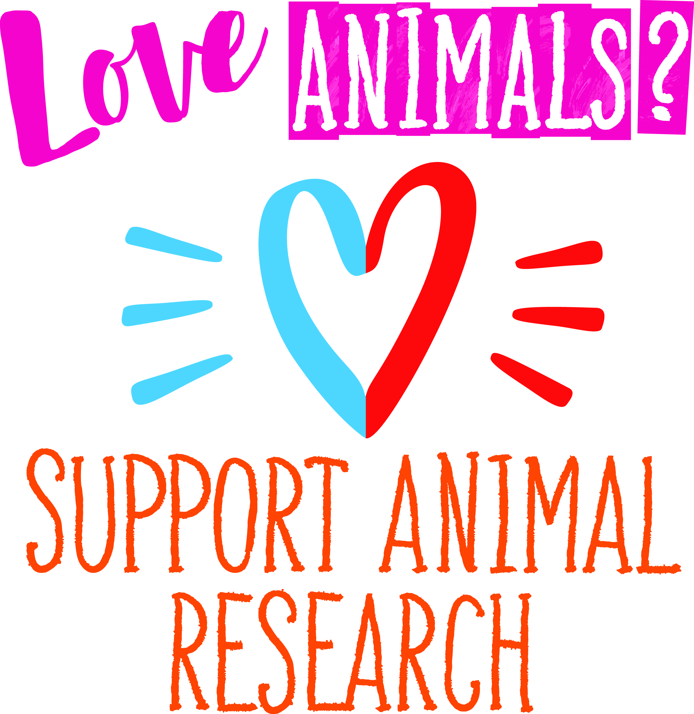

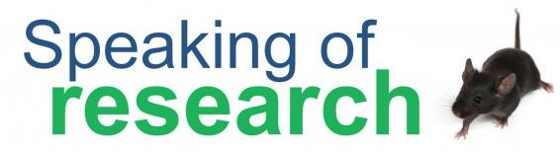

Animal Research Resources
Foundation for Biomedical Research
Americans for Medical Progress
Animals behind the 25 most
prescribed drugs
Species-specific examples of
animal research:
              1. Rodents
            2. Dogs
            3. Cats
            4. Nonhuman primates
        Come See Our World video
        Love Care Progress
        nonhuman primate video
Federation of European Neuroscience Societies
Speaking of Research
Association for Assessment and Accreditation of Laboratory Animal Care International
Notes:
Please utilize these resources for additional information.

