Slide 1
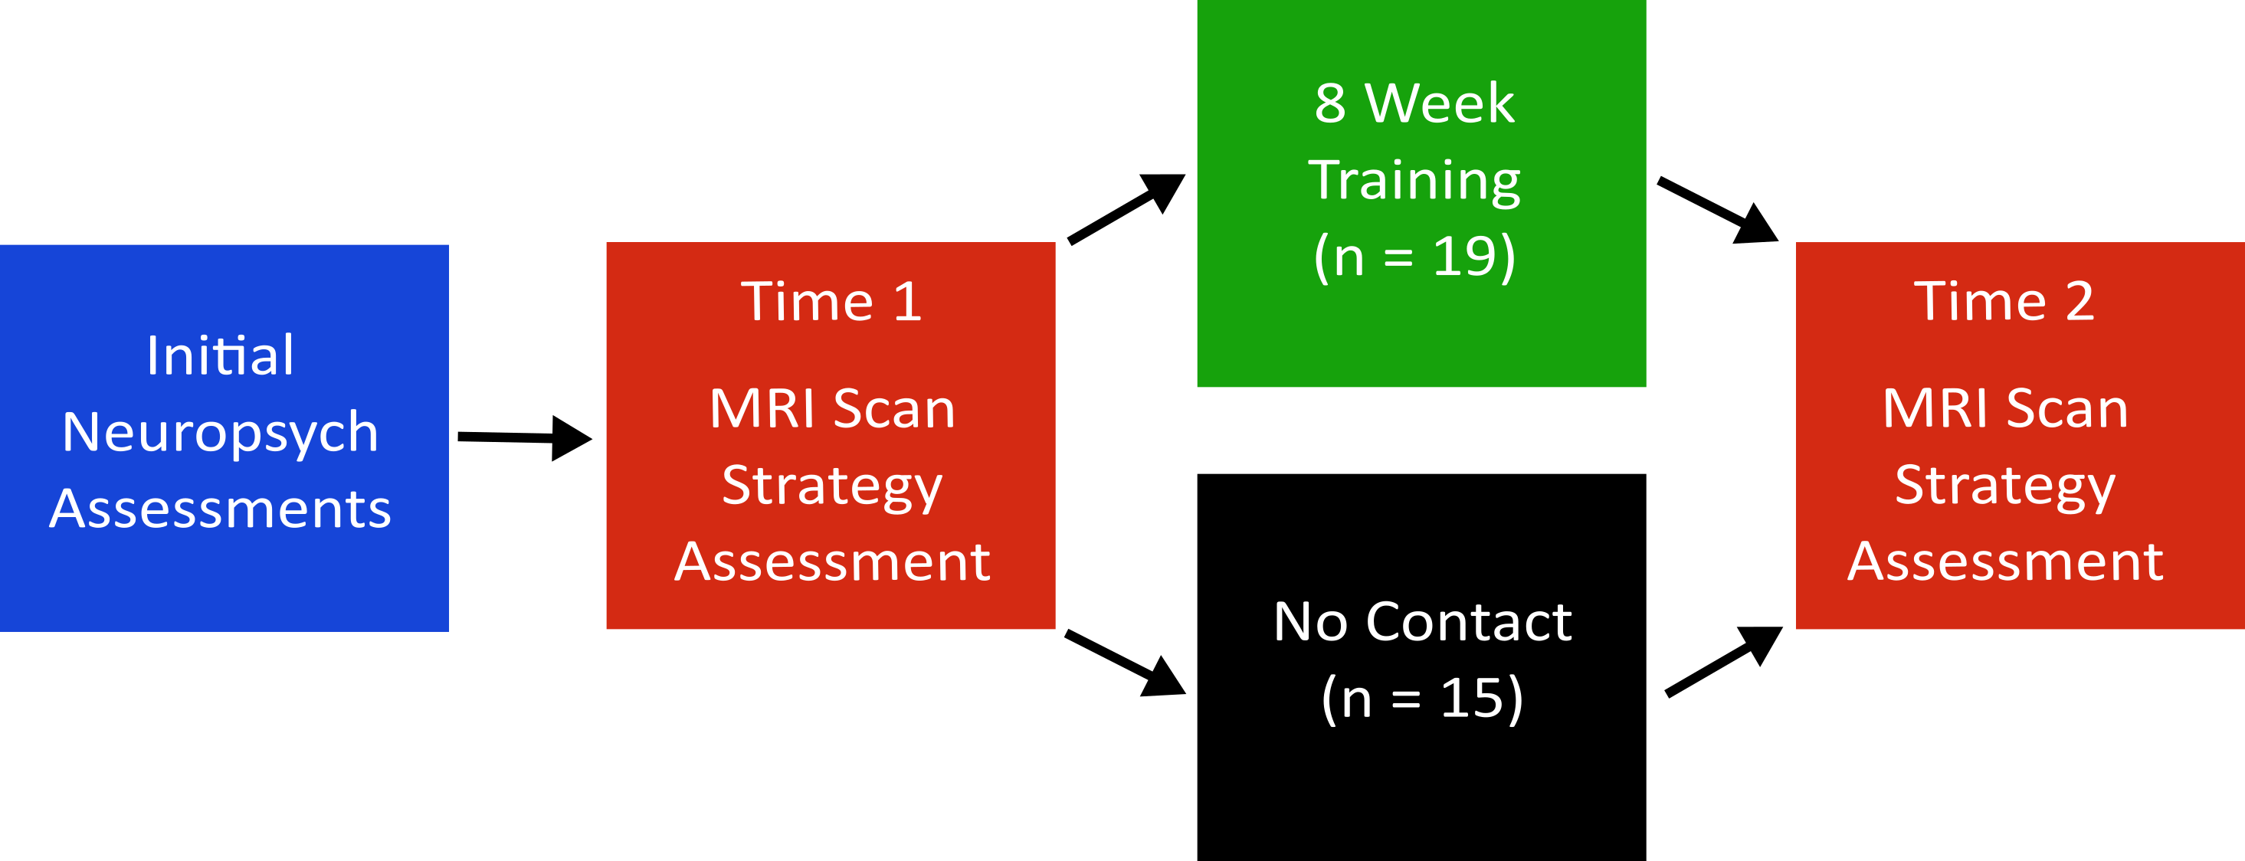
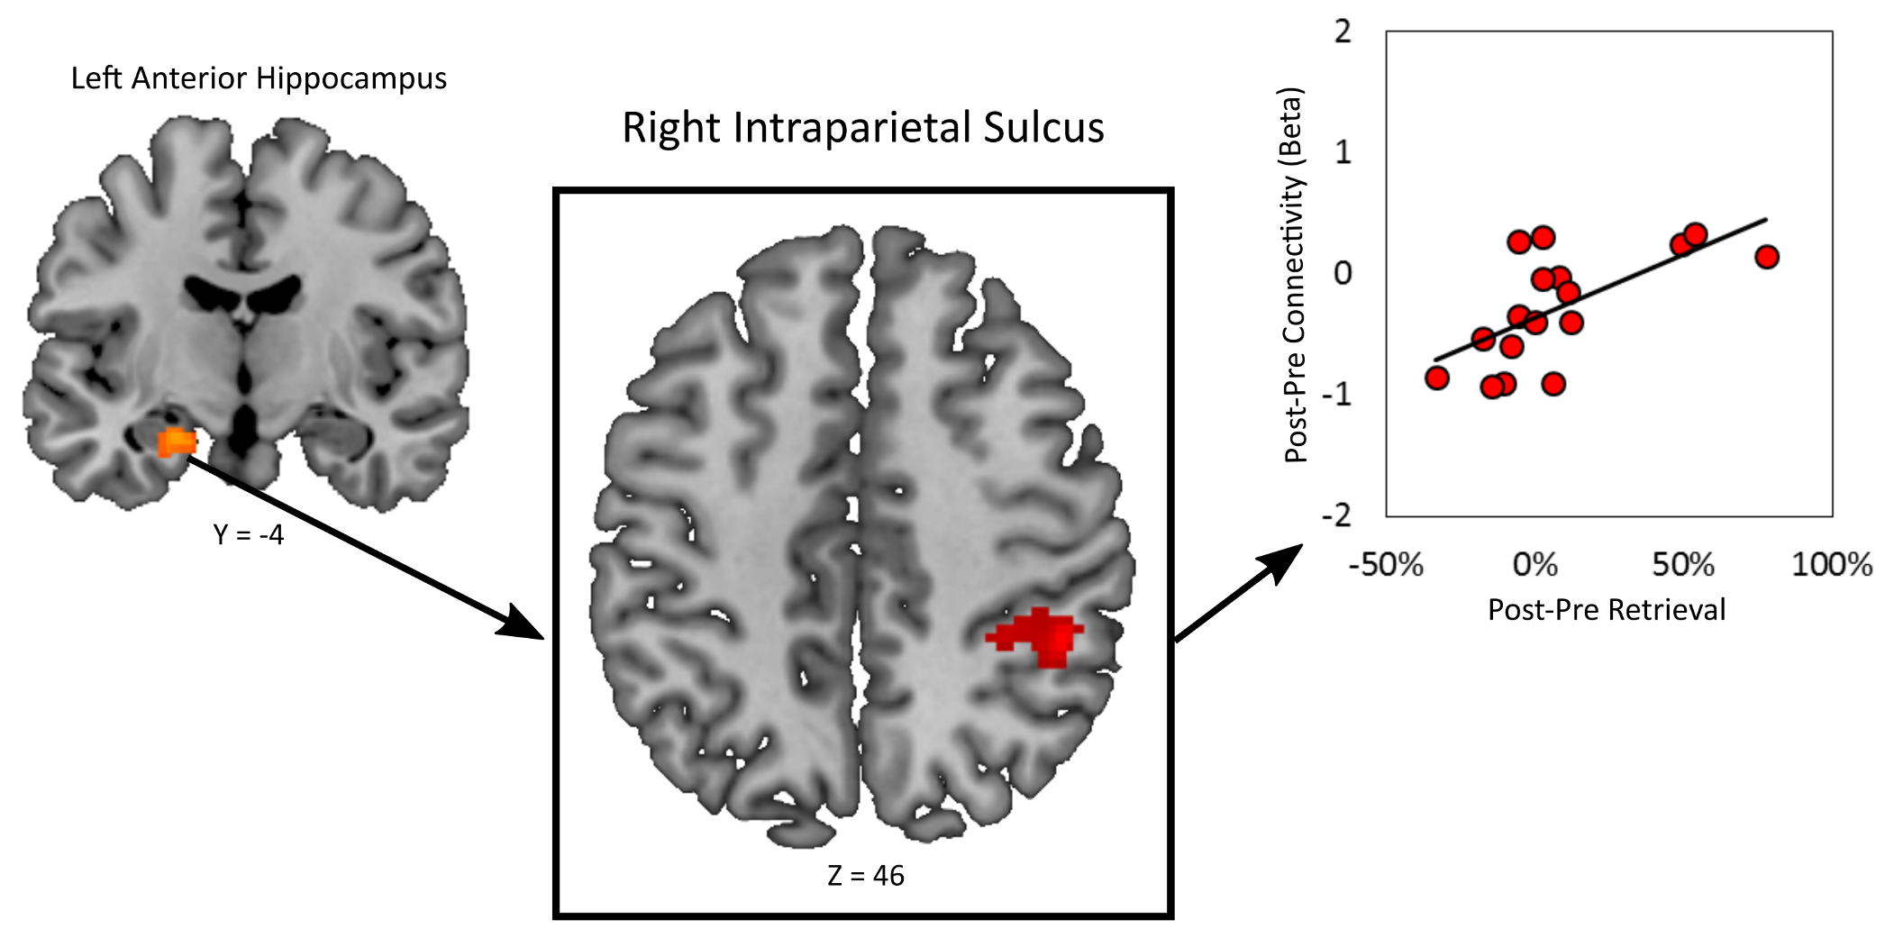
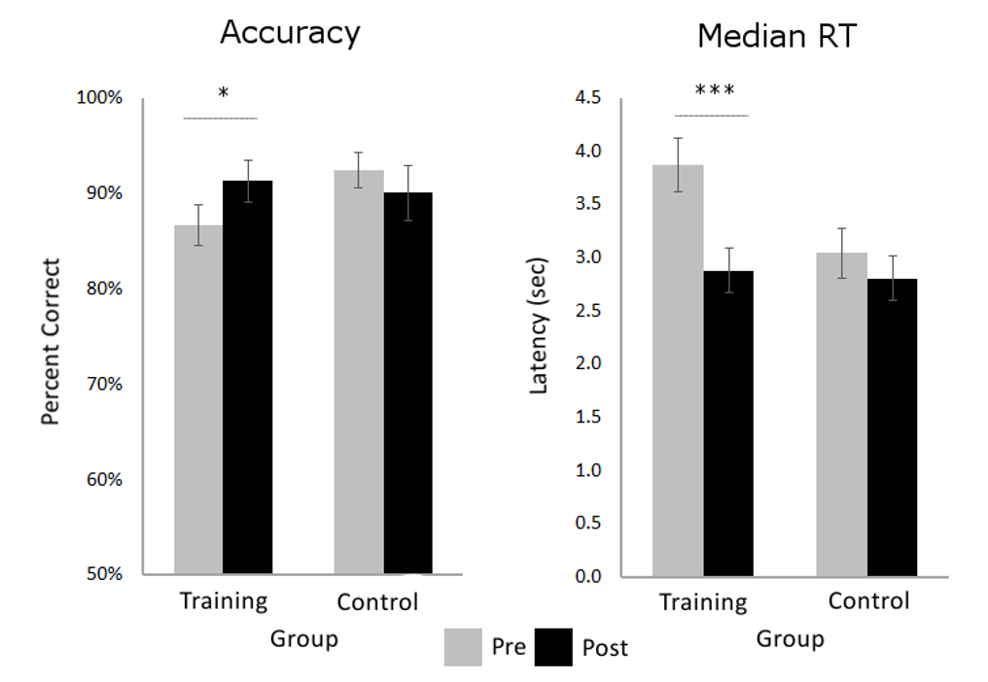
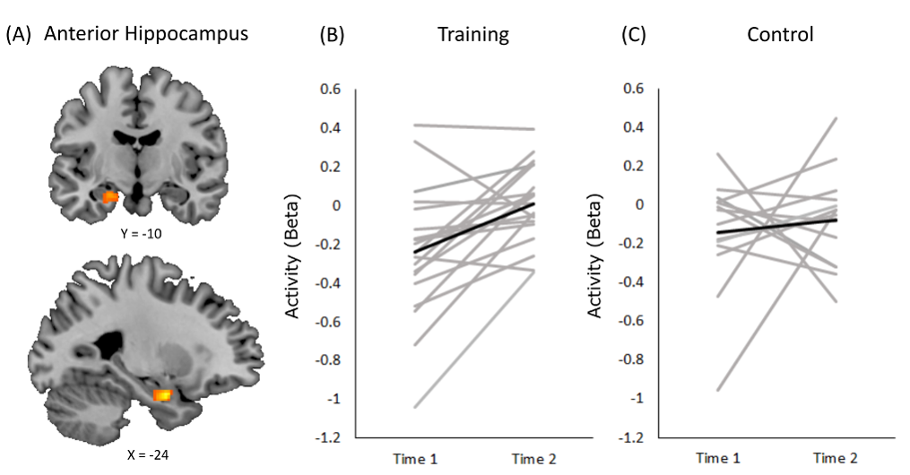
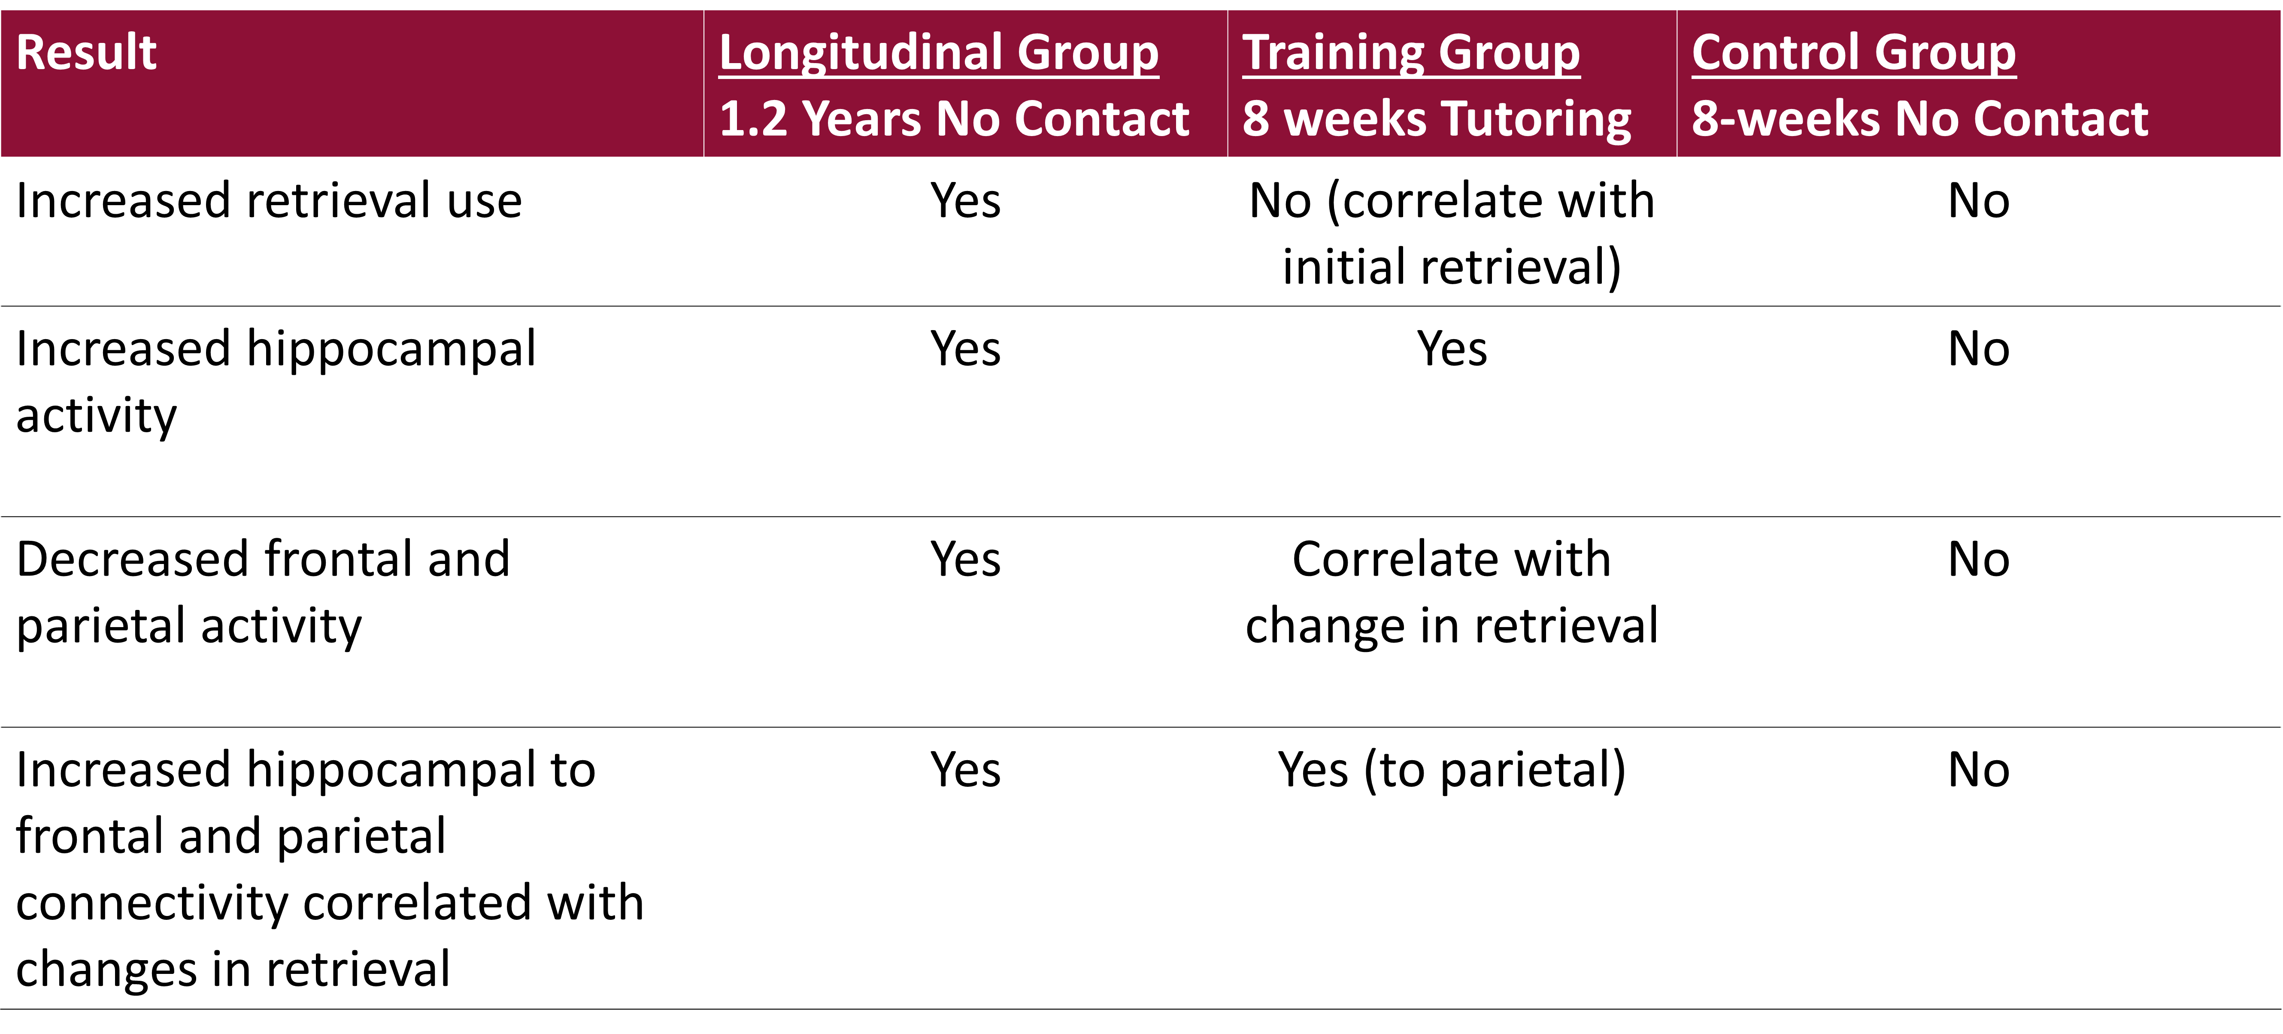
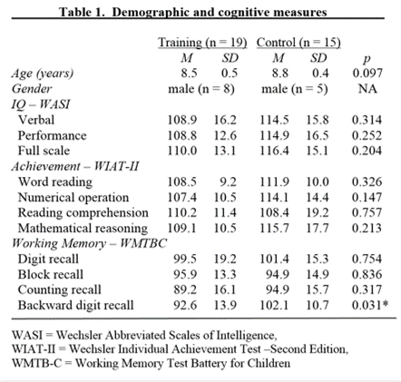
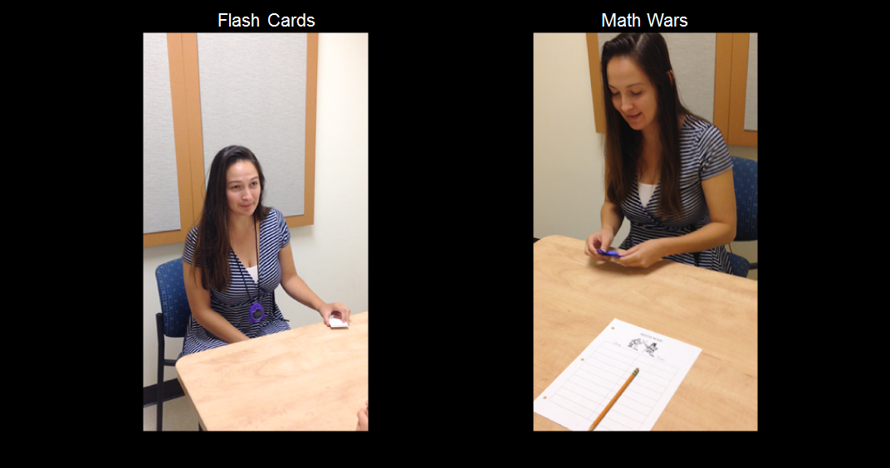
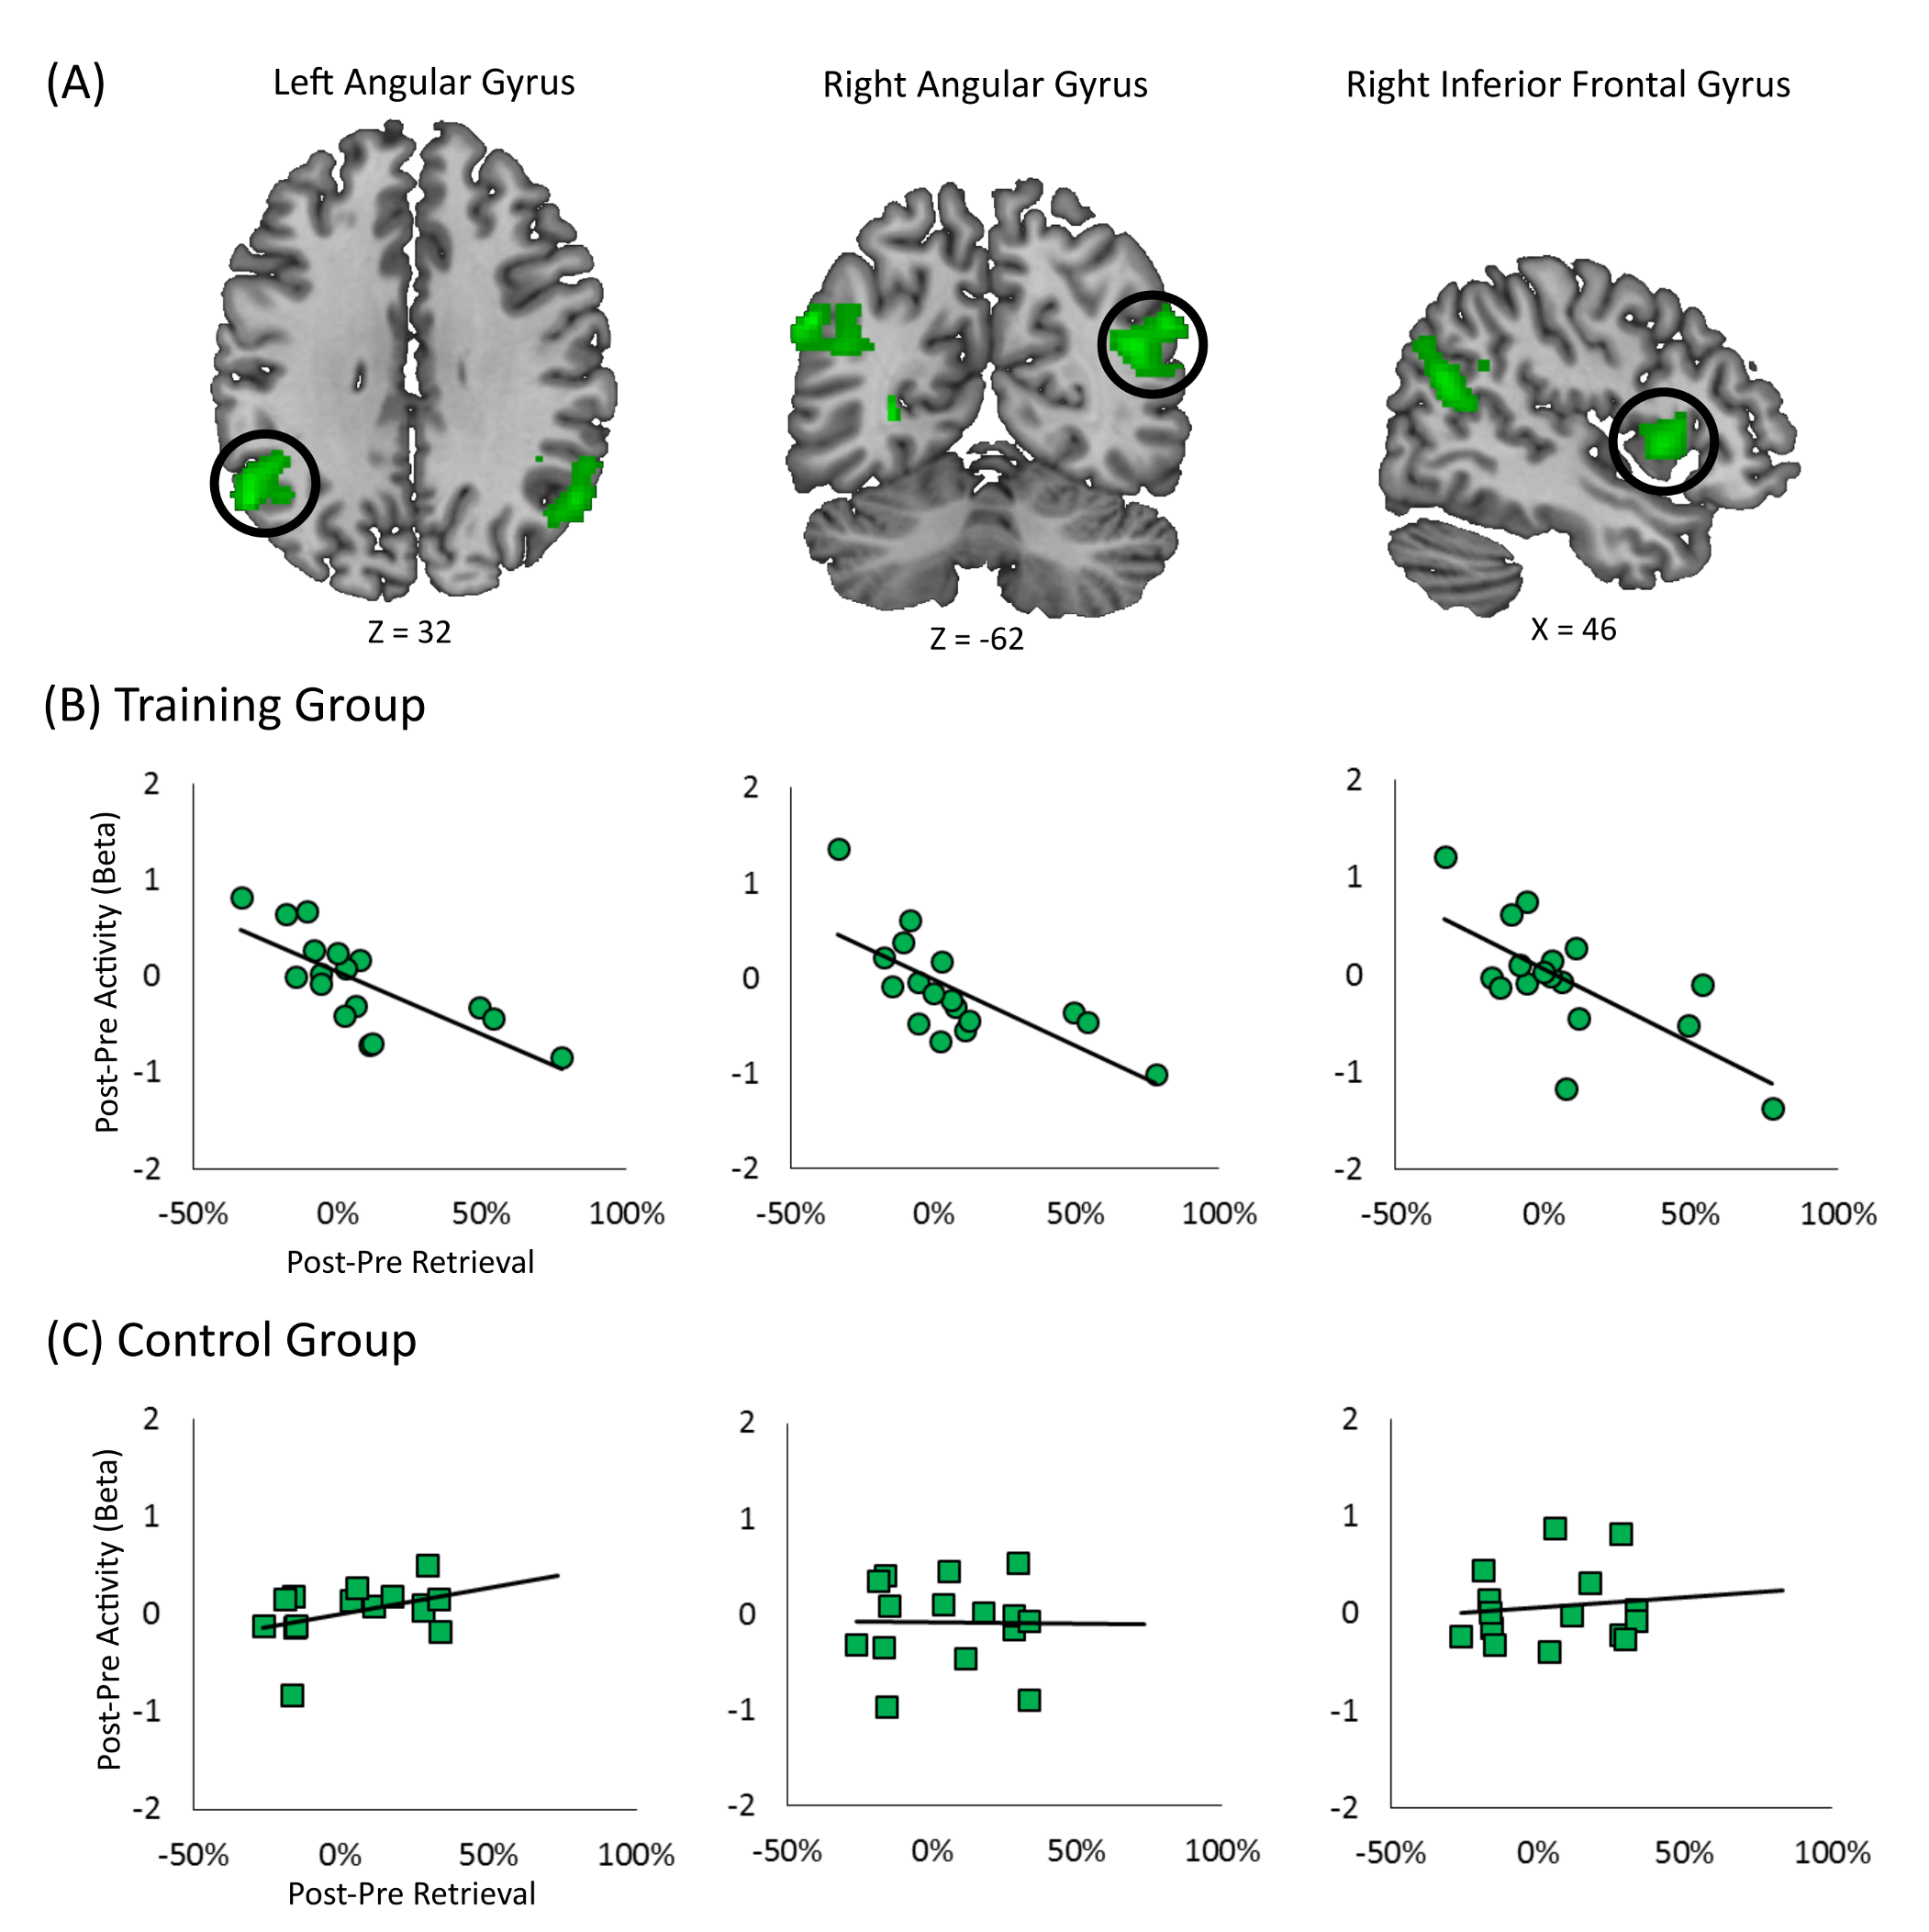
Title
Authors names and affliations
Brain systems involved in math fact retrieval: Growing evidence suggests that the hippocampus and adjacent medial temporal lobe structures are involved when children retrieve math facts. For example, children who use retrieval more often show greater activity in the hippocampus (Cho, JOCN, 2012).
Longitudinal change: Recently we found that in a 1.2 year interval, children increased their use of retrieval and hippocampal activity, and increases in hippocampal-parietal connectivity were related to increases in retrieval use (Qin, Nat Neuro, 2014).
Study Design
Accuracy and reaction time improved in the Training group, but not the Control Group. Retrieval use did not increase in either group but was related to initial level in the Training Group
Connectivity
Introduction
Behavioral Results
Hippocampal connectivity increased to the right intraparietal sulcus, but only in the Training Group.
Outcome Tasks
We found increased hippocampal activity in the Training Group, but not the Control Group
Training recapitulated major brain changes seen in the Longitudinal Group.
Retrieval use did not increase significantly in the Training Group. We found increases in hippocampal activity consistent with Qin (2014), although only on the left side. Decreases in activity were only correlated with change retrieval and were not found at the whole group level. Change in retrieval correlated with increased hippocampal to parietal connectivity but not to frontal regions as in Qin (2014). Crucially, none of this changes were found in the Control group.
More research is needed to establish whether these discrepancies are fundamental differences between long-term schooling and short-term training, or features of the particular training paradigm, which trained multiple skills beyond math fact retrieval.
Whole Brain Results
Conclusions
Scanner Task
Strategy
Assessment
3 + 8 =
3, 4, 5,
6, 7, 8,
9, 10, 11
8 + 3 =
8 + 3 =
Memory
8, 9, 10, 11
8 + 2 + 1 =
10 + 1 =
11
Children in the Training and Control group were matched on IQ, age and gender distribution and did not differ in academic achievement and most measures of working memory.
Correlations
Training Activities
No overall decreases in activity levels, but greater use of retrieval was related to decreases in right frontal and bilateral parietal cortex, in the Training Group, but not the control Group.
This work was supported by NIH grants (HD047520, HD059205, HD057610 to VM; MH101394 to MRL). We thank Holly Wakeman for help with preparing this poster.
Acknowledgements

Slide 2

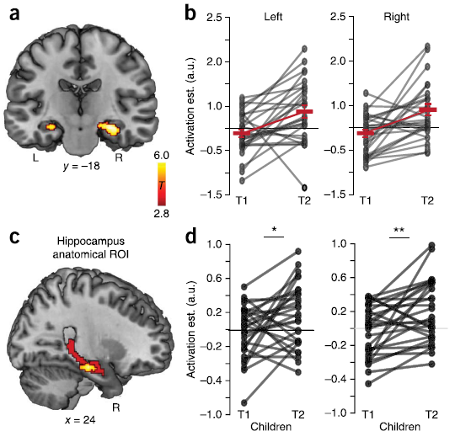
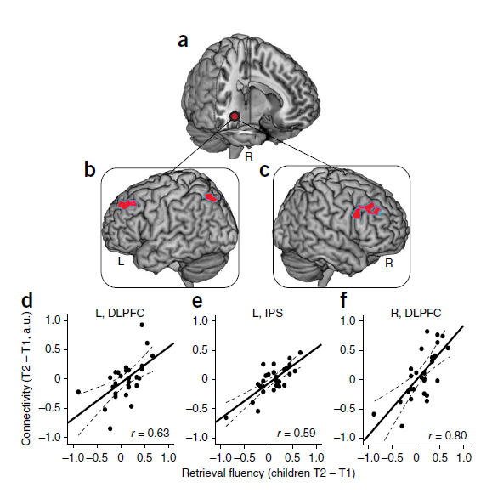
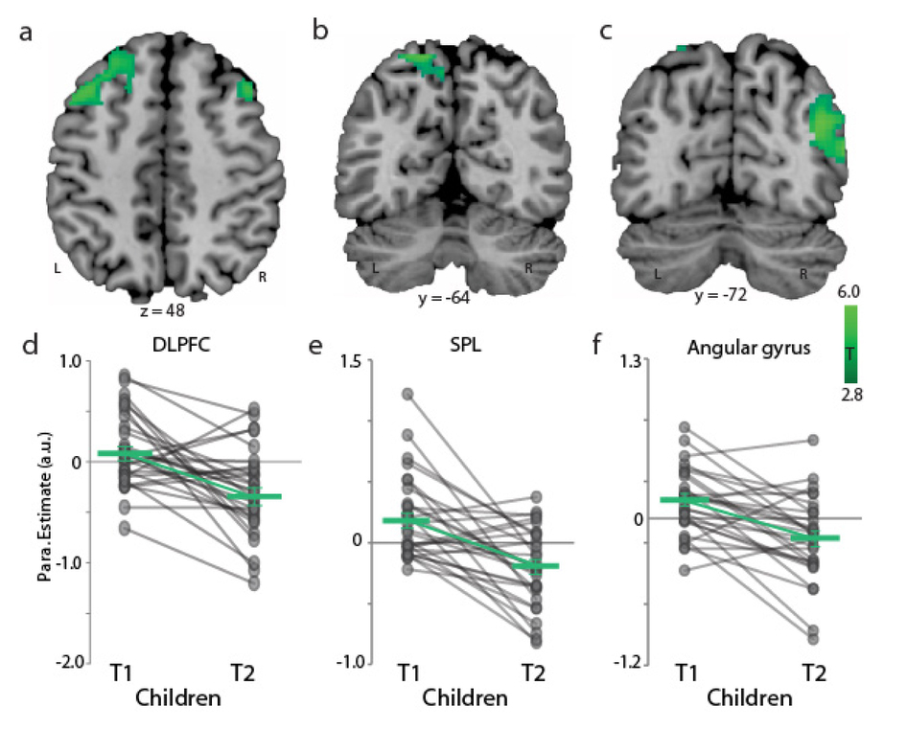
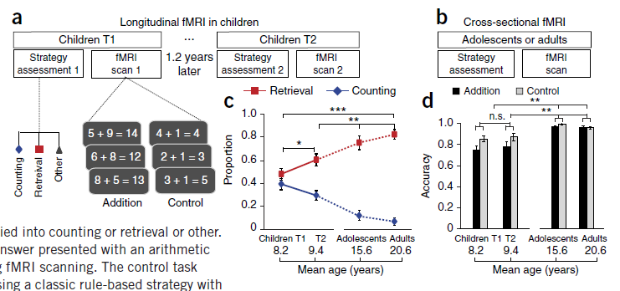
Short-term intensive training recapitulates long-term hippocampal-neocortical functional reorganization during arithmetic learning
Miriam Rosenberg-Lee^{1,2}, Dietsje Jolles^{1,3}, Se Ri Bae¹, Jennifer Richardson¹, Shaozheng Qin¹, Teresa Iuculano¹, & Vinod Menon^{1,2}
¹Department of Psychiatry & Behavioral Sciences, ²Stanford Neuroscience Institute,
Stanford University School of Medicine, Stanford, CA 94304
³Education and Child Studies, Leiden University, Wassenaarseweg 52, 2333 AK Leiden, The Netherlands
Qin, Cho, Chen, Rosenberg-Lee, Geary, Menon. (2014) Hippocampal-neocortical functional reorganization underlies children’s cognitive development. Nature Neuroscience, Sept (9): 1263-9.
Result 2: Increased hippocampal activity
Result 4: Increased hippocampal to frontal and parietal connectivity correlated with changes in retrieval
3 + 8 =
8 + 3 =
8 + 3 =
3, 4, 5,
6, 7, 8,
9, 10, 11
8 + 2 + 1 =
Memory
8, 9, 10, 11
10 + 1 =
11
Result 3: Decreased frontal and parietal activity
Result 1: Increased retrieval use
Result | Longitudinal Group 1.2 Years No Contact | Training Group 8 weeks Tutoring | Control Group 8-weeks No Contact
Increased retrieval use | Yes | No (correlate with initial retrieval) | No
Increased hippocampal activity | Yes | Yes | No
Decreased frontal and parietal activity | Yes | Correlate with Δ Retrieval | No
Increased hippocampal to frontal and parietal connectivity correlated with changes in retrieval | Yes | Yes (to parietal) | No

Slide 3
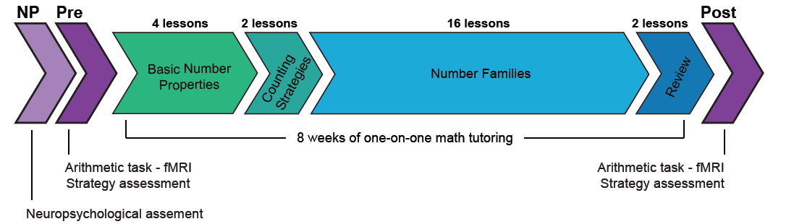
Short-term intensive training recapitulates long-term hippocampal-neocortical functional reorganization during arithmetic learning
Miriam Rosenberg-Lee^{1,2}, Dietsje Jolles^{1,3}, Se Ri Bae¹, Jennifer Richardson¹, Shaozheng Qin¹, Teresa Iuculano¹, & Vinod Menon^{1,2}
¹Department of Psychiatry & Behavioral Sciences, ²Stanford Neuroscience Institute,
Stanford University School of Medicine, Stanford, CA 94304
³Education and Child Studies, Leiden University, Wassenaarseweg 52, 2333 AK Leiden, The Netherlands
Training Group
8-weeks training
N=19
Neuropsychological
Assessment
Time 1
MRI Scan
Strategy Assessment
Time 2
MRI Scan
Strategy Assessment
Control Group
No training
N=15

Slide 4
Short-term intensive training recapitulates long-term hippocampal-neocortical functional reorganization during arithmetic learning
Miriam Rosenberg-Lee^{1,2}, Dietsje Jolles^{1,3}, Se Ri Bae¹, Jennifer Richardson¹, Shaozheng Qin¹, Teresa Iuculano¹, & Vinod Menon^{1,2}
¹Department of Psychiatry & Behavioral Sciences, ²Stanford Neuroscience Institute,
Stanford University School of Medicine, Stanford, CA 94304
³Education and Child Studies, Leiden University, Wassenaarseweg 52, 2333 AK Leiden, The Netherlands
Flash Cards
Math Wars

Slide 5

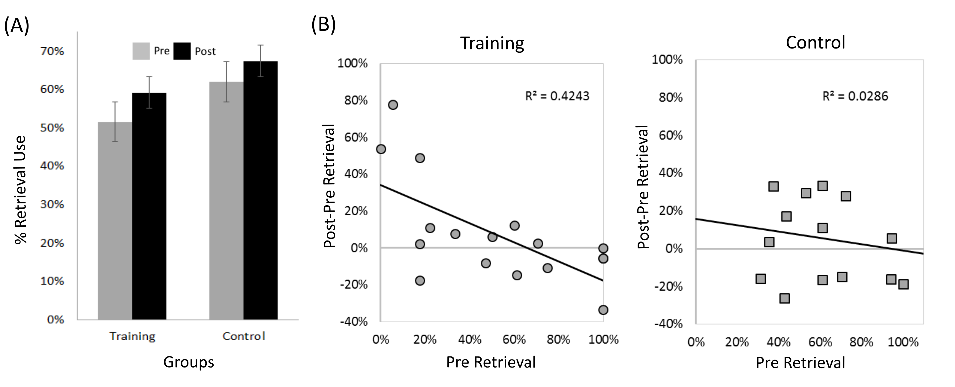
Short-term intensive training recapitulates long-term hippocampal-neocortical functional reorganization during arithmetic learning
Miriam Rosenberg-Lee^{1,2}, Dietsje Jolles^{1,3}, Se Ri Bae¹, Jennifer Richardson¹, Shaozheng Qin¹, Teresa Iuculano¹, & Vinod Menon^{1,2}
¹Department of Psychiatry & Behavioral Sciences, ²Stanford Neuroscience Institute,
Stanford University School of Medicine, Stanford, CA 94304
³Education and Child Studies, Leiden University, Wassenaarseweg 52, 2333 AK Leiden, The Netherlands
Qin (2014) Result 1: Increased retrieval use
Accuracy and reaction time improvements in the training group only
No increase in retrieval strategy use but correlates in initial level in the training group only

Slide 6
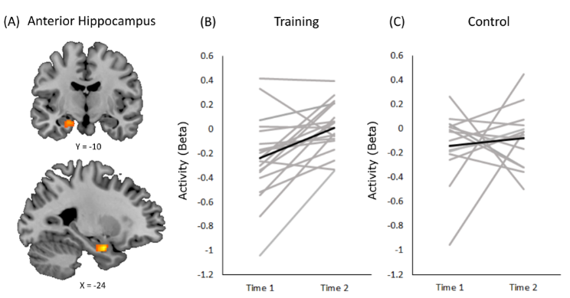
Short-term intensive training recapitulates long-term hippocampal-neocortical functional reorganization during arithmetic learning
Miriam Rosenberg-Lee^{1,2}, Dietsje Jolles^{1,3}, Se Ri Bae¹, Jennifer Richardson¹, Shaozheng Qin¹, Teresa Iuculano¹, & Vinod Menon^{1,2}
¹Department of Psychiatry & Behavioral Sciences, ²Stanford Neuroscience Institute,
Stanford University School of Medicine, Stanford, CA 94304
³Education and Child Studies, Leiden University, Wassenaarseweg 52, 2333 AK Leiden, The Netherlands
Qin (2014) Result 2: Increased hippocampal activity
Increased hippocampal activity in the Training Group only

Slide 7

Short-term intensive training recapitulates long-term hippocampal-neocortical functional reorganization during arithmetic learning
Miriam Rosenberg-Lee^{1,2}, Dietsje Jolles^{1,3}, Se Ri Bae¹, Jennifer Richardson¹, Shaozheng Qin¹, Teresa Iuculano¹, & Vinod Menon^{1,2}
¹Department of Psychiatry & Behavioral Sciences, ²Stanford Neuroscience Institute,
Stanford University School of Medicine, Stanford, CA 94304
³Education and Child Studies, Leiden University, Wassenaarseweg 52, 2333 AK Leiden, The Netherlands
Qin 2014 Result 3: Decreased frontal and parietal activity
Decreased frontal and parietal activity correlates with change in retrieval use, but only in the Training Group.

Slide 8
Short-term intensive training recapitulates long-term hippocampal-neocortical functional reorganization during arithmetic learning
Miriam Rosenberg-Lee^{1,2}, Dietsje Jolles^{1,3}, Se Ri Bae¹, Jennifer Richardson¹, Shaozheng Qin¹, Teresa Iuculano¹, & Vinod Menon^{1,2}
¹Department of Psychiatry & Behavioral Sciences, ²Stanford Neuroscience Institute,
Stanford University School of Medicine, Stanford, CA 94304
³Education and Child Studies, Leiden University, Wassenaarseweg 52, 2333 AK Leiden, The Netherlands
Qin (2014) Result 4: Increased hippocampal to frontal and parietal connectivity correlated with changes in retrieval
Increased hippocampal to parietal connectivity correlated with changes in retrieval, in Training Group only.

Slide 9
Short-term intensive training recapitulates long-term hippocampal-neocortical functional reorganization during arithmetic learning
Miriam Rosenberg-Lee^{1,2}, Dietsje Jolles^{1,3}, Se Ri Bae¹, Jennifer Richardson¹, Shaozheng Qin¹, Teresa Iuculano¹, & Vinod Menon^{1,2}
¹Department of Psychiatry & Behavioral Sciences, ²Stanford Neuroscience Institute,
Stanford University School of Medicine, Stanford, CA 94304
³Education and Child Studies, Leiden University, Wassenaarseweg 52, 2333 AK Leiden, The Netherlands
Result | Longitudinal Group 1.2 Years No Contact | Training Group 8 weeks Tutoring | Control Group 8-weeks No Contact
Increased retrieval use | Yes | No (correlate with initial retrieval) | No
Increased hippocampal activity | Yes | Yes | No
Decreased frontal and parietal activity | Yes | Correlate with change in retrieval | No
Increased hippocampal to frontal and parietal connectivity correlated with changes in retrieval | Yes | Yes (to parietal) | No

