Slide 1
Increasing Women in Neuroscience (IWiN) Toolkit
Candidate Recruitment and Evaluation
Created by the Professional Development Committee
of the Society for Neuroscience
Notes:
This presentation should take approximately 30 minutes to complete.
Module Objective: By the end of this presentation, the audience will have a greater awareness of the problems and challenges women face in the recruitment and evaluation process in academia. They will also have strategies to avoid and remediate common mistakes in hiring as they pertain to gender bias.
Information provided in this presentation – and the supplemental materials – is an extension of the grant funded, Department Chair Training to Increase Women in Neuroscience project.

Slide 2
The Problem: The Leaky Pipeline
Notes:
This data was obtained from a 2011 Neuroscience Training Survey of Graduate, Postdoctoral, & Undergraduate Programs organized by the Society for Neuroscience’s Committee on Neuroscience Departments and Programs. The full survey can be found on the sfn.org website.
The phrase ”leaky pipeline” is often used to describe gender retention issues of women in high ranking positions within academia. So what does this look like?
This chart illustrates the percentage of women in neuroscience, at a particular career stage and the “leak” (in most cases) of women that is present as they transition from one career level to the next. This is particularly prevalent in the transition to tenure track faculty.

Slide 3
Women were 24% of the faculty in 1998 and in 2011 were only 29% of the total
Notes:
This data was obtained from a 2011 Neuroscience Training Survey of Graduate, Postdoctoral, & Undergraduate Programs , organized by the Society for Neuroscience’s Committee on Neuroscience Departments and Programs. The full survey can be found on the sfn.org website.
A deeper look into the academic ranks shows little growth of the percentage of women in non-tenure tracks.

Slide 4
Growth of women neuroscientists in tenure-track faculty positions is slow (% total)
Year | Graduate Student | Postdoc | Non- Tenure Track | Tenure Track | Assistant Professor | Associate Professor | Full Professor
1986 |  |  |  | 15 | 23 | 20 | 9
1991 |  |  |  |  | 27 | 22 | 13
1998 |  |  |  | 24 | 32 | 27 | 19
2000 | 47 | 40 | 43 | 21 | 30 | 26 | 14
2003 | 50 | 42 | 43 | 25 | 33 | 28 | 21
2005 | 52 | 41 | 38 | 25 | 32 | 27 | 21
2007 | 52 | 44 | 44 | 26 | 36 | 28 | 21
2009 | 54 | 37 | 44 | 29 | 34 | 31 | 26
2011 | 57 | 38 | 40 | 29 | 34 | 32 | 23
*Data from ANDP and SfN Neuroscience Training Survey of Graduate, Postdoctoral, & Undergraduate Programs
Notes:
Presenter Note: optional slide
Presenter Note: animation exists on this slide
Another illustration of the problem for women in tenure-track positions can be seen by observing the highlighted columns. The first shows the percentage of women who were in tenure track positions between 1986 and 2011. The second highlighted column shows the percentage of women who were full professors during that same range. Neither group experience significant growth over the shown reporting period.

Slide 5
The Leaky Pipeline: Across STEM
Discipline/Field | PhD | Postdoc | Total Faculty
Neuroscience (1) | 52 | 44 | 29
Physiology (2) | 48 | 44 | 23
Chemistry (3) | - | - | 14
Life Sciences (4) | 49 | 40 | 32
Doctoral Univ (5) | - | - | 30
Computer Science (6) | 21 | - | 21*
Engineering (6) | 20 | - | 10*
(1) = 2011 Neuroscience Training Survey of Graduate, Postdoctoral, & Undergraduate Programs
(2) = Association of Chairs of Departments of Physiology 2007 Survey (The Physiologist 51:87, 2008)
(3) = Chemical and Engineering News 2006 Survey (C&EN 84:58, 2006)
(4) = NSF Survey of Earned Doctorates 1998-2005; Survey of Doctoral Recipients 1973-2006
(5) = American Association of University Professors Faculty Equity Indicators 2006
(6) = NSF Survey of Women in Faculty S&E Positions 1958-2006
* Percentages are representative of tenured and tenure track faculty only
Notes:
Presenter Note: optional slide
Furthermore, this problem is not unique to the field of neuroscience. The chart above shows the percentage of women across STEM (STEM = science, technology, engineering, and mathematics) fields at the PhD, Postdoc, and faculty level.

Slide 6
2009 Neuroscience Training Survey
“At the most recent rate of increase, it could take as long as four decades before women comprise 50% of the tenure-stream faculty members in neuroscience unless graduate programs become even more committed than they now are to a policy of gender equality in their faculty. A similar statement can be made regarding members of underrepresented U.S. racial and ethnic minorities among faculty in graduate neuroscience programs.”
Notes:
Presenter Note: This is a reinforcement slide of the data results. This could be discussed, shown to reinforce the previous slides, or omitted.
CNDP = Committee on Neuroscience Departments and Programs

Slide 7
What is Causing the Leaky Pipeline?
Why has the representation of women in the professorate remained low at 25% tenure track female faculty and 21% female full professors?
  Not due to a failure to recruit at the graduate student level.
  A disproportionate number of women graduates fail to secure tenure track positions.
  Fewer women are promoted from Asst. Prof to Assoc. and Full Professor.
Notes:
What is evident is that women are entering into the field, but somewhere they are dropping off and not making it to the full professor and tenure track roles. So what can be done?

Slide 8
The Leaky Pipeline: What Can Be Done?
Understand Implicit Bias
Employ Open Recruitment and Evaluation Practices (this module)
Mentoring, Promotion and Tenure Practices
Address Workplace Climate Issues
Notes:
Presenter Note: Bolded text refers to this module – the other bullets refer to the other modules. Together, these bullet points provide a complete view of the resources available through the Society for Neuroscience and show that these issue are not isolated – nor are the remediation approaches. Instead, these issues need to be addressed in tandem in order to advance women in STEM academia.
There are many stages along an individual career path that can influence outcome of professional success and progression. What the research does show is that implicit bias can play a heavy role in determining outcomes of that progression, including during the recruitment and evaluation process of candidates for positions at an institution.
The next slides will provide an overview of ways to remediate this issue, including employing the use of open recruitment practices.

Slide 9
Recruiting Strategies to Increase Diversity
Prime the pump – searching begins before position is available
Search committee composition
Job description – “open” searches
Advertisement and active recruiting
Promote awareness of the issues
Interviewing tips

Slide 10
Recruiting Strategies to Increase Diversity
Cast a wide net
Open Searches: Define the position in the widest possible terms consistent with the department’s needs.
Be proactive: Seek out people you think are right for the job, even if they're not actively looking.
Notes:
Presenter Note: An example of an open search description might simply, indicate “a behavioral neuroscientist” or “a neuroscientist interested in neural mechanisms of behavior, broadly defined”. Women and URMs are less likely to respond to a narrowly defined job description than white males, and that white males are more likely to respond even if the description does not precisely match their background.

Slide 11
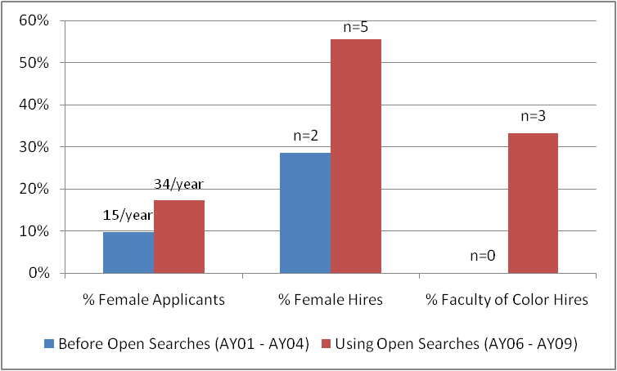
Active Recruiting and Open Searches: A University of Michigan Success Story
The difference achieved by one UMich department
Notes:
- Data and graph courtesy of the University of Michigan STRIDE / ADVANCE program.

Slide 12
Qualitative Feedback on the Use of Open Searches at University of Michigan
"The open searches led to both a larger number of applicants AND a more diverse applicant pool."
"I was not sure if the ‘open search’ is the best way to attract the best candidates to apply for job. I am convinced now it is indeed an excellent strategy to add ‘new blood’ to our department."
"The open searches led to a department-wide discussion of all of the applicants. This has the added benefit of everyone on the faculty knowing the candidate and being invested in their success from their first day on campus."
Notes:
University of Michigan Faculty Experience with Open Searches Has Been Positive

Slide 13
Evaluation of Candidates and Reviewing Applications

Slide 14
Promote Awareness of Evaluation Bias
Awareness of evaluation bias is a critical first step
  Blind Auditions
  CVs and Resumes
  Letters of Recommendation
  (see module 1, Implicit Bias for more information)
Spread awareness to entire search committee.
Understand that evaluation bias can be counteracted.
Bauer and Baltes, 2002, Sex Roles 9/10, 465.

Slide 15
Evaluation of Identical CVs: Gender
When evaluating identical application packages, both male and female University psychology professors preferred 2:1 to hire “Brian” over “Karen” as an assistant professor.
When evaluating a more experienced record (at the point of promotion to tenure), reservations were expressed four times more often when the name was female.
Karen
Brian
Science faculty’s subtle gender biases favor male students
Corinne A. Moss-Racusina,b, John F. Dovidiob, Victoria L. Brescollc, Mark J. Grahama,d, and Jo Handelsmana,
PNAS (2012)
Steinpreis, Anders, & Ritzke (1999) Sex Roles, 41, 509.

Slide 16
Evaluation of Identical Resumes: Race
Applicants with African American- sounding names had to send 15 resumes to get a callback, compared to 10 needed by applicants with white-sounding names.
White names yielded as many more callbacks as an additional eight years of experience.
Jamal
Greg
Bertrand & Mullainathan (2004) American Economic Review, 94 (4), 991-1013.

Slide 17
Why do race cues produce different evaluations? Ambiguity in Job Credentials: Race
Identical resumes, but ambiguous fit of credentials to job (rather than ambiguous credentials)
  A sample of white evaluators recommended
    Black candidate 45% of the time
    White candidate 76% of the time
With awards - criteria can shift to meet the strengths of individual (white male) candidates if due diligence is not paid.
    Dovidio & Gaertner (2000). Psychological Science, 11, 315-319.

Slide 18
Evaluation of Fellowship Applications: Gender
“…the success rate of female scientists applying for postdoctoral fellowships at the [Swedish Medical Research Council] during the 1990s has been less than half that of male applicants.”
Wenneras & Wold (1997) Nature, 387, 341.
Notes:
Women applying for a post- doctoral fellowship had to be 2.5 times more productive to receive the same reviewer rating as the average male applicant.
Similar findings: USA/GAO report on Peer Review in Federal Agency Grant Selection (1994); European Molecular Biology Organization Reports (2001); NIH Pioneer Awards: Journal of Women’s Health (2005) & Nature (August 2006)

Slide 19
Letters of Recommendation for Successful Medical School Faculty Applicants
Letters for men:
  Longer
  More references to:
    CV
    Publications
    Patients
    Colleagues
Letters for women:
  Shorter
  More references to personal life
  More “doubt raisers” (hedges, faint praise, and irrelevancies)
    “It’s amazing how much she’s accomplished.”
    “It appears her health is stable.”
    “She is close to my wife.”
Trix & Psenka (2003) Discourse & Society, Vol 14(2): 191-220.

Slide 20
Critical Mass Affects the Use of Implicit Bias in Evaluations
When there are many individuals, we differentiate among them and cannot rely on group-based schemas.
In both experimental and field settings, increasing the female share of those being rated increased ratings of female applicants and employees.
Valian (1998) Why So Slow? The Advancement of Women. Cambridge: MIT Press, p. 280;
Heilman (1980) Organizational Behavior and Human Performance, 26: 386-395;
Sackett et al (1991), Journal of Applied Psychology, 76(2): 263-267.
Notes:
20

Slide 21
Lowered success rate
If We Do Not Actively Intervene,
The Cycle Reproduces Itself
Accumulation of disadvantage
Inertia
Performance is underestimated
Solo status/Lack of critical mass
Evaluation bias
Schemas

Slide 22
Focus on Multiple Specific Criteria During Evaluation
Weigh judgments that reflect examination of all materials and direct contact with the candidate.
Specify evaluations of scholarly productivity, research funding, teaching ability, ability to be a conscientious departmental/university member, fit with the department’s priorities.
Avoid “global” evaluations
Bauer and Baltes, 2002, Sex Roles 9/10, 465.

Slide 23
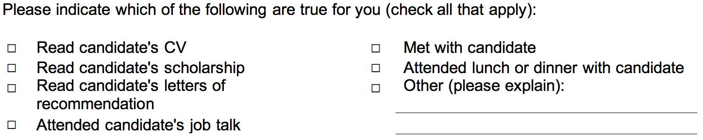
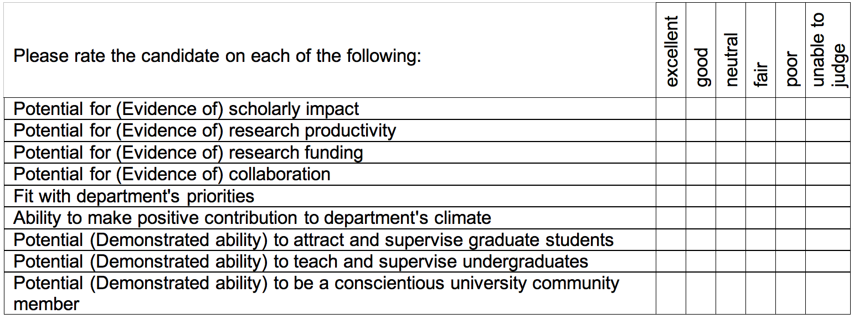

Candidate Evaluation Tool
http://www.umich.edu/%7Eadvproj/CandidateEvaluationTool.doc
Notes:
Presenter Note: Forms are available from the University of Michigan ADVANCE program.
Use an evaluation tool that has specific criteria and ask the evaluator to indicate the degree of their involvement with the candidate’s materials and the candidate.

Slide 24
Reviewing Applications
Be objective
Use clear ranking criteria
Get input from institutional leaders
Evaluate the interview process
Notes:
Be objective: Develop a tool for all members of the search committee to fill out about each candidate. An objective tool will help everyone stay on task and focus on each candidate's strengths and weaknesses. The most objective evaluations of application materials are those that are the most specific.
Ranking criteria: Since implicit bias can creep into application materials, such as letters of recommendation, be sure to rank candidates on several different criteria, rather than using a single aggregate ranking. Evaluation forms that contain a rubric for each scoring category also helps to mitigate bias. A glance at a publications list or curriculum vitae is not enough.
Get input from institution leaders: Require search committees to submit their short lists for candidates to senior-level institution officials to further ensure that bias has been minimized.
Evaluate the interview process: Before candidates leave the campus after their interview, have someone not on the search committee conduct an exit interview with each candidate to see how it went and identify any problem areas.

Slide 25
Interviewing Tips
Bringing in more than one female and/or minority candidate can disproportionately increase the likelihood that a woman and/or minority will be hired.
Treat female and minority faculty applicants as scholars and educators, not as just female or minority scholars and educators.
Ensure that all candidates will meet a diverse set of people so that they are more likely to meet someone like them.
Heilman , 1980, Organizational Behavior and Human Performance, 26: 386-95.
Hewstone et al., 2006, Group Processes & Intergroup Relations, 9(4): 509–532.
Huffcutt & Roth, 1998, Journal of Applied Psychology, 83(2): 179-189.
Van Ommeren et al., 2005, Psychological Reports, 96: 349-360.

Slide 26
Asking Non-Job-Related Questions
Can Be Counter-Productive
In a 2007 study of candidates for positions at a Univ Michigan department, who withdrew from searches or turned down offers, several women mentioned that they had been asked illegal and discriminatory questions about their personal lives.
  One candidate reported that she did not answer truthfully (knew the “right” answer and gave it)
  One candidate reported that she resented the questions
Notes:
- In addition to being counterproductive, asking non-job related questions is a violation of Federal Equal Employment Opportunity (EEO) laws and regulations, which prohibit discrimination against applicants on the basis of race, color, religion, sex, national origin, age, handicapping condition, marital status, or political affiliation.

Slide 27
Dual Career Issues Should Not be Discussed by the Search Committee
Identify someone with whom the candidate can have a confidential conversation in which they could ask questions they don’t want to ask the search committee.
Ensure all candidates know about dual career support mechanisms available at your institution.
Support for dual careers enhances both recruitment and retention of men and women.

Slide 28
Top Mistakes in Recruitment
Committee or faculty make summary judgments about candidates without using specific criteria.
Committee does not have a diverse pool.
The committee discussed information about the candidate that is inappropriate.
Asking counter-productive questions.
Telling a woman or underrepresented minority candidate that "we want you because we need diversity."
The candidate does not meet others like themselves during the visit.

Slide 29
Cognitive Errors during Evaluation
Negative stereotypes: far more evidence is required to be certain an individual has an “unexpected” attribute (competence)
Positive stereotypes: earn extra points due to presumption of competence
Raising the bar: happens during evaluation when candidate is member of group thought to be suspect/incompetent
Elitism
First impressions (dress, posture, laughter)

Slide 30
Mistakes During Recruitment
The longing to clone: reproducing self, search committee members, retiring faculty member
Good fit/Bad fit: Will we feel comfortable and culturally at ease?
Provincialism: undervaluing something outside own province, circle or clan

Slide 31
Mistakes During Recruitment
Distorting and ignoring evidence:
  Extraneous myths (no qualified women or URMs) and psychoanalyzing candidate (candidate won’t come because too rural/small, salary too low)
  Wishful thinking (rhetoric, not evidence); holding to notion in spite of overwhelming evidence to contrary, allowing it to cloud cognitive processes
  Self-fulfilling prophecy: set up situations that spotlight person in positive or negative way
  Character over context: e.g., lack of awareness of implicit bias in teaching evaluations
  Premature ranking/digging in
  Momentum of the group

Slide 32
Mistakes During Recruitment
These mistakes contaminate and undermine the credibility and equity of various evaluation reviews; they are magnified by bad practices at the organizational level

Slide 33
What Else Can Be Done?
Make a high quality offer
Employ family friendly work practices
Equitable teaching, minimal committee work (at the start), a mentoring plan.
Notes:
The job will be even more appealing if the offer includes a reasonable salary and space and equipment for research.
Paid leave / modified duties for the birth or adoption of a child; Extension of the tenure clock 1 yr for both parents if contributing 50% of care; Hold faculty meetings and seminars at times that don’t compete with parental responsibilities
Best practices for promotion and tenure begin when a faculty member is hired; Look at procedures and process for promotion and tenure to insure fairness.

Slide 34
Conclusions
Implicit bias affects evaluation.
Cast a wide net.
Open searches enhance recruitment of women and minorities.
Use explicit evaluation criteria in selection of candidates to interview and in evaluation of candidates after the interview.
Avoid cognitive errors during interview and evaluations.
Notes:
Better understanding the leaky pipeline and its causes is an important step to fixing the problem.
Proven success strategies, that cast a wide recruitment net (such as open searches) provides can provide an increased pool of qualified candidates.
Further remediation includes creating explicit criteria that can help reduce cognitive errors during the evaluation process

