Slide 1
International Exchange Programs to Enhance Neuroscience Education
Mary Harrington
Smith College
March 30, 2012

Slide 2
Benefits of international experiences?
Broaden global understanding
Build international collaborations
Increase awareness of international graduate training opportunities
Build fluency in another language
Broaden exposure to range of questions in neuroscience

Slide 3
Challenges for the student
Difficult to find time within academic year
Fluency of an intermediate student may not allow science courses taken in the local language
Timing of semesters
Cost
Challenges for the host institution
Uneven preparation of visiting students
Limited space in courses and laboratories

Slide 4
Summer Programs
More flexibility for scheduling
Can allow time for laboratory internship after course work
Less opportunities for financial aid for students

Slide 5
UConn Neuroscience Program in Salamanca Spain
5 week Summer program May 20-June 22, 2012
Initially focused on neurobiology of hearing, a shared area of expertise among faculty at both institutions
Now also offers Introductory Neuroscience and Spanish language courses.
Neurobiology courses are taught in English

Slide 6
Summer internships for students in US, Canada, and UK
Undergraduate is matched with a German graduate student mentor
Stipend support for circa 300 students per year
Working language is English

Slide 7
Minority Health and Health Disparities International Research Training (MHIRT) Program at Christian Brothers University
Paid summer research internships in Brazil and Uganda (NIH support)
Targeted to students from socially or economically under-represented groups
Undergraduate, graduate, or medical students

Slide 8
4 Week Seminar Style Course in Munich and Berlin.
Combination of Talks, Laboratory Exercises and Demonstrations
Program Dates: May 21st – June 18th 2011

Slide 9
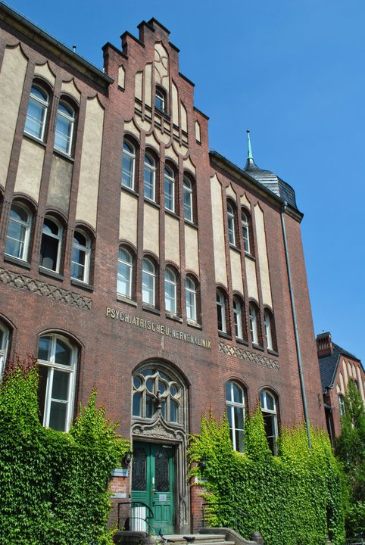
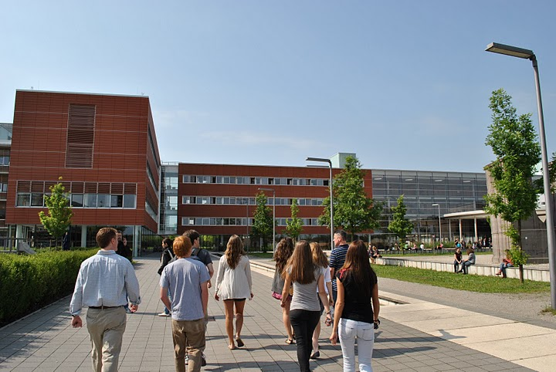
Partner Universities
Charité Medical University. Berlin
Ludwig Maximilians Universität (LMU).
Munich

Slide 10
Course Content and Organization
Content
History of Behavioral Neuroscience (Munich and Berlin)
Comparative and Systems Level Neuroscience (Munich)
Neurophysiology and Medical Neuroscience (Berlin)
Organization
Background Reading and Lectures
Faculty Seminar / Research Talks
Critical Analysis of Primary Research Articles and Reviews
Student Presentations and Discussion
Journal Club Style Written Reports and Discussion.
Lab Exercises and Demonstrations
Information on Graduate Programs; Interactions with Grad Students
Site Visits and Excursions

Slide 11
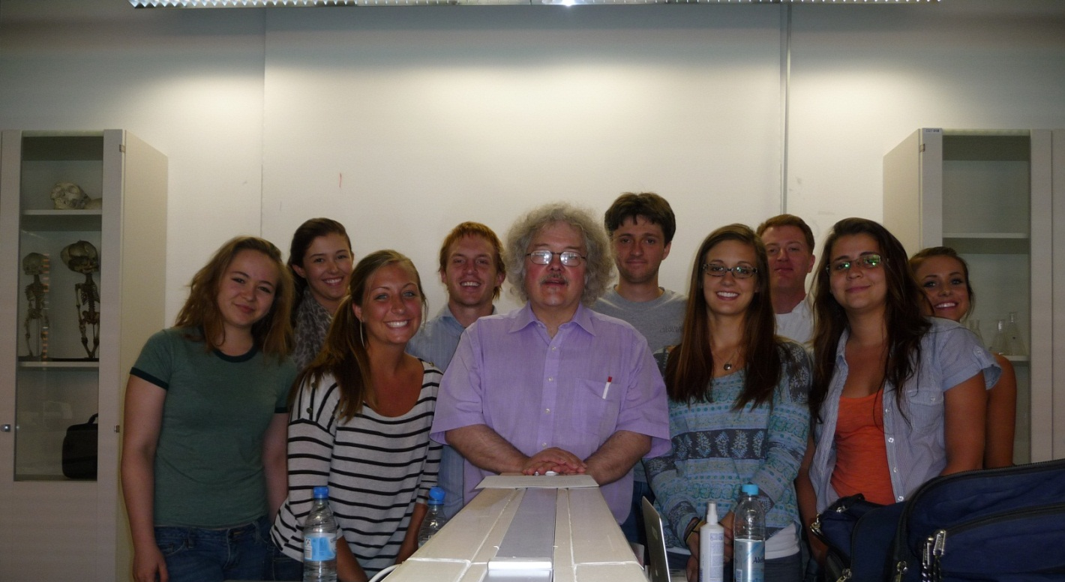
Dr. Mario Wullimann LMU
Neuroanatomy and Evolution of Vertebrate Brains
Laboratory Exercise: Identification of vertebrate brains via histology
Telencephalic evolution

Slide 12
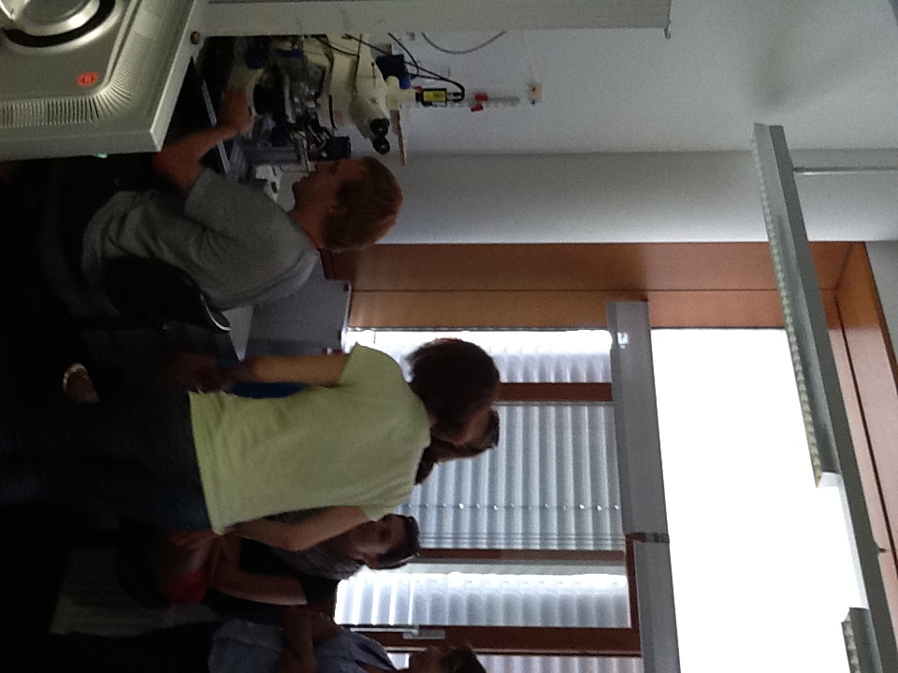
Dr. Oliver Behrend & Dr. Alex Kaiser LMU
Patch and Voltage Clamping
Auditory Physiology

Slide 13
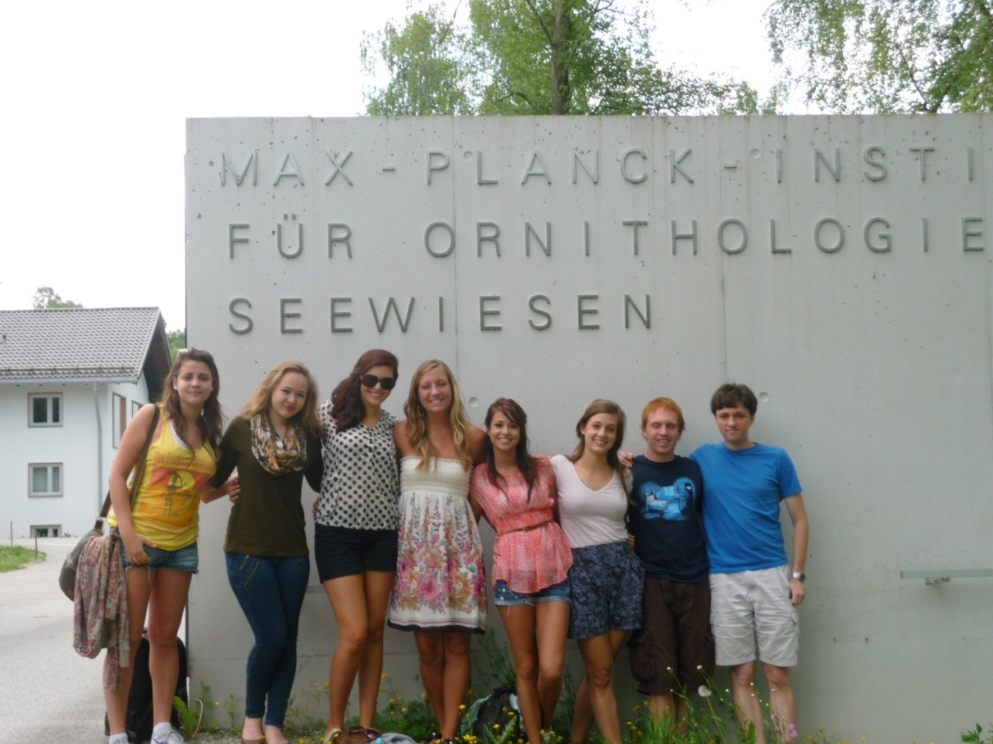
Max Planck Institute for Ornithology
Dr. Moritz Hertel
Dr. Manfred Gahr
Research talks
Lab demonstration and facility tours

Slide 14
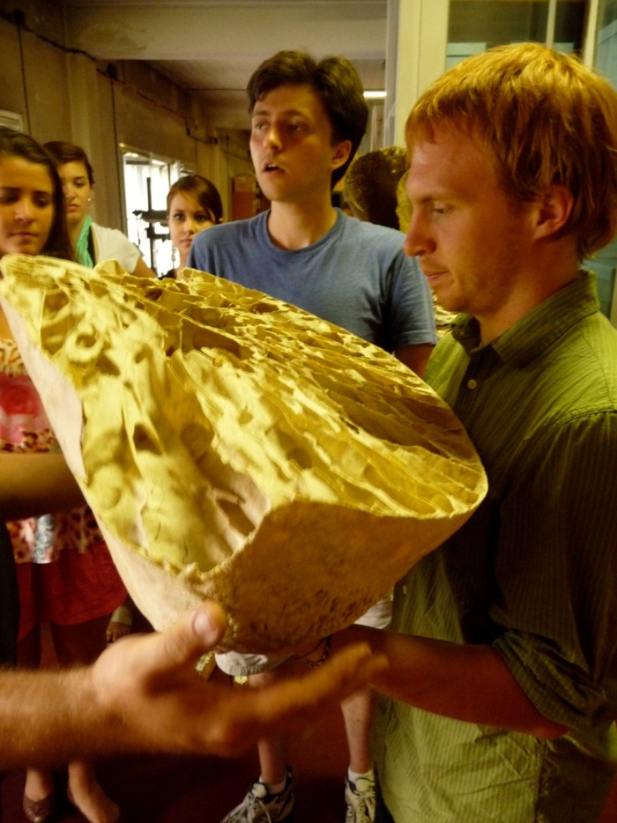
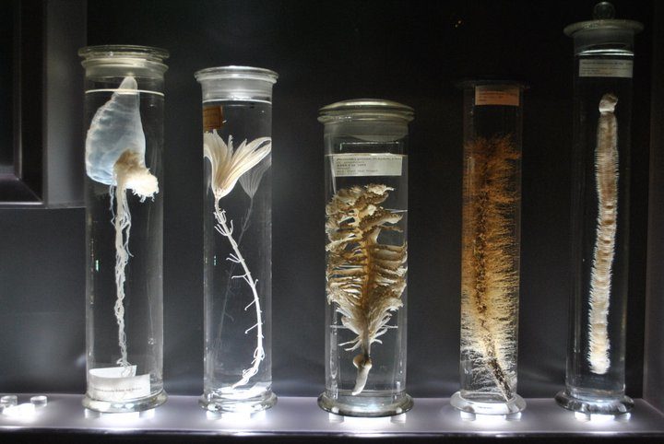
Dr. Peter Giere
Natural History Museum Berlin
Museum Collections
Brain Evolution
Embryology

Slide 15
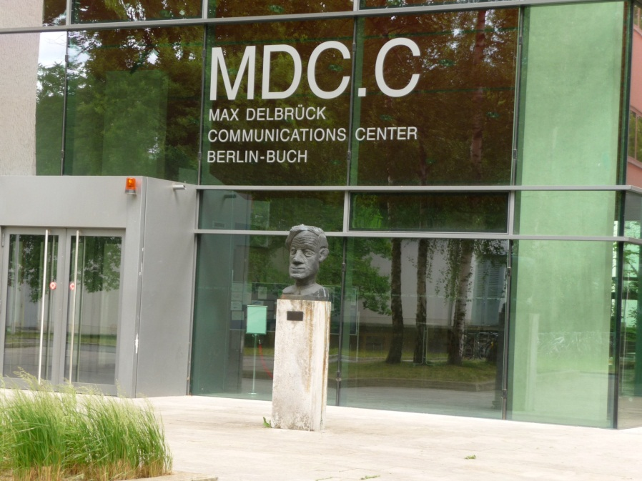
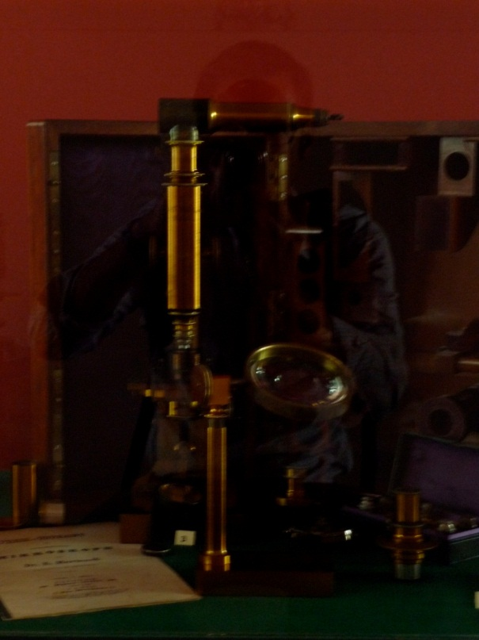
Dr. Helmut Kettenmann
Berlin-Buch Campus
History of Microscopy
Golgi’s Microscope – Made in Berlin

Slide 16
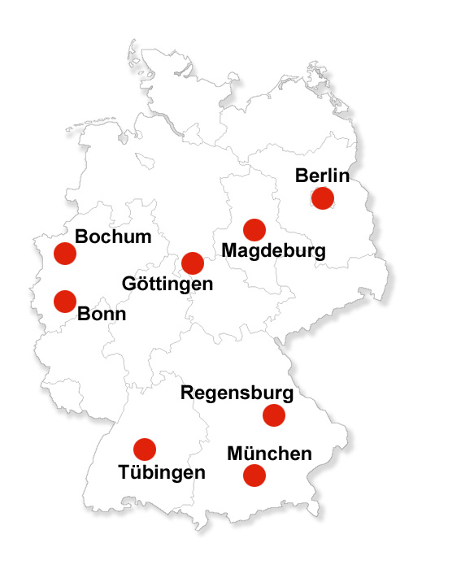
Planning and Preparation
Site Visits – Summer of 2010
Berlin, Göttingen, Munich.
Correspondence with graduate program directors to coordinate faculty contributions and facilities at each university
Develop themes and identify primary research articles.

Slide 17
Credits and tuition
College of Charleston
Course is offered through CofC, enrollment is open to students from any US university
Transfer Credit
Program Fee $4,450
Travel reservations , housing, meals
Site Visits and Excursions
Faculty Travel and Per Diem
Tuition for a four credit summer course $1500 (in state, SC) or $1950.

Slide 18
Academic Year Programs
Can allow time for laboratory research projects
Students can often apply regular financial aid
More in-depth experience for the student

Slide 19
A good option: visiting student programs at universities in the UK
I recommend to our undergraduates: University College and King’s College in London; University of Bristol; University of Manchester; Cambridge University; Cardiff University; Edinburgh
Academic year programs, often many excellent courses with laboratories
Generally no research project opportunities outside of classes

Slide 20
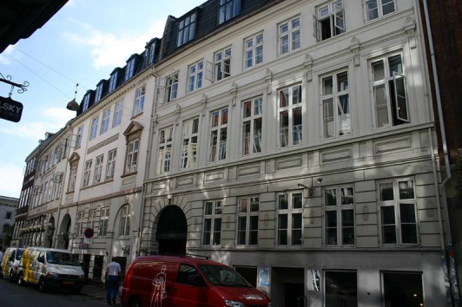
Academic year program taught in English, $15,125 per semester
Neuroscience courses offered (eg, “Neuroscience of fear”), Bioinformatics
Biotech Research Project for full-year students in the Biomedicine Program only. Students must have taken Medical Biotechnology & Drug Development core class taken in fall. Research projects will be completed in the spring.

Slide 21
12 Research Universities
Undergraduate or (post) graduate students
1-2 Semesters
Research Project, Literature review, Elective, Language
€ 9.975 per semester
Notes:
Belgium: Leuven University
Netherlands: Leiden University Utrecht University Universiteit van Amsterdam
Finland: University of Helsinki
Germany: Ruprecht Karls University, Heidelberg Ludwig-Maximilians University, Munich
Italy: Università degli Studi di Milano
Switzerland University of Zurich University of Geneva
Sweden Karolinska Insitutet, Stockholm

Slide 22
Institution University of Helsinki
Research Project Mitochondrial dysfunction underlying neurodegeneration
Project description Our research unit (FinMIT), an Academy of Finland Centre of Excellence, includes three closely integrated research teams. Two of them, led by Professor Howy Jacobs and Docent Hans Spelbrink are based in the Institute of Medical Technology of the University of Tampere. The third, led by Docent Anu Wartiovaara, is housed in Biomedicum Helsinki (the biomedical research institute of the University of Helsinki). The three teams have overlapping interests and complementary expertise. Howy Jacobs’ team uses both mammalian cell and fruit fly models to analyse mitochondrial gene expression and disease. Hans Spelbrink studies the genetic apparatus of mitochondrial DNA maintenance in mammalian cells, and collaborates closely with Anu Wartiovaara’s team to investigate the clinical and molecular consequences of mutations in these genes. Anu Wartiovaara’s main interest is to identify disease-causing genes and to clarify the disease pathogenesis in defects of the mitochondrial energy-generating system.
Pre requisites Excellent record in studies, curious and enthusiastic mind. Previous experience in cell biology.
Duration 2 semesters

Slide 23
Future plans?

Slide 24
nEURO – Neuroscience European Undergraduate Research Opportunities
Collaborative Efforts
Federation of European Neuroscience Societies (FENS) and the Network of European Neuroscience Schools (NENS).
Identification of labs that would provide research experience for undergraduates during a semester abroad

Slide 25
Your ideas?

