Slide 1
Master’s Degrees in a Biotechnology Environment
Susan D. Croll, PhD
Regeneron Pharmaceuticals
March 25, 2011

Slide 2
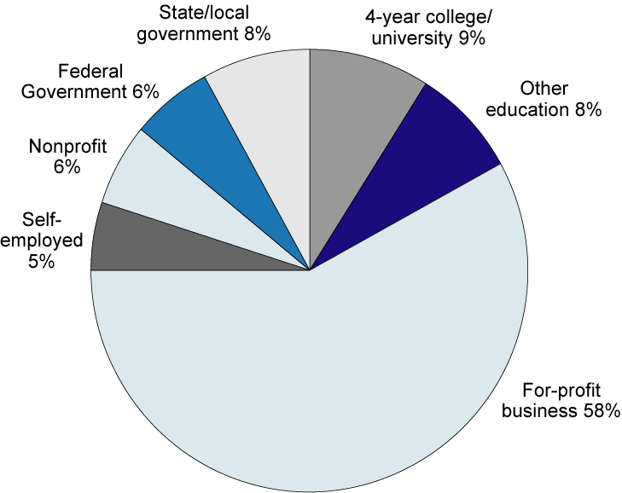
Employment sector of S&E degree holders: 1999
SOURCE: NSF Science and Engineering Indicators - 2004

Slide 3
Career Advisement for Terminal Neuroscience BA’s & MA’s in industry
Does student like the hands-on research?
Yes
No
Does student have strong laboratory skills?
Alternative Path
Entry-level support for:
-medical writing
-program management
-information gathering
-translational medicine
-”deep divers”
No
Yes
Encourage RA path

Slide 4
Regeneron (Biotechnology) Overview
Founded in 1988 - Corporate headquarters in Tarrytown, NY
  GMP manufacturing facility in Rensselaer, NY (10,000L Scale; expanding capacity to 50,000L)
  Currently more than 1300 employees
  Founded as a neurobiology company ; contributed to cloning and understanding of neurotrophin and Trk receptor family
Board of Directors is highly technical
  P. Roy Vagelos, M.D., Chairman of the Board (Former Chairman and CEO of Merck)
  Three Nobel Laureates (Mike Brown, Joe Goldstein, Al Gilman)
  Chief Scientific Officer, George Yancopoulos, M.D., Ph.D., elected to National Academy of Sciences
Partnership with Sanofi-Aventis : ~50:50 profit split for marketed monoclonal antibodies
Notes:
4

Slide 5
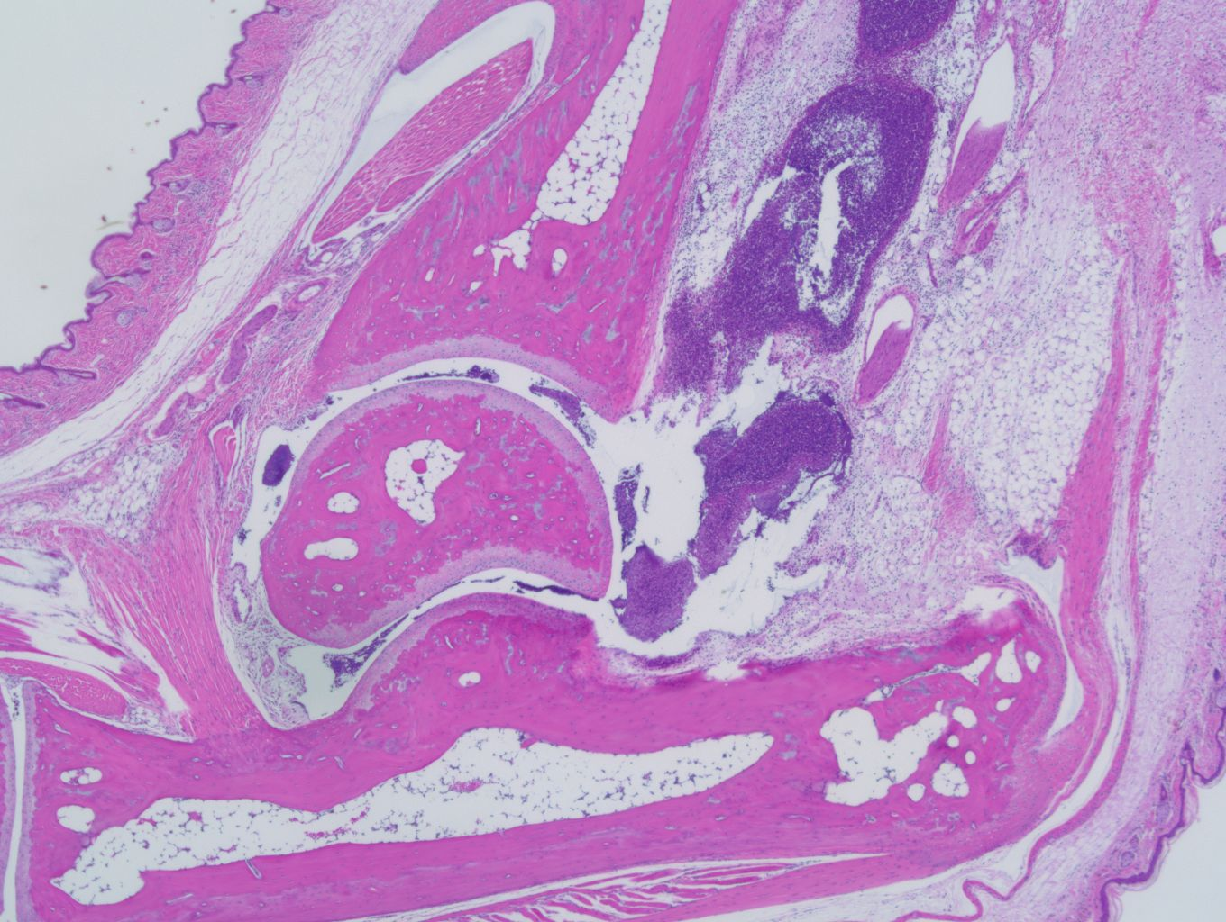
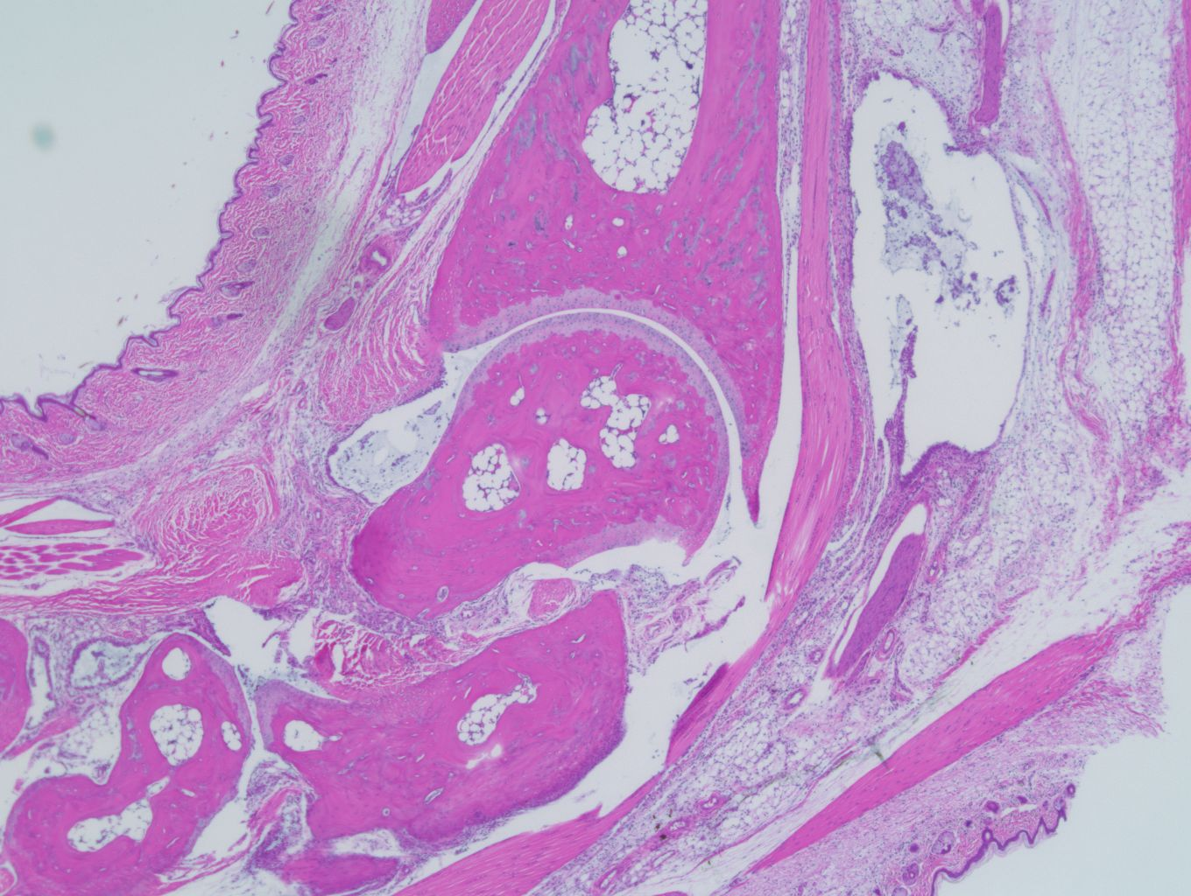
Find new treatments
Biotechnology: First Goal
Inflamed gouty joint
Inflamed gouty joint + IL-1 Trap

Slide 6
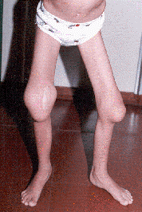
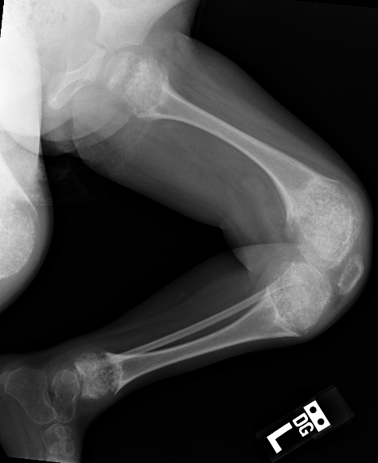
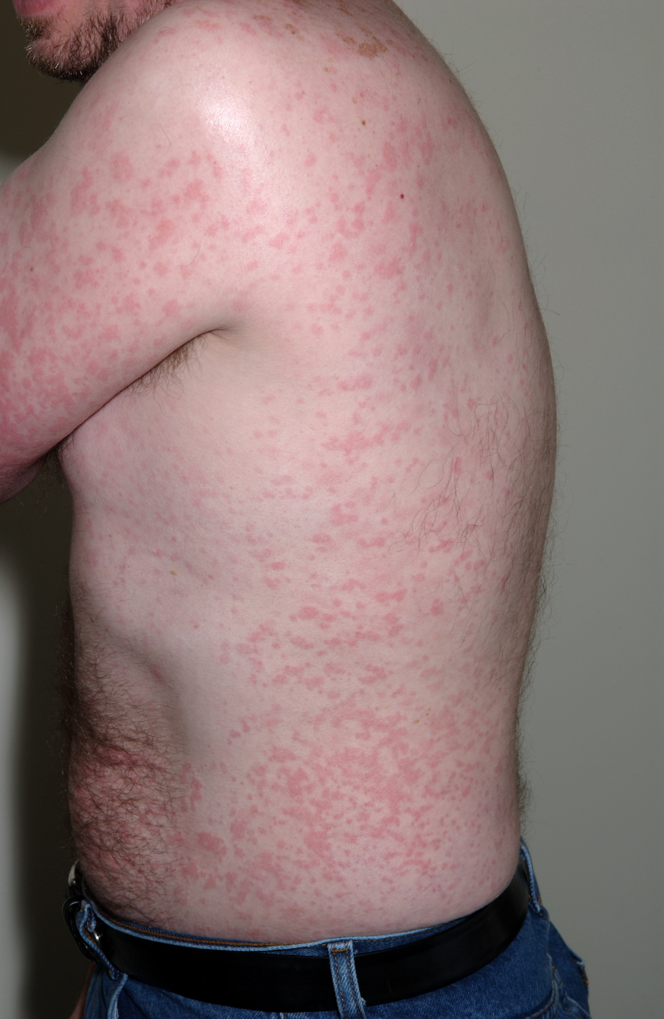
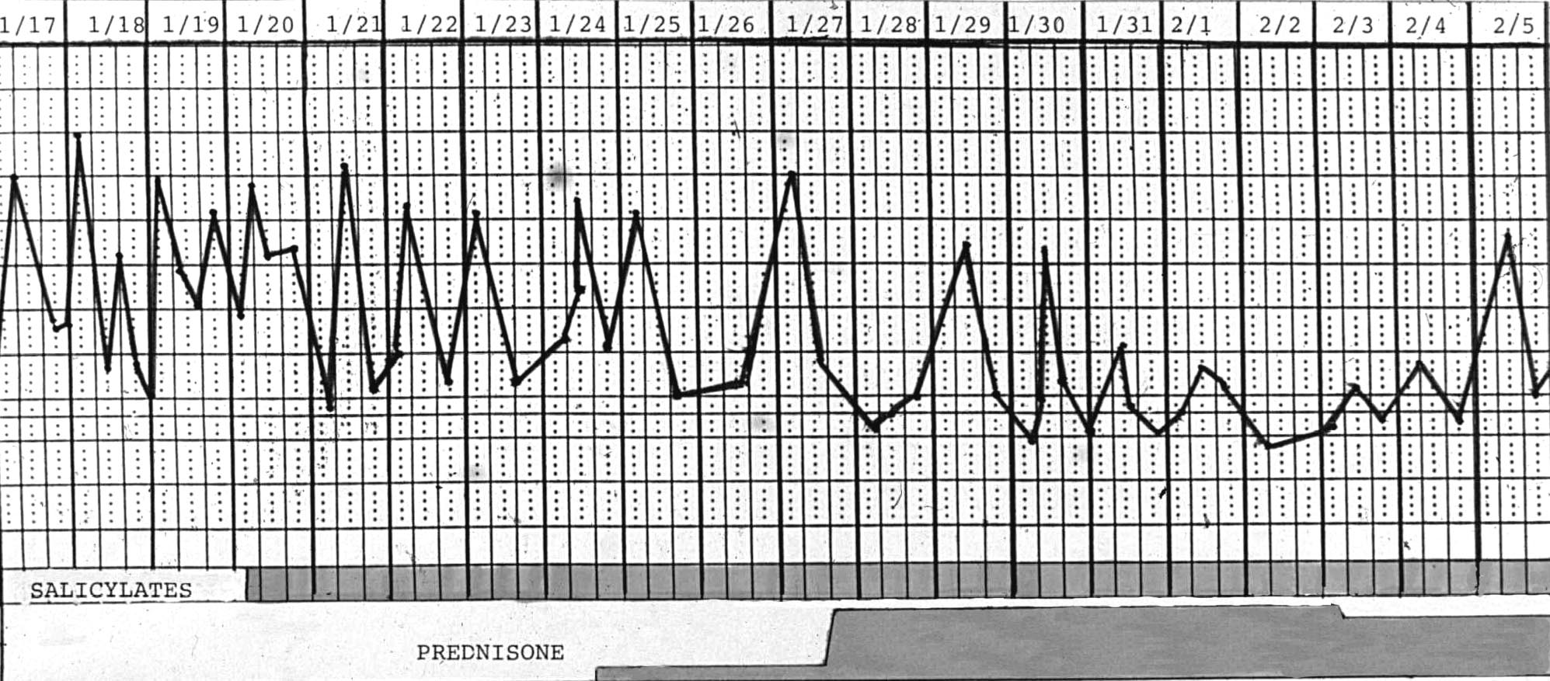
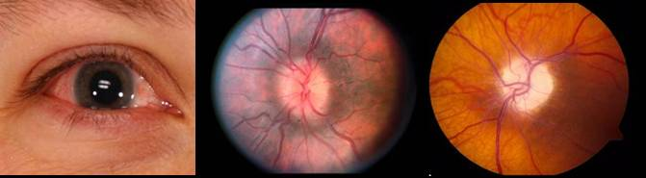
Rilonacept (IL-1 Trap) is approved by the FDA for the treatment of CAPS including FCAS and MWS.
CAPS: Cryopirin-associated periodic (fever, etc) syndromes; mutations activate inflammasome, leading to processing of pro-IL1 and release of IL-1
Familial Cold Autoinflammatory Syndrome (FCAS/FCU)
Muckle-Wells Syndrome
(MWS)
Neonatal Onset Multisystem Inflammatory Disease (NOMID/CINCA)
Cold-induced rash and symptoms: fevers, joint aches, fatigue, uveitis (symptoms 50% of days)
Bony overgrowth
Symptoms not cold-induced
Deafness
papilledema
Neural Involvement:
Aseptic meningitis
Mental Retardation
daily fevers &
symptoms
rash

Slide 7
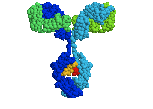
Create better technologies
Biotechnology: Second Goal
Fully human anti-NGF to treat pain

Slide 8
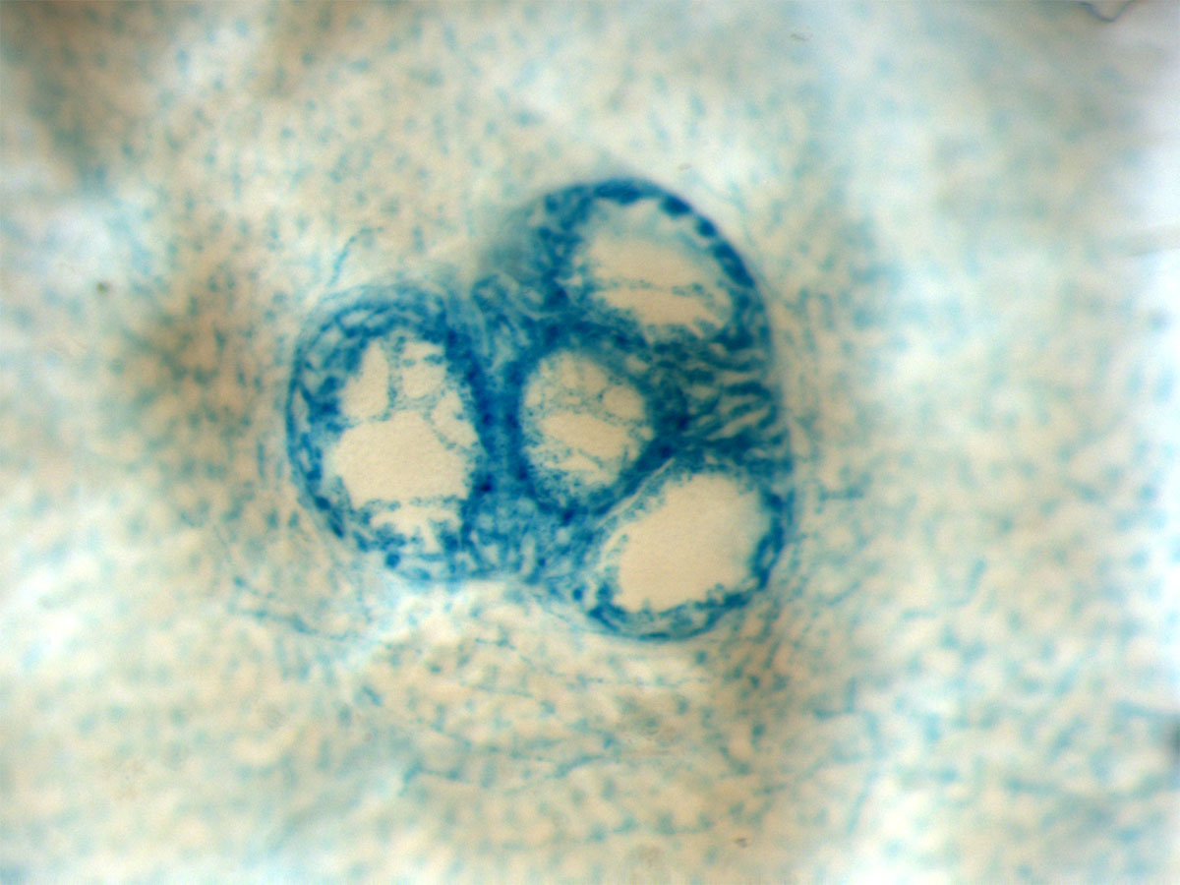
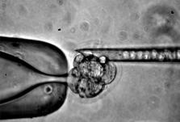
REGN’s Veloci-Technologies:
Designed to create better therapeutics
VelociGene® : Exploits high-throughput mouse genetics to identify and validate drug targets
Generates any genetic alteration in the mouse genome in ES cells
Rapid, efficient, and high-throughput
Recently selected by NIH as part of $50M grant to KO the genome
Valenzuela et al. Nature Biotechnology (2003) 21:652
VelociMouseTM: Genetically altered mice directly from ES Cells
Faster mouse breeding
Rapid and efficient
Poueymirou et al. Nature Biotechnology (2007) 25:91
VelocImmune® : REGN’s next generation technology for human
antibodies
Generates fully human monoclonal antibodies
Rapid and efficient
Precisely humanized Ig genes in the mouse
Notes:
8

Slide 9
So where can Neuroscience MA’s fit in?
Usually start in research associate (RA) positions (research-based)
Any employee can propose new ideas/experiments/projects
Any research associate is eligible for our scientist track
Any employee can re-specialize at company expense
  eg. 1: two of the first Neuroscience RA’s I met went back to school for engineering and telecommunications, respectively, and are now in high-level facilities or telecommunications management
  eg. 2: one of our current Neuroscience RA’s is currently in school taking business courses

Slide 10
So why should anyone get a Neuroscience MA for industry?
MA’s start at a higher level and higher salary than BA’s
  According to NSF statistics (2006), median starting income is $32K for BA’s and $48K for MA’s in life sciences
  At REGN, average current starting level/salary for 0 experience BA is RA I/$50K
  At REGN, average current starting level/salary for 0 experience MA is RA II/$57K
MA’s have a deeper base of knowledge, and are often better prepared to offer new ideas as a consequence
MA’s are often better prepared to engage in evidence-based critical thinking (graduate level training)
MA’s are rarely “0 experience,” especially if they completed a thesis

Slide 11
Why do Regeneron scientists value RA’s with MA’s?
Broader base of knowledge – areas of focus in industry can shift rapidly
Better analytical and critical thinkers
Better trained to find, read, and use the literature
Often, more laboratory experience
Usually, more committed to learning and to field of inquiry
Of course, the big confound is: do MA programs make better scientists, or do better scientists seek the additional education/experience?
Only careful assessment & prospective studies will answer this question.

Slide 12
What would industry scientists most like to see in our RA’s?
Skill/Ability | Possible Training Strategy
Strong sense of experimental design/confounds/controls/analysis | Require training in design and analysis
Ability to critically evaluate and use the literature for ideas and techniques | Require primary literature and teach students to use it properly
Hands-on research experience | Make research mandatory
Perseverance/trouble-shooting/lab culture | Expose students to “real” science and its hard work/frustrations – don’t set them up for success

Slide 13
What is less useful to us…
Ability to rattle off all the cranial nerves
Ability to outline the Creb’s Cycle from memory on a blackboard
We want thinkers and doers, not databases….

Slide 14
Suggestions for student evaluations/examinations to help prepare students for “biotech” thinking
have students design an experiment
have students list alternate explanations for data
have students analyze, graph, and interpret a data set
have students critically evaluate an article
have students write a final research thesis
have students present their research findings orally

Slide 15
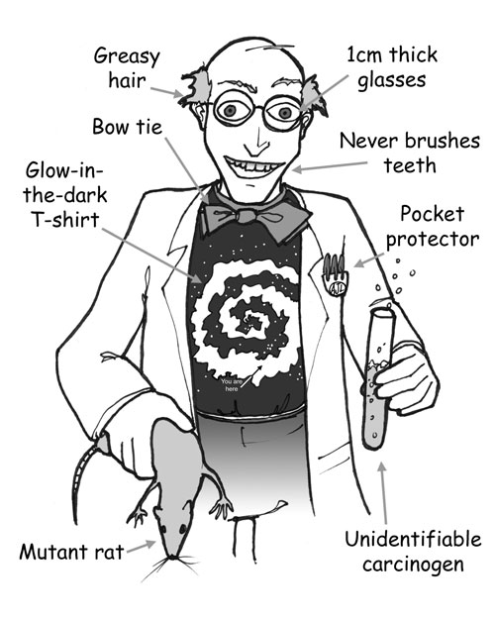
Take home message:
Biotechnology wants real scientists!

