Slide 1

Tackling Bias
Best Practices for Recruiting and Retaining a Diverse Faculty
Anne M. Etgen, PhD
Kathie L. Olsen, PhD
Frederick L. Smyth, PhD

Slide 2

ADVANCE-PAID GRANT
IWiN (Increasing Women in Neuroscience) is a program funded by an NSF ADVANCE-PAID grant awarded to SfN that is designed to enhance recruitment, retention and promotion of women and underrepresented minority faculty.

Slide 3
Leaky Pipeline: Women drop out at most transitions in particular the transition to Tenure Track Faculty:

Slide 4
Growth of women neuroscientists in tenure-track faculty positions is slow (% total)
Year | Graduate Student | Postdoc | Non- Tenure Track | Tenure Track | Assistant Professor | Associate Professor | Full Professor
1986 |  |  |  | 15 | 23 | 20 | 9
1991 |  |  |  |  | 27 | 22 | 13
1998 |  |  |  | 24 | 32 | 27 | 19
2000 | 47 | 40 | 43 | 21 | 30 | 26 | 14
2003 | 50 | 42 | 43 | 25 | 33 | 28 | 21
2005 | 52 | 41 | 38 | 25 | 32 | 27 | 21
2007 | 52 | 44 | 44 | 26 | 36 | 28 | 21
2009 | 54 | 37 | 44 | 29 | 34 | 31 | 26
2011 | 57 | 49 | 50 | 29 | 34 | 32 | 25
*Data from annual ANDP/CNDP surveys

Slide 5
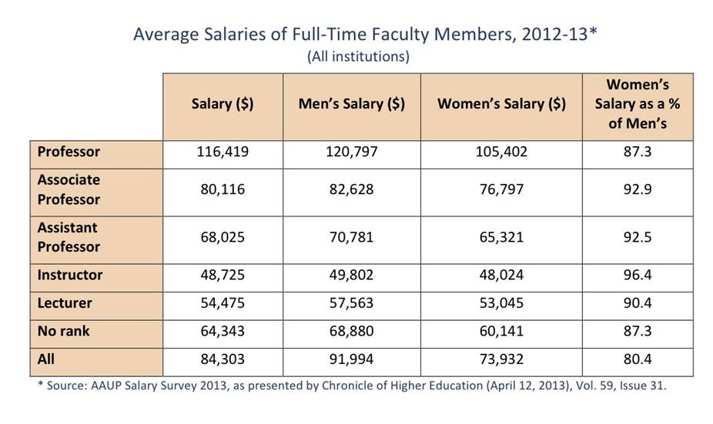
Full Time Faculty Member Salaries

Slide 6
Ethnicity Findings in the 2011 SfN Survey (%)
 | PhD Student | Postdoc | Non-Tenure Track Faculty | Assistant Professor | Associate Professor | Professor
African-American | 4 | 2 | 2 | 2 | 1 | 1
Asian | 16 | 27 | 25 | 23 | 11 | 7
Caucasian | 65 | 56 | 63 | 64 | 78 | 84
Hispanic | 5 | 6 | 3 | 6 | 5 | 3
Native American | 1 | 0 (n=3) | 0 | 0 (n=1) | 0 | 0 (n=2)
Pacific Islander | 0 (n=4) | 0 (n=5) | 0 (n=1) | 0 | 0 | 0 (n=1)
Other | 3 | 3 | 1 | 2 | 1 | 1
No answer | 6 | 5 | 6 | 3 | 4 | 4

Slide 7

Fred Smyth
Department of Psychology
University of Virginia
Implicit Gender Bias in STEM

Slide 8
Reading Test

Slide 9
Reading Test
The procedure is quite simple. First, you arrange things into different groups. Of course, one pile may be sufficient, depending on how much there is to do. If you have to go somewhere else due to the lack of facilities, that is the next step; otherwise, you are pretty well set.

Slide 10
Make sense?

Slide 11
Washing Clothes

Slide 12
Washing Clothes
The procedure is quite simple. First, you arrange things into different groups. Of course, one pile may be sufficient, depending on how much there is to do. If you have to go somewhere else due to the lack of facilities, that is the next step; otherwise, you are pretty well set.

Slide 13
Washing Clothes
Makes sense now?

Slide 14
Schemas

Slide 15
Stereotypes

Slide 16
Stereotypes
Explicit and Implicit
Conscious,
intentional,
subject to logic.
Unconscious,
automatic,
logic irrelevant.

Slide 17
Stereotypes
Explicit and Implicit
Conscious,
intentional,
subject to logic.
Unconscious,
automatic,
logic irrelevant.

Slide 18
Stereotypes
Explicit and Implicit
Conscious,
intentional,
subject to logic.
Gender and STEM

Slide 19
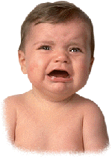
Feelings
Condry & Condry, 1976

Slide 20
Feelings
Debbie
Danny
Condry & Condry, 1976

Slide 21
Feelings
Debbie
Danny
“Afraid”
“Angry”
Condry & Condry, 1976

Slide 22
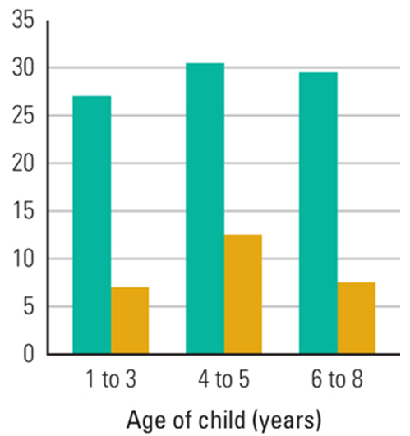

Parents’ explanations of
Museum Science Exhibits
Percent offered explanations
Crowley et al., 2001

Slide 23
Parents’ explanations of
Museum Science Exhibits
Percent offered explanations
Crowley et al., 2001

Slide 24
Parents’ explanations of
Museum Science Exhibits
Percent offered explanations
Crowley et al., 2001

Slide 25
Parents’ explanations of
Museum Science Exhibits
Percent offered explanations
Crowley et al., 2001

Slide 26
Parents’ explanations of
Museum Science Exhibits
Percent offered explanations
Crowley et al., 2001

Slide 27
Parents’ explanations of
Museum Science Exhibits
Percent offered explanations
Crowley et al., 2001

Slide 28
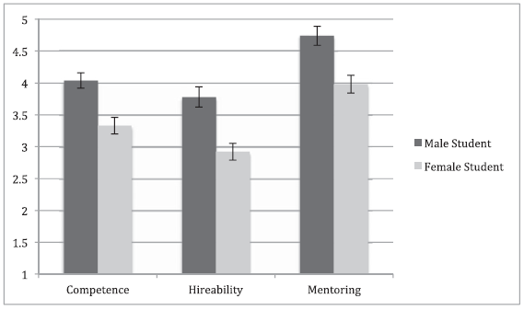
STEM Faculty’s judgments of lab manager applicant
Rating
Competence Hireability Mentoring
Moss-Racusin et al., 2012

Slide 29
STEM Faculty’s judgments of lab manager applicant
Applicant Name
Male
Female
Rating
Competence Hireability Mentoring
Moss-Racusin et al., 2012

Slide 30
STEM Faculty’s judgments of lab manager applicant
Applicant Name
Male
Female
Rating
Competence Hireability Mentoring
Moss-Racusin et al., 2012

Slide 31
STEM Faculty’s judgments of lab manager applicant
Applicant Name
Male
Female
Rating
Competence Hireability Mentoring
Moss-Racusin et al., 2012

Slide 32
STEM Faculty’s judgments of lab manager applicant
Applicant Name
Male
Female
Rating
Competence Hireability Mentoring
Moss-Racusin et al., 2012

Slide 33
STEM Faculty’s judgments of lab manager applicant
Applicant Name
Male
Female
Rating
Competence Hireability Mentoring
Moss-Racusin et al., 2012

Slide 34
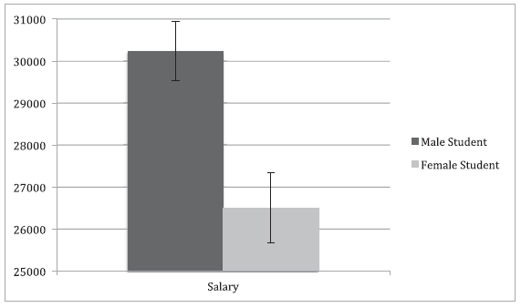
Salary Offered
Salary Offered
Male Female
Applicant Gender
Moss-Racusin et al., 2012

Slide 35
Salary Offered
Salary Offered
Male Female
Applicant Gender
Moss-Racusin et al., 2012

Slide 36
Salary Offered
But women
more “likeable”!
Salary Offered
Male Female
Applicant Gender
Moss-Racusin et al., 2012

Slide 37
Take Home
Implicit gender bias affects STEM outcomes
Humility

Slide 38
Measuring Implicit Bias
(in individuals)

Slide 39
Implicit Association Test (IAT)
Greenwald, McGhee & Schwarz, 1998

Slide 40
VTech
UVa

Slide 41

VTech
UVa
Left
Right
Training

Slide 42
VTech
UVa
Left
Right
Right
Training

Slide 43
Good
Bad
Left
Right
Training

Slide 44
Good
Bad
Left
Love
Right
Training

Slide 45
Good
Bad
Left
Left
Love
Right
Training

Slide 46
VTech
UVa
Good
Bad
Left
Right
Test Phase 1

Slide 47

VTech
UVa
Good
Bad
Left
Right
Test Phase 1

Slide 48
VTech
UVa
Good
Bad
Left
Right
Left
Test Phase 1

Slide 49
VTech
UVa
Good
Bad
Left
Hate
Right
Test Phase 1

Slide 50
VTech
UVa
Good
Bad
Left
Right
Hate
Right
Test Phase 1

Slide 51
VTech
UVa
Good
Bad
Left
Right
Test Phase 2

Slide 52
UVa
VTech
Good
Bad
Left
Right
Test Phase 2

Slide 53
Which sorting is faster, fewer errors?
VTech
UVa
Good
Bad
OR
UVa
VTech
Good
Bad

Slide 54
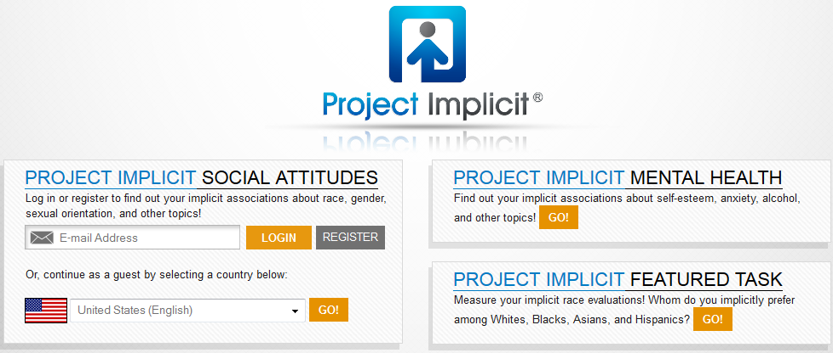
implicit.harvard.edu/implicit/

Slide 55

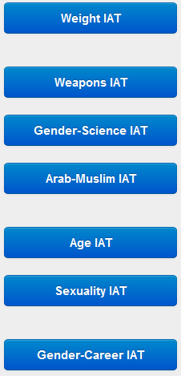
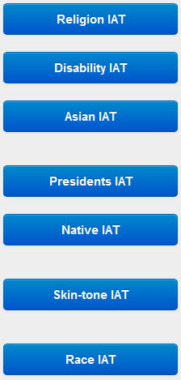
Demonstration Options

Slide 56
Demonstration Options

Slide 57
Gender-Science on Project Implicit
Male
Female
Liberal Arts
Science

Slide 58
Gender-Science on Project Implicit
Male
Female
Liberal Arts
Science
OR
Female
Male
Liberal Arts
Science

Slide 59
Gender-Science on Project Implicit
Male
Female
Liberal Arts
Science
Easier for 70%
Female
Male
Liberal Arts
Science

Slide 60
Gender-Science on Project Implicit
Easier for 10%
Male
Female
Liberal Arts
Science
Easier for 70%
Female
Male
Liberal Arts
Science

Slide 61
Gender-Science on Project Implicit
Easier for 10%
Male
Female
Liberal Arts
Science
No Difference for 20%
Easier for 70%
Female
Male
Liberal Arts
Science

Slide 62
Not one-size-fits-all
Notes:
62

Slide 63
Gender-Science on Project Implicit
30000
25000
20000
70%
Number of Participants
15000
10000
10%
5000
Science=Female Science=male Stereotype
0

Slide 64
Gender-Science on Project Implicit
30000
25000
20000
70%
Number of Participants
15000
10000
10%
5000
Science=Female Science=male Stereotype
0

Slide 65
Gender-Science on Project Implicit
30000
25000
20000
70%
Number of Participants
15000
10000
10%
5000
Science=Female Science=male Stereotype
0

Slide 66
Same for Men and Women (unless…)
Male Respondents
Female Respondents
70%
71%
11%
10%

Slide 67
Academic Identity Matters
Notes:
67

Slide 68
Academic Identity Matters
Implicit Science=Male
(SDs from zero)
Female-Male Cohen’s d
.63 .68 .19 .69 .26 .48 .02 .15 -.37 -.30 -.81 -.78
Humanities
Communication
Health Sci
Education
Business
Psychology
Visual/Perform Arts
Social Sci-History
Biology-Life Sci
Computer-Info Sci
Law-Legal Studies
Engin-Math-Phy Sci
Major Field
Smyth, 2013

Slide 69
Academic Identity Matters
Implicit Science=Male
(SDs from zero)
Scienceness →
Female-Male Cohen’s d
.63 .68 .19 .69 .26 .48 .02 .15 -.37 -.30 -.81 -.78
Humanities
Communication
Health Sci
Education
Business
Psychology
Visual/Perform Arts
Social Sci-History
Biology-Life Sci
Computer-Info Sci
Law-Legal Studies
Engin-Math-Phy Sci
Major Field
Smyth, 2013

Slide 70
Women (N=124,479)
Implicit Science=Male
(SDs from zero)
Female-Male Cohen’s d
.63 .68 .19 .69 .26 .48 .02 .15 -.37 -.30 -.81 -.78
Humanities
Communication
Health Sci
Education
Business
Psychology
Visual/Perform Arts
Social Sci-History
Biology-Life Sci
Computer-Info Sci
Law-Legal Studies
Engin-Math-Phy Sci
Major Field
Smyth, 2013

Slide 71
Women (N=124,479)
Implicit Science=Male
(SDs from zero)
Men (N=52,456)
Female-Male Cohen’s d
.63 .68 .19 .69 .26 .48 .02 .15 -.37 -.30 -.81 -.78
Humanities
Communication
Health Sci
Education
Business
Psychology
Visual/Perform Arts
Social Sci-History
Biology-Life Sci
Computer-Info Sci
Law-Legal Studies
Engin-Math-Phy Sci
Major Field
Smyth, 2013

Slide 72
Women (N=124,479)
Implicit Science=Male
(SDs from zero)
Men (N=52,456)
Female-Male Cohen’s d
.63 .68 .19 .69 .26 .48 .02 .15 -.37 -.30 -.81 -.78
Humanities
Communication
Health Sci
Education
Business
Psychology
Visual/Perform Arts
Social Sci-History
Biology-Life Sci
Computer-Info Sci
Law-Legal Studies
Engin-Math-Phy Sci
UVa 1st Semester Engin
Major Field
Smyth, 2013

Slide 73
Environment Matters
Notes:
73

Slide 74

International Variation
Nosek, Smyth et al., 2009, PNAS

Slide 75
8th-grade TIMSS Gender Gap
Nosek, Smyth et al., 2009, PNAS

Slide 76
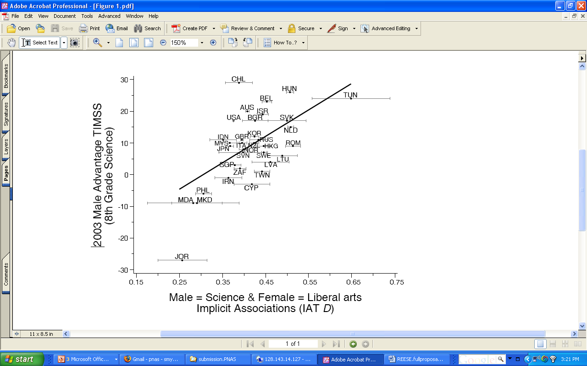
8th-grade TIMSS Gender Gap
30
20
10
0
-10
-20
-30
Male Advantage TIMSS Science
Nosek, Smyth et al., 2009, PNAS
0.15 0.25 0.35 0.45 0.55 0.65 0.75
Science = Male IAT D
Science = Male IAT

Slide 77
8th-grade TIMSS Gender Gap
30
20
10
0
-10
-20
-30
Male Advantage TIMSS Science
Nosek, Smyth et al., 2009, PNAS
0.15 0.25 0.35 0.45 0.55 0.65 0.75
Science = Male IAT D
Science = Male IAT

Slide 78
Greater 8th-grade Boys’ Advantage correlated with greater country-level implicit bias, r = .60
30
20
10
0
-10
-20
-30
Male Advantage TIMSS Science
Nosek, Smyth et al., 2009, PNAS
0.15 0.25 0.35 0.45 0.55 0.65 0.75
Science = Male IAT

Slide 79
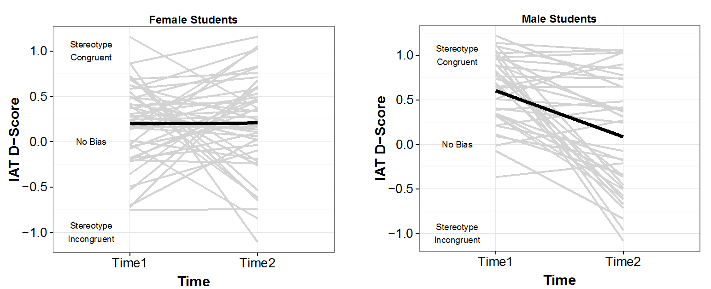
Math-is-male stereotype in
Differential Equations Courses
Male Students
Female Students
Martin, von Oertzen, Smyth et al. (2013)
Notes:
79

Slide 80
Math-is-male stereotype in
Differential Equations Courses
Male Students
Female Students
Martin, von Oertzen, Smyth et al. (2013)
Notes:
80

Slide 81
Math-is-male stereotype in
Differential Equations Courses
Male Students
Female Students
Martin, von Oertzen, Smyth et al. (2013)
Notes:
81

Slide 82
Take Home
Implicit gender bias affects STEM outcomes
Humility

Slide 83
Take Home
Implicit gender bias affects STEM outcomes
Humility
Implicit biases can change

Slide 84
Take Home
Implicit gender bias affects STEM outcomes
Humility
Implicit biases can change
Self-concepts and environments matter

Slide 85
Take Home
Implicit gender bias affects STEM outcomes
Humility
Implicit biases can change
Self-concepts and environments matter
To Do
Education, measurement and evaluation.

Slide 86
Take Home
Implicit gender bias affects STEM outcomes
Humility
Implicit biases can change
Self-concepts and environments matter
To Do
Education, measurement and evaluation.
More longitudinal research

Slide 87
Thank you
Brian Nosek, Irina Mitrea, Tai Melcher, Kate Ratliff, Dan Martin, Will Guilford, Ed Berger, Reid Bailey, Dana Elzey, Rich Price
Project Implicit
National Science Foundation REC-0634041
UVa Learning Assessment Grants Program

Slide 88
Strategies for breaking the cycle
  Increase conscious awareness of bias and how bias leads to overlooking talent
    Implicit Association Test: https://implicit.harvard.edu/implicit/
  Develop more explicit criteria (less ambiguity)
  Alter departmental policies and practices

Slide 89
Implicit biases most influential when…
Criteria unclear
Decisions made rapidly
Decisions are complex
Information is ambiguous or incomplete
You’re stressed, tired.

Slide 90
The Ohio State University
Dr. Scott Herness, Assoc. Dean, Grad. School
Progress to Date:
“Recruiting a Diverse Faculty” Workshop
    Mirror workshop; repeated regularly w/ALD
“Recognizing Implicit Bias” Online Video
    http://www.youtube.com/watch?v=UZHxFU7TYo4
    Available for all Search Committees
    ADVANCE program http://www.ceos.osu.edu/index.php?id=52

Slide 91
University of Minnesota
Scott Lanyon -Dept. of Ecology, Evolution, and Behavior
IWiN information now presented to all search committees in the College of Biological Sciences
I meet with every search committee to talk about Schema and to provide data/references about bias.
I provide suggestions about how to increase the number of women and under-represented groups in the applicant pool.
I provide suggestions on how to minimize bias in the evaluation of applications.
I provide suggestions to chairs and committee members on how to handle situations if bias is introduced.

Slide 92
Implicit Leadership-is-Male stereotype undone by exposure to female leaders
Dasgupta & Asgari, 2004

Slide 93
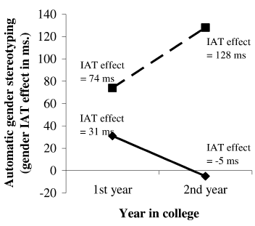
Exposure to female profs
Female students
Coed
college
Leaders-are-male IAT (ms)
Co-ed college
Women’s college
Dasgupta & Asgari, 2004

Slide 94
Recruiting Strategies
Prime the pump – searching begins before position is available
Search committee composition
Job description –” open” searches
Advertisement and active recruiting
Promote awareness of the issues
Interviewing tips

Slide 95
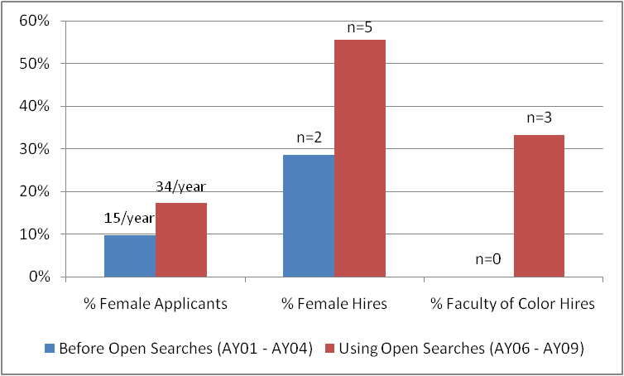
Active Recruiting and Open Searches
Can Help Increase Diversity
The difference achieved by one UMich department

Slide 96
Evaluation of Candidates: Promote Awareness of Evaluation Bias
Awareness of evaluation bias is a critical first step.
Spread awareness to the others on the search committee.
Evaluation bias can be counteracted.
Bauer and Baltes, 2002, Sex Roles 9/10, 465.

Slide 97
Focus on Multiple Specific Criteria during Evaluation
Weigh judgments that reflect examination of all materials and direct contact with the candidate.
Specify evaluations of scholarly productivity, research funding, teaching ability, ability to be a conscientious departmental/university member, fit with the department’s priorities.
Avoid “global” evaluations.
IWiN (http://www.sfn.org/Careers-and-Training/Women-in-Neuroscience/Department-Chair-Training-to-Increase-Diversity/Workshop-Resources) and ADVANCE (http://www.umich.edu/%7Eadvproj/CandidateEvaluationTool.doc) have evaluation forms that can be modified to fit your situation.
Bauer and Baltes, 2002, Sex Roles 9/10, 465.

Slide 98
Thank you
STRIDE: University of Michigan’s ADVANCE Program
Project Implicit
National Science Foundation
Society for Neuroscience
SfN members can continue the Conversation on NeurOnLine

Slide 99
Top Mistakes in Recruitment
Committee does not have a diverse pool.
The committee discussed information about the candidate that is inappropriate.
Asking counter-productive questions.
Telling a woman or underrepresented minority candidate that "we want you because we need diversity."
The candidate does not meet others like themselves during the visit.
Committee or faculty make summary judgments about candidates without using specific criteria.

